Slide 1
Transit Data and Beyond: Emerging Landscapes
Brendon Hemily, Ph.D.
Senior Advisor, TAL

Slide 2
Agenda
Transit Data and Analytics Evolution
Internal Landscape – Evolving Arc
Emerging Internal Landscape
Emerging External Landscapes

Slide 3
Transit Data and Analytics Evolution

Slide 4
Uses of Data from Automated Systems: A Long Time Coming
1980’s: First CAD/AVL (ITS) Systems in Europe and Canada (a bit later):
Focus is on security, incident management, service restoration
SOPs: Standard Operating Procedures!
1988: CUTA International Conference on AVL (Ottawa)
Session on using AVL data
1991: CUTA Report: Use of AVL/APC Data for Planning and Management
Mid 1990s: First AVL systems in US: Focus is on security
2005: TCRP Report 113 (2002-Workshop with suppliers)
2008: TCRP 126: ITS Data for Market Research

Slide 5
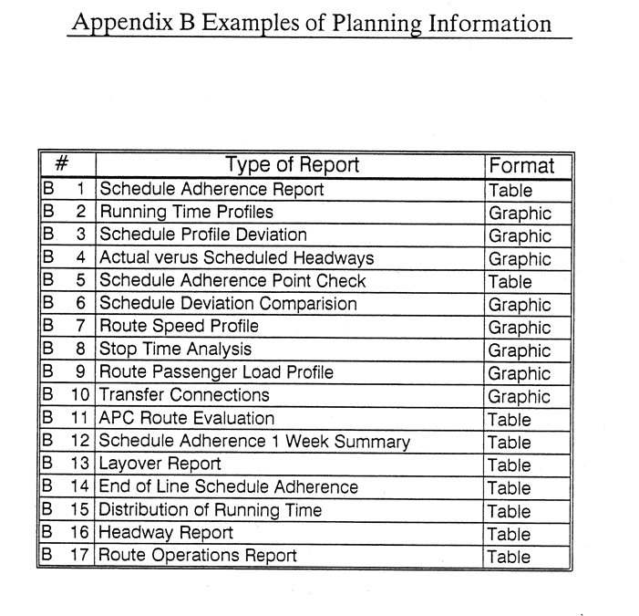
CUTA 1991 Report: Use of AVL/APC Data

Slide 6
What has changed in Recent Years?
ITS and AFC are more mature
Easier access to data
Traditional ITS suppliers providing data reporting modules
New visualization and analytic tools
New suppliers targeting uses of data using these and other tools
Increased discussion of use cases in industry
(TRB Transit Data Task Force becomes Committee)
Coincides with:
Societal discussion of Big Data, IOT, Smart Cities creating more leadership interest

Slide 7
Recent Progress in Transit Industry: An Increased Focus on Data and Analytics
Growing industry recognition that Transit ITS Data is a valuable resource
Potential to create information that can be used to enhance effectiveness and efficiency
Data is growing in importance as a strategic resource in decisionmaking:
Business Intelligence, Data Analytics
Decision-Support Systems
Open data
Big Data (Volume, Velocity, Variety)

Slide 8
ITS Data-Driven Information: Typology
Systematic Monitoring
Dashboards (external consumption)
Executive management (KPIs / alarms)
Service / Operations Planning
On-time performance / schedule adherence
Running time analyses
Operator performance
Strategic Analyses
Campaigns / major redesigns
Tactical Analyses
Delays by intersection
Locations for priority treatment
Excessive stop dwell time
Stop consolidation
Exploratory / Data Mining
Safety analyses
Accessibility and equity, access to health
Decision-Support for Real-Time Operational Control

Slide 9
TransitData Workshops
Small group of international academics organizing workshops on use of transit smart card and ITS data
2014 (Gifu): Smart Card data only
2016 (Boston): Automated Data Collection Systems (ADCS)
Smart card data powerful, but data fusion even more powerful
AVL, APC are more common in transit industry and can be used for more operational purposes
2017 (Santiago): Increased focus on operations-based applications and on bus transit
2018 (Brisbane, in conjunction with CASPT Conference on scheduling/optimization): Increased focus on use of passive data
TransitData 2019 (Paris): New applications, travel behavior
TransitData 2020: Toronto, University of Toronto,
August 11-13, 2020

Slide 10
University of Toronto UTTRI/TAL
11-13 August, 2020
www.TransitData2020.ca
250 participants
2/3 practitioners
100 speakers
19 countries
13 Lightning Presentation Sessions
9 Plenary Sessions

Slide 11
And then COVID Highlighted the Importance of Data !!!
Communicating vehicle crowding based on:
Historical patterns of demand derived from archived APC data.
Updated weekly or next day patterns of crowding based on analysis of most current APC information (Montreal STM metro).
Real-time crowding on buses using APC data transmitted and processed in realtime): Montreal STM bus, Boston MBTA bus.
Real-time crowding on commuter rail using weight monitoring systems on rail cars as an index of crowding (New York LIRR commuter rial).
New sources of data are also being explored; wi-fi traces in the TfL tube to measure crowding levels on platforms.
As an alternative to ITS-based data, some systems have explored the use of crowd sourced customer feedback. This approach was used by New Jersey Transit in their “How Full is Your Ride” app (the same approach used by Google Maps with their historically-based predictions of “busy times” charts)
Availability of data for recutting schedules or rejigging / redesigning network

Slide 12
Internal Landscape – Evolving Arc

Slide 13
Data Governance and Management Arc
Initial technical and challenges
Ad-hoc applications: inter-organizational issues and discussions
Leadership buy-in?
Business Intelligence strategic plan to address organizational (and technical) issues
Enterprise deployment

Slide 14
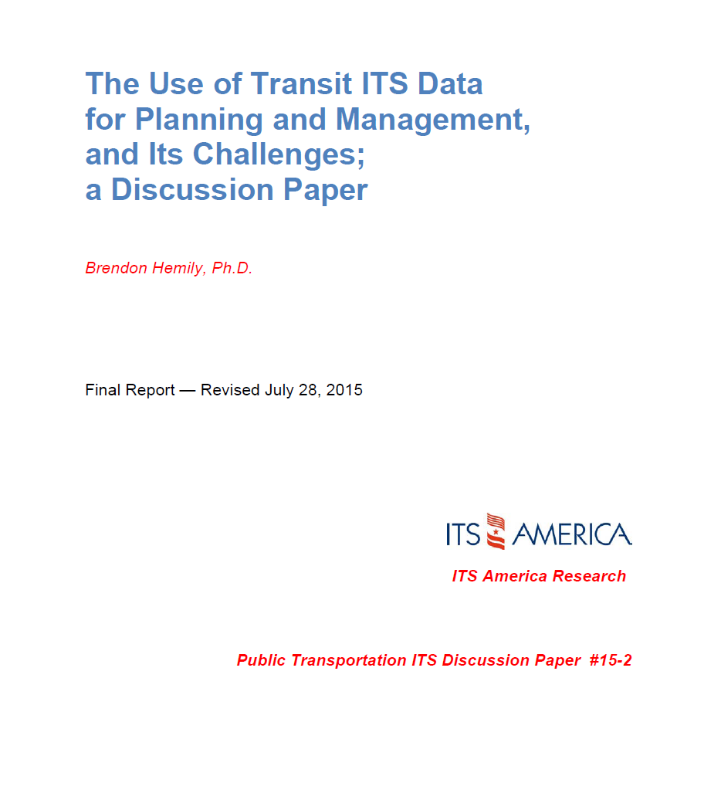
USDOT / ITSA Discussion Paper

Slide 15
Initial Technical Challenges
Corporate data management challenges
Data storage and maintenance
Cybersecurity
Challenges related to ensuring data quality
ITS not designed to create data and lack of diagnostics tools
Factors affecting data quality
Challenges in matching and cleaning data
Challenges in using ITS data once cleaned
Supplier ownership of data
Lack of internal expertise
Lack of support
“Bad Day Challenge”

Slide 16
Examples of Technical Challenges: Data Quality: Matching and Cleaning
Imprecise geocoding of bus stops
Multiple bus stop inventories and bus stop IDs
Data matching problems between Scheduling / CAD/AVL systems
Layover locations
Loops
Branches
Negative loads, etc.
Multiple sources of GPS location
Factoring up samples
Linking data to scheduled / actual service
Adjusting to ever changing schedules / bus stops

Slide 17
Ad-Hoc Applications: Inter-Organizational Issues and Discussions
Different objectives, different perspectives, different expectations, even different language
Data specialists
Transit Planning
IT
Operations
Finance
How to obtain buy-in from Operations?
Who should fix data problems identified by users?
How to enable shared use of new tools developed by users?
Data scientists vs. business analysts vs. planners – Roles and organizational positions?

Slide 18
Gaining Policy Board / Senior Management Buy-In? Required for procuring tools and expertise, and to resolve organizational issues
Challenges:
Lack of interest from senior management and policy boards
Experience-based / operations-driven vs. data-driven decision-making
Design and use of ITS is primarily operations-driven
Confusion over benefits
Inter-departmental conflicts
“Single source of truth” issue
Lack of focus on importance of data
Ownership of data!
Lack of internal resources

Slide 19
How to Build Bridge Between IT and Subject Matter Experts?
How to provide business units:
Access to data?
Ability for fast processing?
Space for complex queries?
Ability to create tools and share with enterprise?
Centralization vs decentralization dilemma?
How to build social capital?
Common goals
Align expectations about data access

Slide 20
Data Governance and Management Plan (Business Intelligence Strategic Plan)
Organizational framework
Where data resides
Access policies
Development of applications / dashboards
Data retention
Cybersecurity
Open data policy
External data sharing (APIs, standards)
Etc.

Slide 21
Challenge: Obtaining and Retaining Data Specialists?
Compensation is challenging
But transit is / can be attractive
Social good
Stability
Interesting applications using data
New horizons: Integrated mobility, integrated payment, MaaS, smart cities
Degree of challenge varies with location
Big cities: high competition for data skills
Medium / small sized city with universities
Small urban
Collaboration with universities

Slide 22
Emerging Internal Landscape

Slide 23
Changes to Transit Data
Real Time Data for Decision Support Systems
Transforming Data into Information:
Descriptive, Predictive, Prescriptive
Gap and bunching analysis
Managing service disruptions
Proactive operational control
New Data Sources
Social media
Wi-Fi traces
Drones
Lidar

Slide 24
The Emerging Use of Artificial Intelligence (AI)
UITP (2018)
Customer Excellence:
Use of AI applications to achieve better customer service and intelligence amongst authorities and operators.
Operational Excellence:
Using AI to improve system and operational efficiencies through business process optimisation.
Engineering Excellence:
AI-powered solutions for inventory and asset management and predictive maintenance.
Safety and Security Management:
AI applications to improve operational safety and security measures, including offences that involve revenues and property.
USDOT Program: AI for ITS (7 transit applications)
Identifying Real-World Transportation Applications Using Artificial Intelligence: (7 transit applications)

Slide 25
Transit Specifications – Existing GTFS Family
MobilityData.org
GTFS Best Practices
GTFS (GTFS-Schedule)
GTFS Realtime
GTFS Flex v2
GTFS-ride (ridership data) – University of Oregon

Slide 26
Emerging Transit Specifications / Frameworks
Open Software: OpenTripPlanner
Demand Response Transactional (DRT) Data Specification (TRB/TCRP Report 210)
Transit ITS Data Management Framework (TRB/TCRP G-18)
General OnDemand Feed Specification (GOFS) – Rider-facing transactional data
GTFS Performance (service level, schedule adherence, running times
USDOT ITS Transit Standards Training
Integrated Multimodal Payment: various specifications
Cal-ITP: California Integrated Travel Project:
Standardizing contactless payment + customer discounts + trip planning info
In Europe: Transmodel Standards – SIRI, OpRA, and NeTEx

Slide 27
Emerging External Landscapes

Slide 28
Emerging Mobility Specifications
GBFS (Bikeshare)
Mobility Data Specification (MDS) – Open Mobility Foundation/NACTO
SAE J3163TM – Taxonomy and Definitions for Terms Related to Shared Mobility and Enabling Technologies
Mobility as a Service (MaaS):
Carol Schweiger: “An integrated mobility concept in which travelers can access their transportation modes over a single digital interface. MaaS primarily focuses on passenger mobility allowing travelers to seamlessly plan, book, and pay for travel on a pay as-you-go and/or subscription basis.”
Numerous private or public platforms being proposed, developed, tested (and deployed)

Slide 29
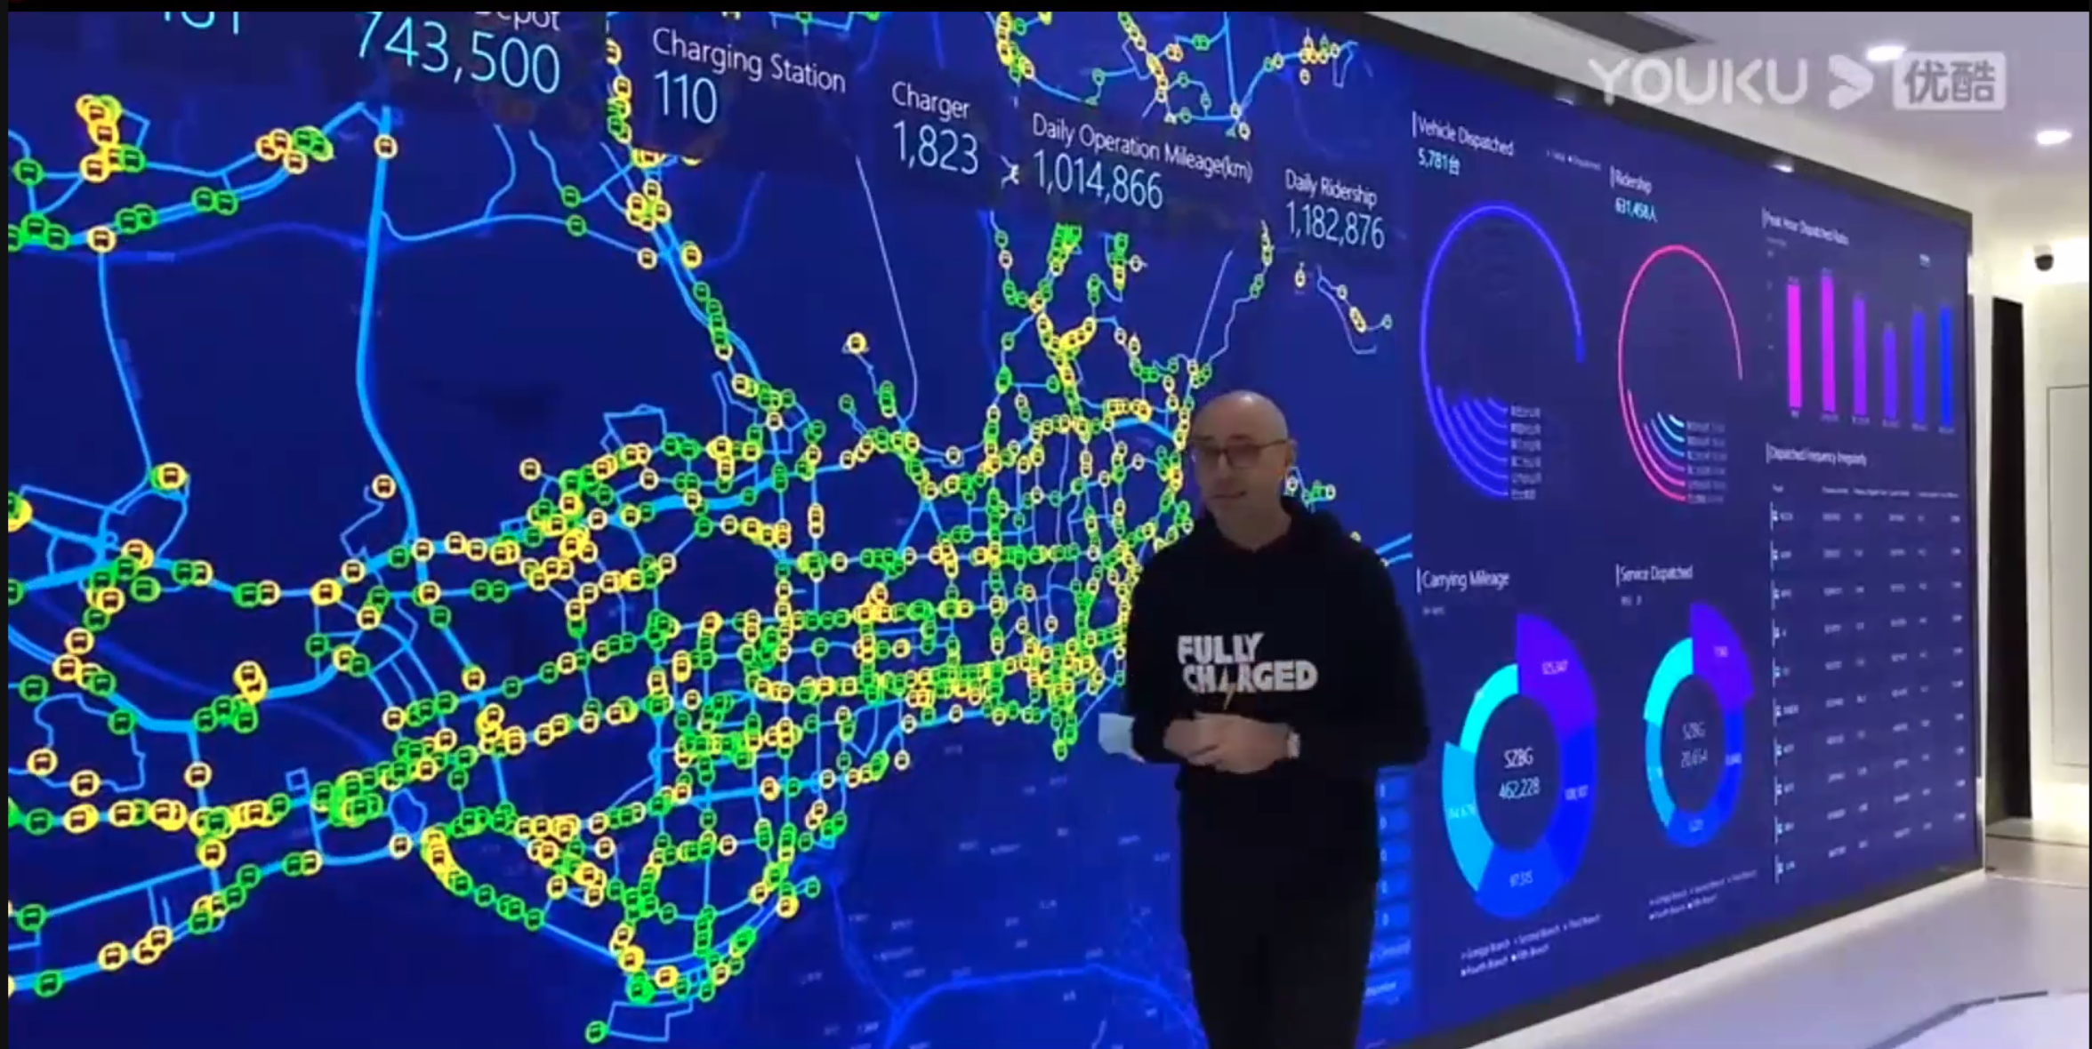
Integrated Multi-Modal Control Centres
Integrated Corridor Management (ICM)
Transportation Management Centres (TMCs)

Slide 30
Other Mobility / Transportation Perspectives and Initiatives
Location-Based Services (LBS)
Curbside Management
ScaleAI.ca: Collaborative approach to using AI in transportation
Canadian Centre on Transportation Data (CCTD):
Transport Canada and Stats Canada
Data (Static), Analysis, Performance
build new partnerships with the transportation industry, transportation users, researchers and other levels of government
make available better data, analysis and information about the national transportation system
develop new tools and applications to promote the flow of transportation-related information and knowledge and enhance understanding and decision-making.

Slide 31
Connected and Automated Vehicles (CAV)
Cooperative Driving Automation (CDA)
SAE J3216 Standard: CDA enables communication and cooperation between properly equipped vehicles, infrastructure, and other road users.
USDOT CARMA Program: Redefining TSP
Connected Vehicle Data
USDOT Research Data Exchange (RDE)
Data Access and Exchange Research Area
ITS Datahub
Data for Automated Vehicle Integration (DAVI)
Open Source Solutions for ITS (OSS4ITS)
Where is transit and how does it fit in?

Slide 32
Other Emerging Landscapes
Smart Cities
Open municipal data portals & dashboards: Data access and data fusion analyses
Digital Twins
Next-generation urban modelling tools which make use of ubiquitous data [to generate] realistic digital representations of physical city systems, assets and processes providing digital simulation and management environments to aid decision-making
Municipal Innovation Hubs
Where is transit and how does it fit in?

Slide 33
Thank You!
Brendon.hemily@sympatico.ca
Symposium Presentations and Recordings available at Transitdata2020.ca

