Slide 1
Making Transit Smart-Card Data a Viable Database for Travel Demand Analysis
Khandker Nurul Habib, Ph.D., P.Eng
Sanjana Hossain, M.Sc

Slide 2
Outline
Introduction
Filling Gaps in Smart-card Dataset
Data Fusion Framework
Example of PRESTO data and Transportation Tomorrow Survey
Conclusions

Slide 3
Introduction (cont.)
Reliable and up-to-date origin-destination (O-D) information is vital for transit demand analysis.
Regular O-D surveys (or travel surveys) are costly to undertake.
Smart-card transaction data can provide a viable alternative.
Continuously collected.
Can be summarized into daily, weekly, monthly and annual basis.
Can provide accurate picture of transit demand and variations.

Slide 4
Introduction
However, smart-card data alone is not sufficient
Data are the stop/station level: even data may not have precise origin-destination stop/station.
Further inferences are necessary to make the dataset complete.
Station/stop level data does not reveal actual origin and destination of transit trips.
Transit users’ profiles are missing.
Heuristic based imputation of trip origin-destination from smart-card data can be misleading and wrong
Overlooks “park & ride” and “kiss & ride” access options.
Under-estimate spatial dispersion of transit demands.

Slide 5
Supplementing Smart-Card Data by Model-based Inference
Smart-card data can be expanded by using data fusion methodology exploiting companion datasets, e.g. customer satisfaction survey, transit user survey, regional household travel surveys, etc.
Transit trip details from a companion dataset to model trip details that are missing in smart-card datasets:
Trip origin location
Trip destination location
Access/Egress travel modes
Socio-economic profile of the transit users

Slide 6
Smart Card Data to Complement Travel Survey data
PRESTO Card data
Transportation Tomorrow Survey Data
Data
Fusion
Reweight the combined sample
Improved travel behaviour representation by TTS

Slide 7
Smart Card Data to Complement Travel Survey data
PRESTO Card data
Customer Satisfaction Survey
Data
Fusion
Transit User Profile, Demand Distribution and Users’ Behaviour

Slide 8
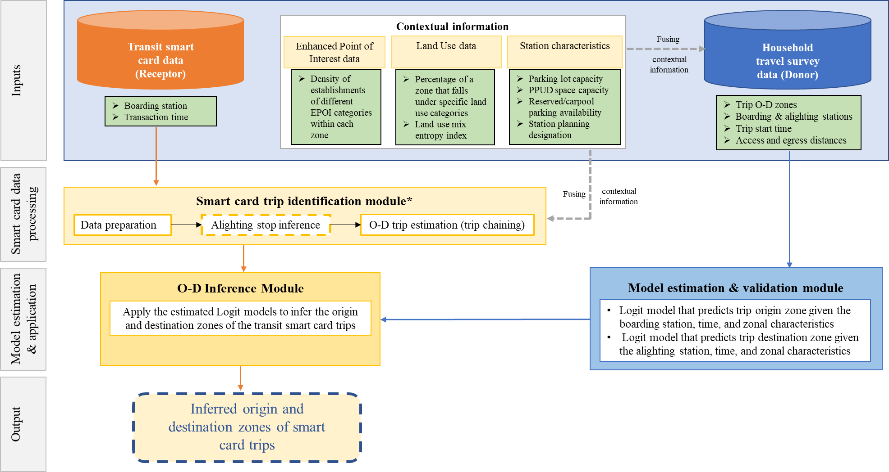
Data Fusion Framework

Slide 9
Conclusions
Fusing smart-card data with companion data sources can provide up-to-date (and continuous) transit demand levels and distributions.
It is important to use a model-based fusion methodology to make sure that the results are realistic.
Once developed, the model-based fusion framework can be periodically updated.

Slide 10
Questions
Partners: Metrolinx, NSERC, FASE UofT

