Slide 1
A Comprehensive Transit Accessibility and Equity Dashboard
dashboard.transitcenter.org
Willem Klumpenhouwer
Jeff Allen, Lisa Li, Rick Liu, Mitchell Robinson, Diego Da Silva, Steven Farber, Alex Karner, Dana Rowangould, Amer Shalaby, Mary Buchanan, Steven Higashide
TAL Research Day | July 6, 2021
Photo Credit: Corey Agopian

Slide 2
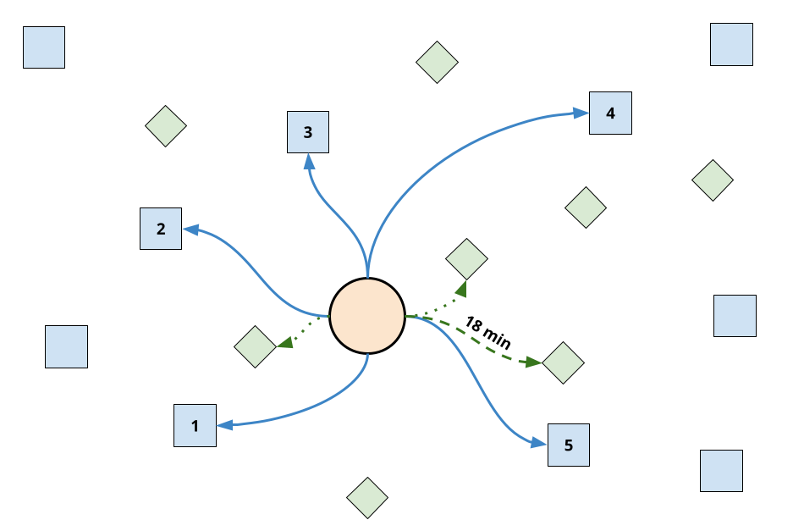
Accessibility: Measuring Freedom of Choice
Klumpenhouwer et al. | A Comprehensive Transit Accessibility and Equity Dashboard

Slide 3
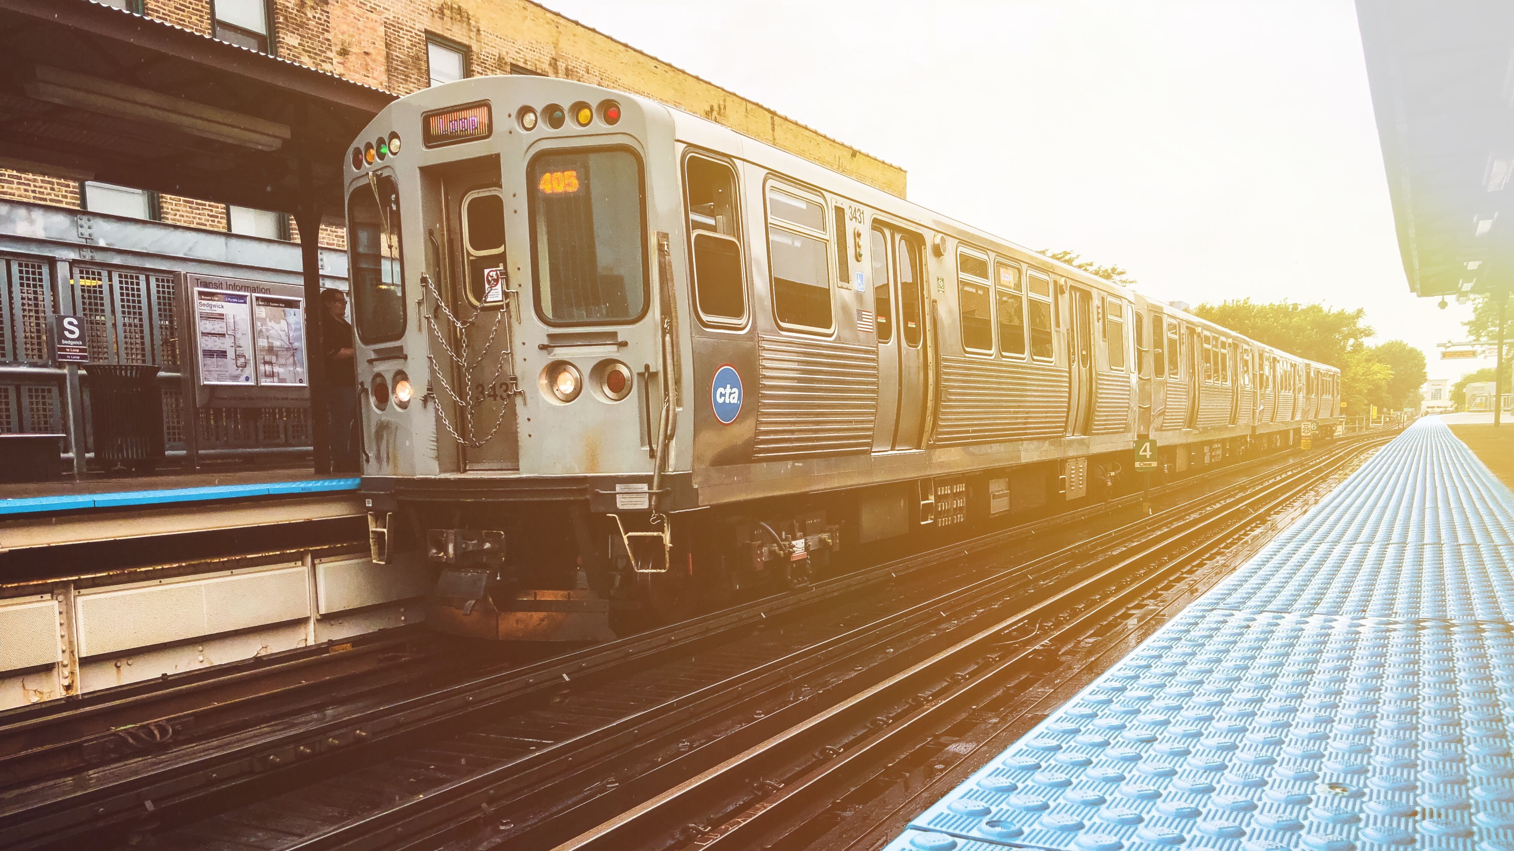
Research Questions
Differences between socioeconomic groups
Changes during COVID-19?
Differences between various destination types
Transit and car accessibility comparison
Limited fare budget effects
Transit service reliability
Boston · Chicago · Los Angeles · New York · Philadelphia · San Francisco-Oakland · Washington D.C
Klumpenhouwer et al. | A Comprehensive Transit Accessibility and Equity Dashboard
Photo Credit: Jeremiah Higgins

Slide 4
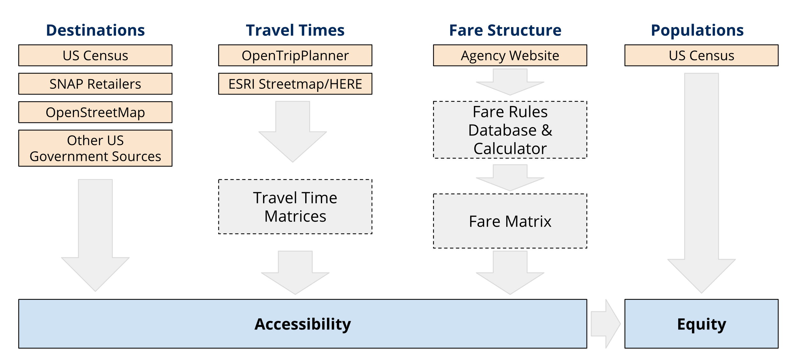
Calculating Accessibility
Klumpenhouwer et al. | A Comprehensive Transit Accessibility and Equity Dashboard

Slide 5
A Plethora of Possibilities
9 Destination Types
2-3 Measurement Options
Fare/Non-Fare Restricted
2-3 times of day
Auto Comparison
~3,000-14,000 block groups
12 months
7 regions
146,463,346 scores
Klumpenhouwer et al. | A Comprehensive Transit Accessibility and Equity Dashboard
Photo Credit: Jeremiah Higgins

Slide 6
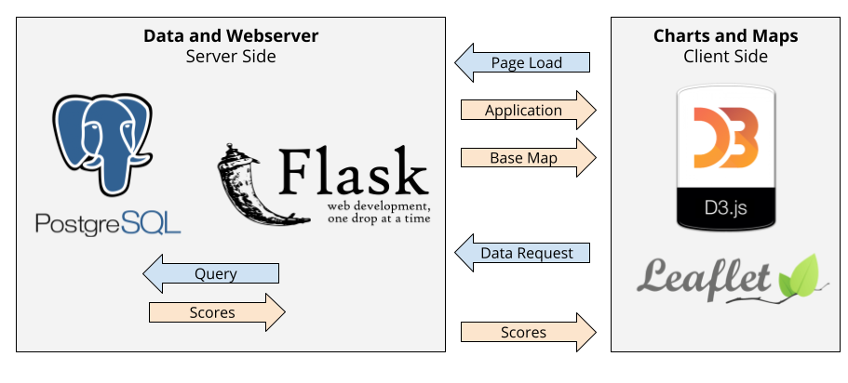
From Data to Visualization
Klumpenhouwer et al. | A Comprehensive Transit Accessibility and Equity Dashboard

Slide 7
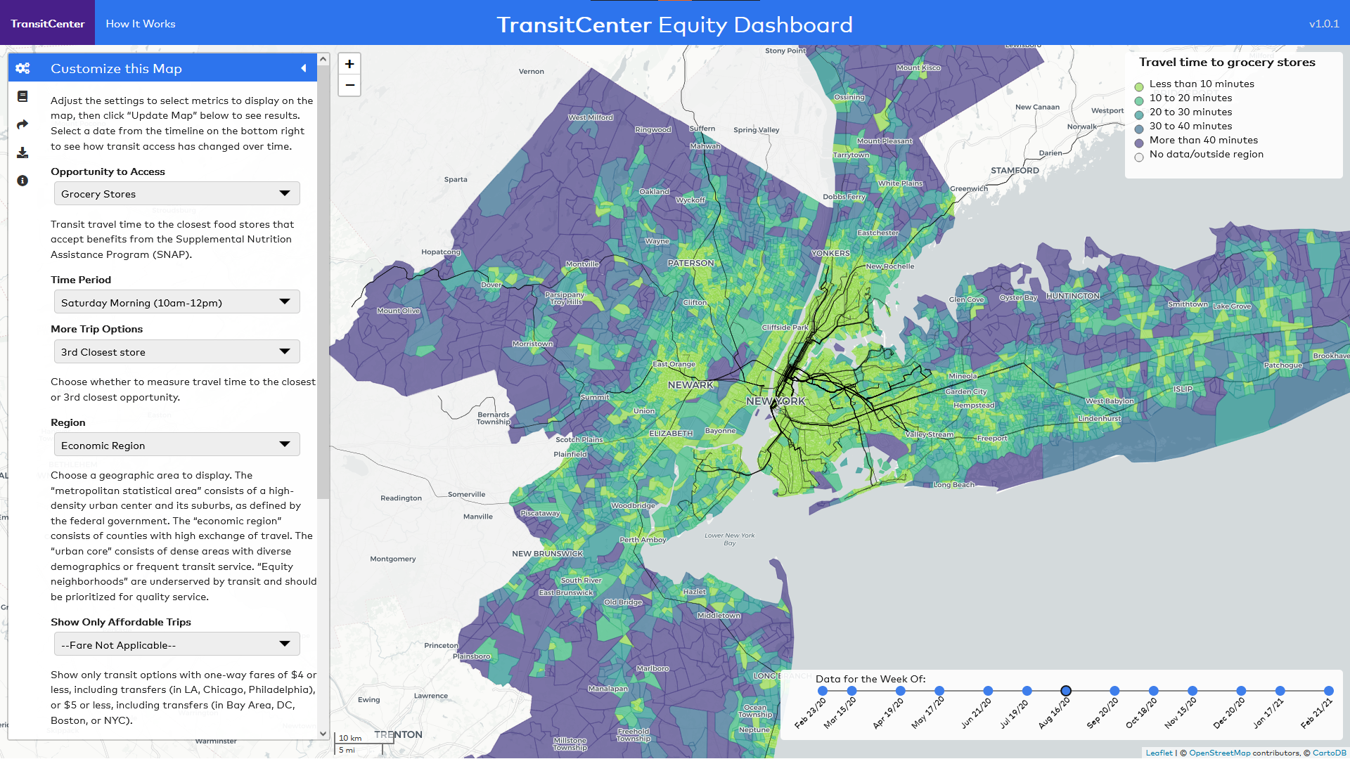
Source: TransitCenter Equity Dashboard

Slide 8
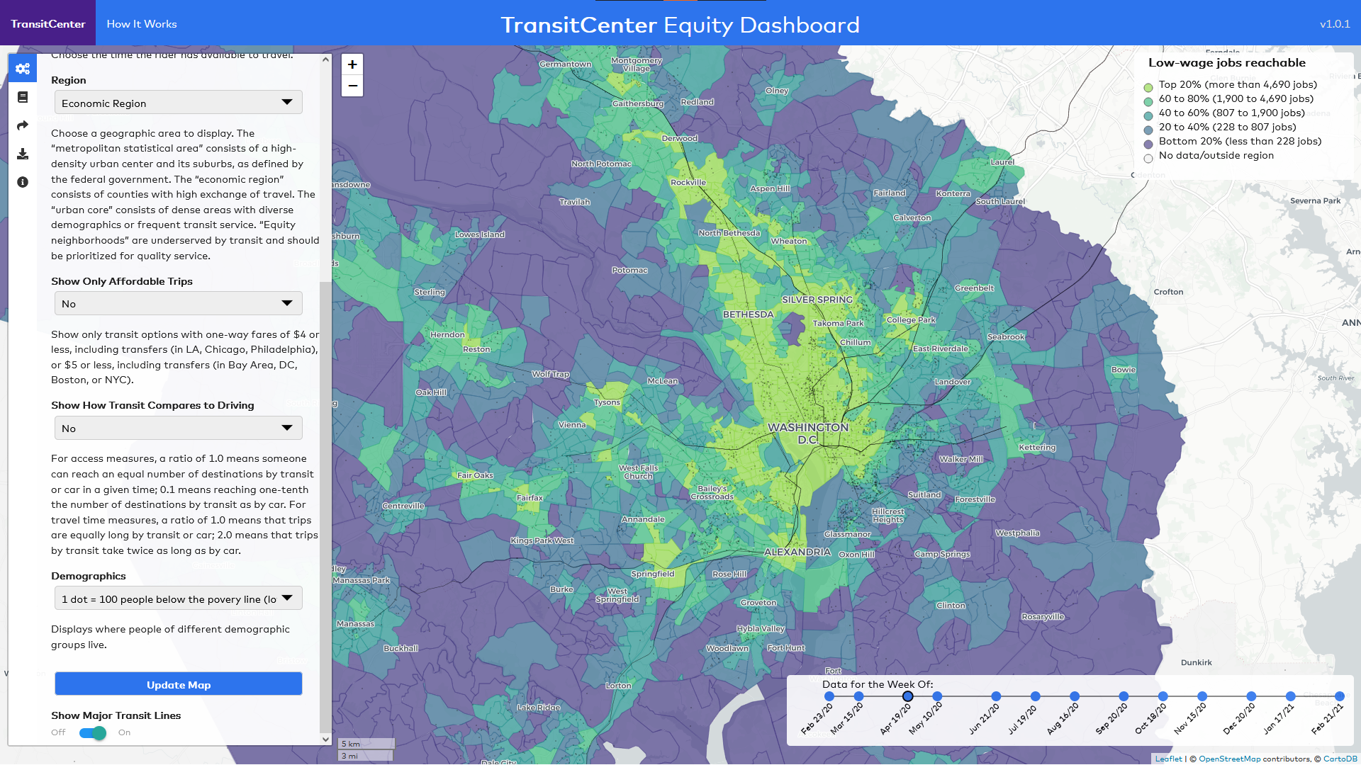
Source: TransitCenter Equity Dashboard

Slide 9
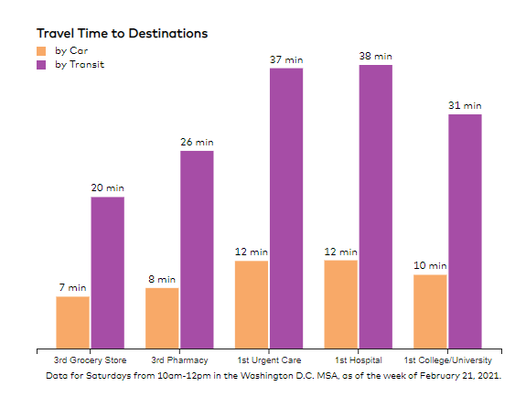
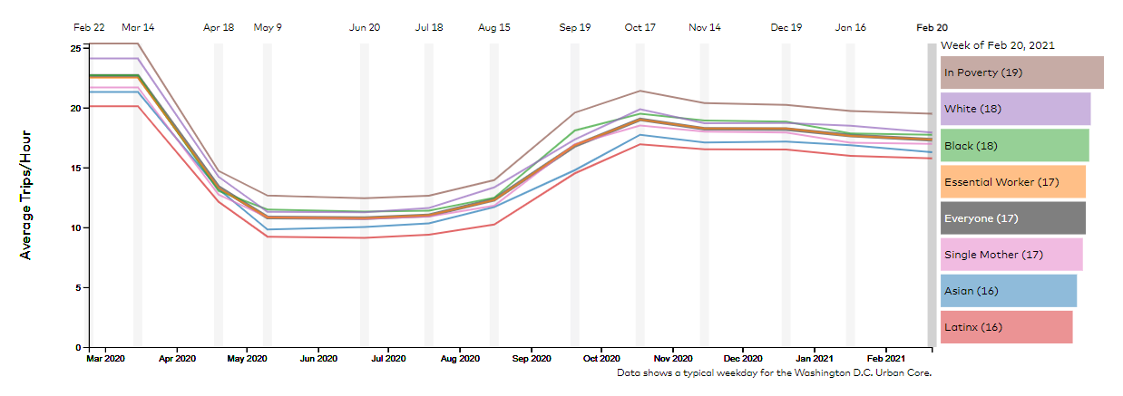
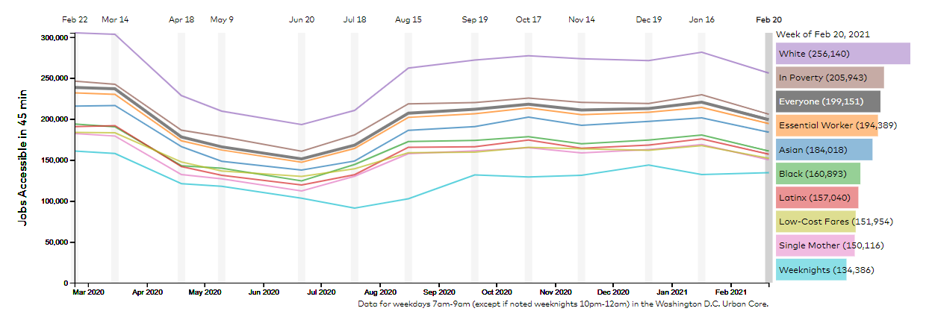
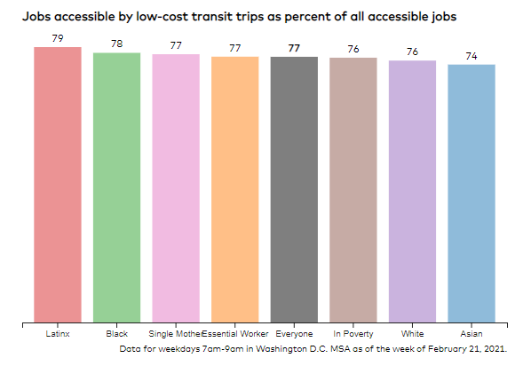
Regional Summary Stories

Slide 10
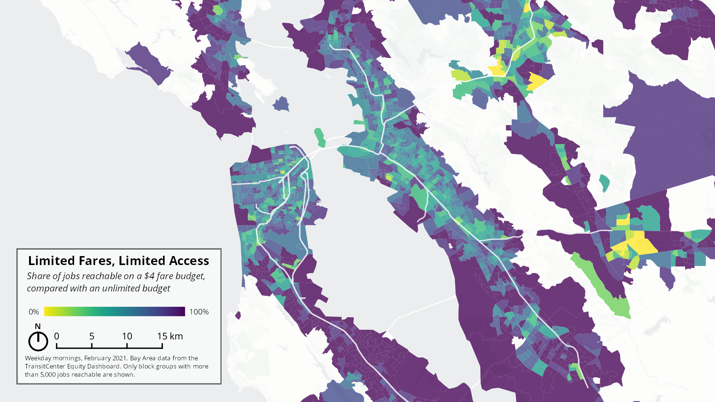

Slide 11
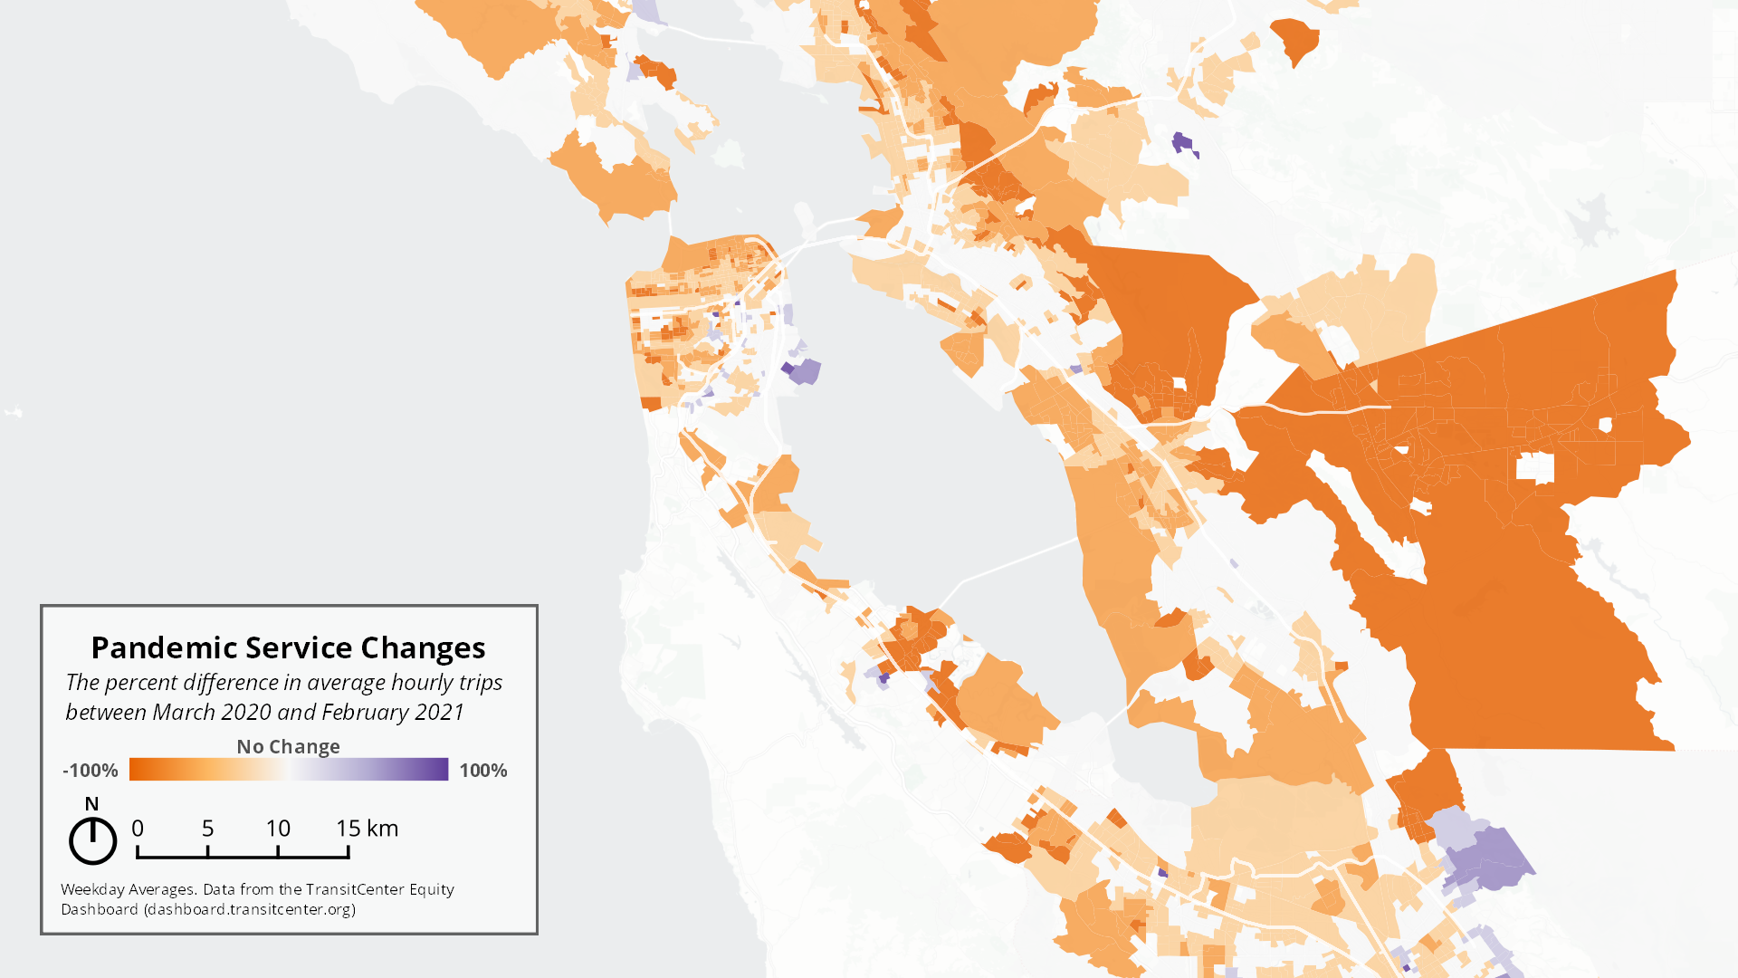

Slide 12
Takeaways
Accessibility connects transit planning and land use together
Open data and software can be used to calculate and visualize these measures
Combining accessibility, population data, and visualization enables conversations about transit equity
Your agency can do this!
Klumpenhouwer et al. | A Comprehensive Transit Accessibility and Equity Dashboard
Photo Credit: Jeremiah Higgins

Slide 13
Questions?
dashboard.transitcenter.org
Partners: TransitCenter, Sustainable Systems Research, University of Vermont, SF2 Enterprises, Klumpentown Consulting
Photo Credit: Corey Agopian

