Slide 1
Bus On Time Performance, Equity, and Wellbeing: What We Know and What We Need To Find Out
Matthew Palm, Ph.D., Amer Shalaby, Ph.D.,P.Eng, Steven Farber, Ph.D.
Transit Analytics Lab Research Day,
6 July, 2021

Slide 2
Outline
Equity and operational performance: the U.S. experience
Application of Title VI to Toronto
Route-scaled results
What happens if we rescale the analysis to the individual?
Next steps: linking operational outcomes to wellbeing

Slide 3
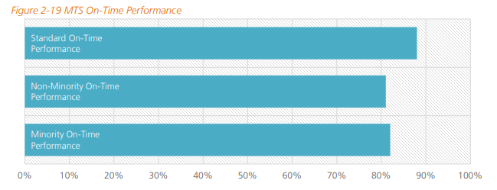
Equity in Operations: Precedent from the U.S.
U.S. Federal Transit Administration Title VI Guidance
Routes must be classified as “minority” or “non-minority”
Agencies must compare service quality between minority and non-minority routes
(SANDAG, 2018)

Slide 4
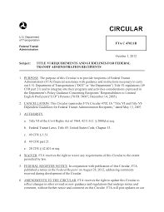
Definitions from USDOT
Census Defined Minority Route: A fixed transit route where at least 1/3 of revenue miles are in a block group where the percentage minority population exceeds the percentage minority population in the service area.
On-Board Survey Defined: A route is Minority Serving if the percent minority ridership is greater than the percent minority of the service area population.

Slide 5
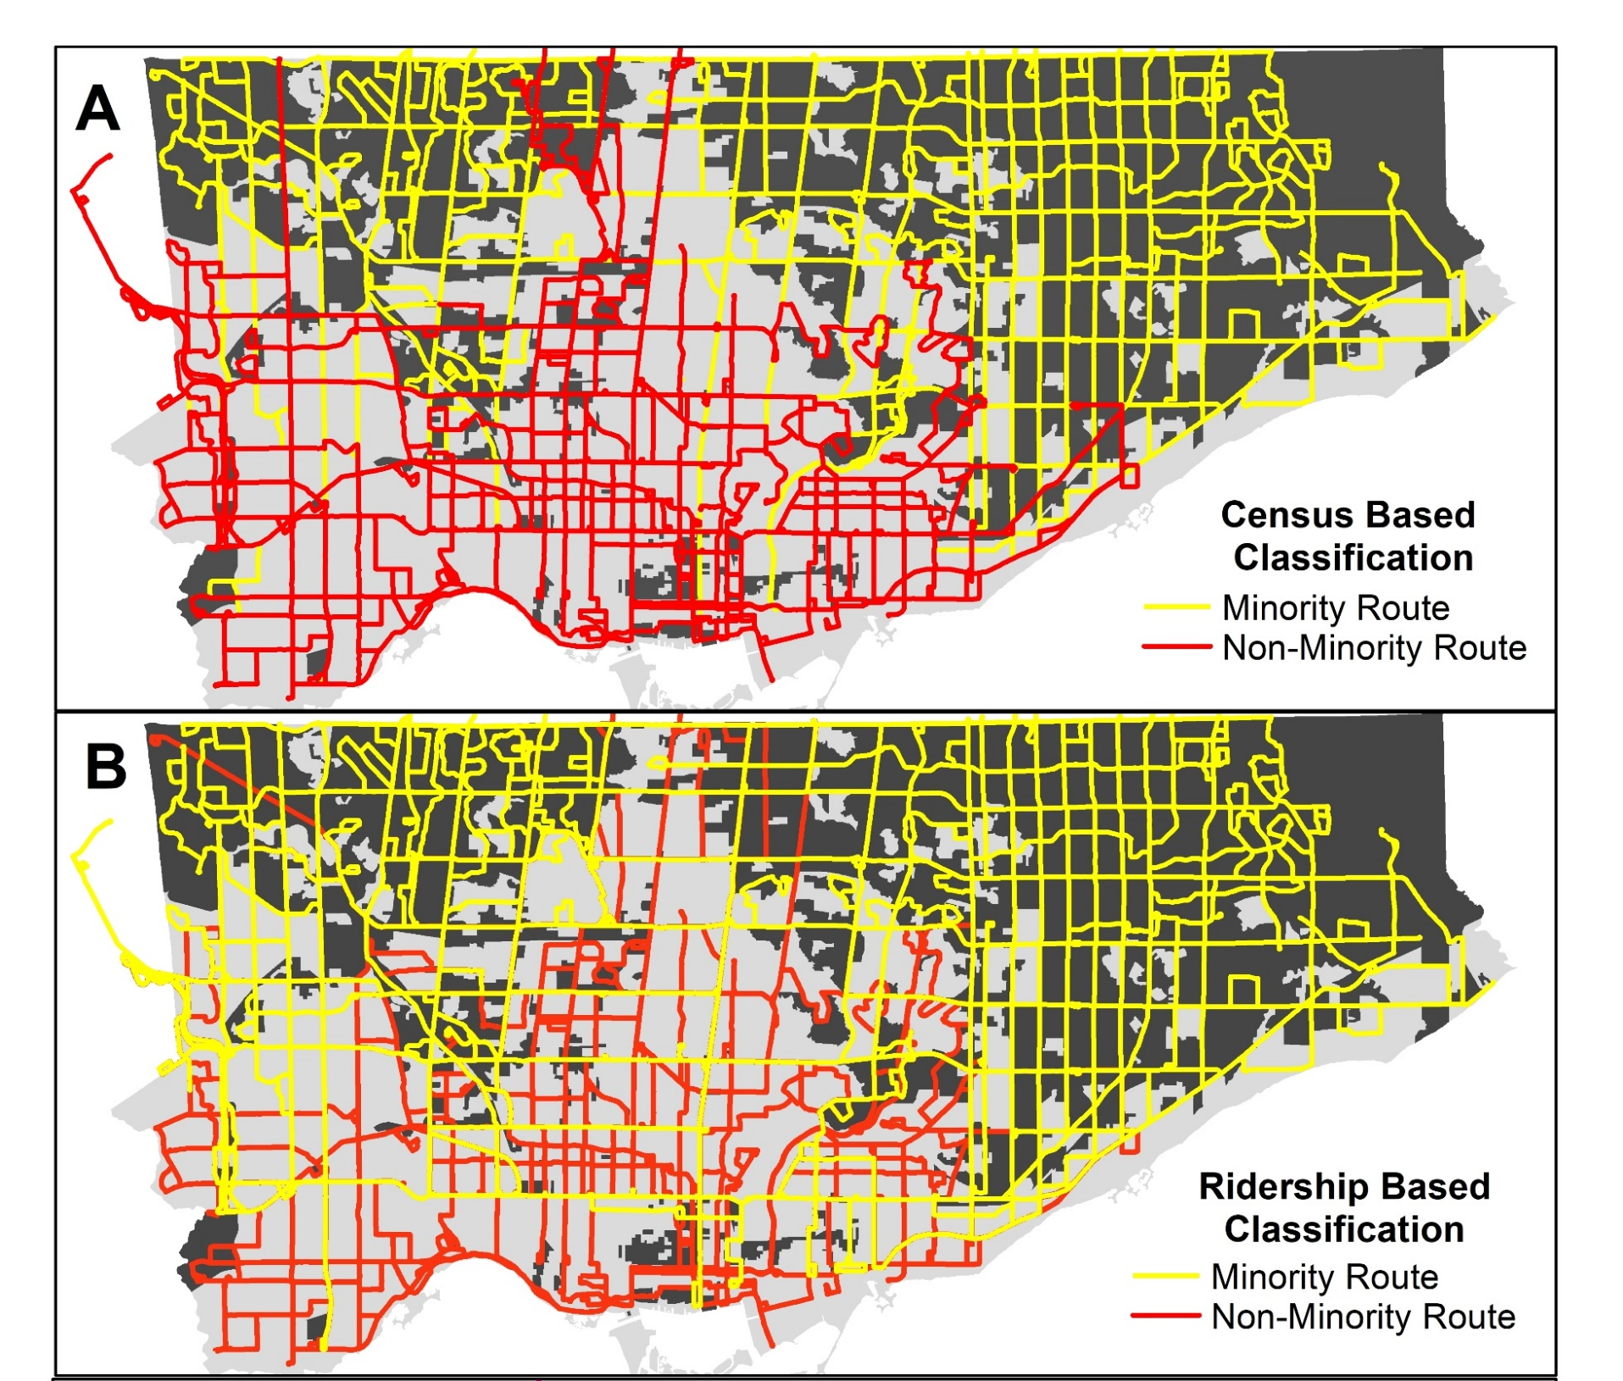
Toronto Application
Census Data: Statistics Canada.
Ridership Data: Transportation Tomorrow Survey (DMG, 2014).
OTP Data: TTC Route-level on-time statistics (AVL) from September 2016 through September 2018
(Palm et al., 2020)

Slide 6
Data inputs altering results
Switching from Census to Ridership definitions:
Many night routes become minority routes
Downtown connectors become non-minority
(Palm et al., 2020)

Slide 7
Why On-Time Performance for Equity?
For infrequent routes (where a bus comes every 15 minutes or later), being on time matters:
A late bus means a longer wait time
An early bus means the rider might miss it, and must wait for the next one
On-Time Performance is rated as one of the most important factors for rider satisfaction and a major predictor of ridership and rider loyalty (Idris et al., 2014; Van Lierop et al., 2018).

Slide 8
Results: TTC is horizontally equitable
(Palm et al., 2020)

Slide 9
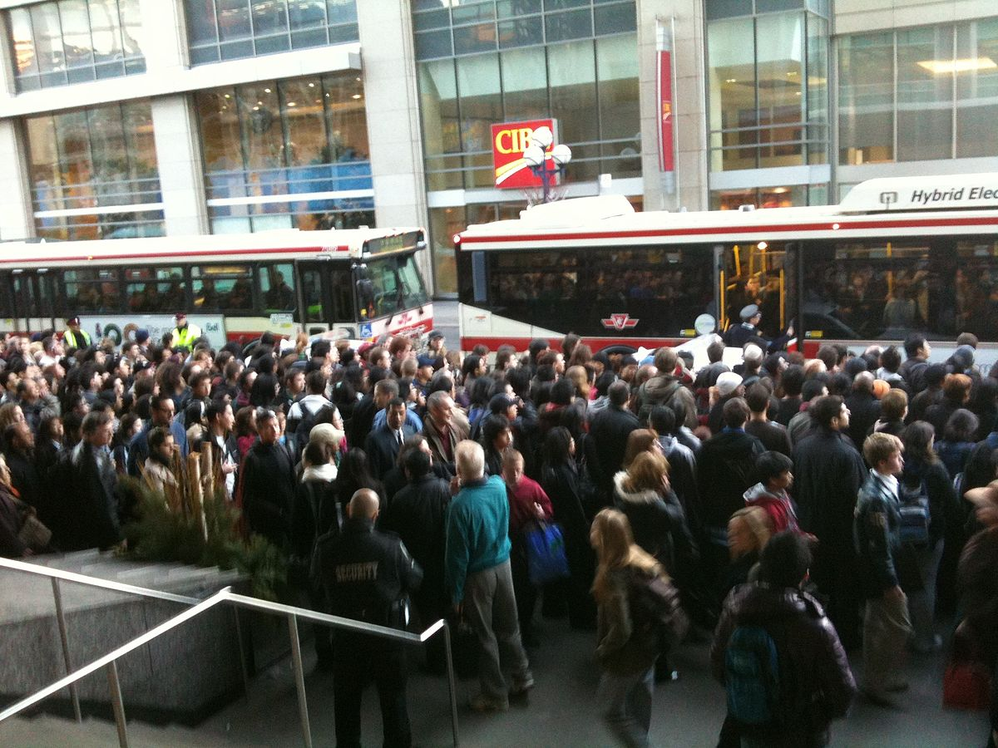
What if we drop down to the level of the individual?
Pulled all transit trips from the region’s household travel survey (DMG, 2014).
Assigned each rider an On-Time Performance score based on the route and time of day of their trips.
Compared across socio-economic strata.
Photo credit: Wikipedia

Slide 10
(Palm et al., 2020)
A quarter of all visible minority riders in the city are using routes where on-time departures are between 9 - 61%
A quarter of transit users from carless households are using routes where on-time departures are between 20 - 56%

Slide 11
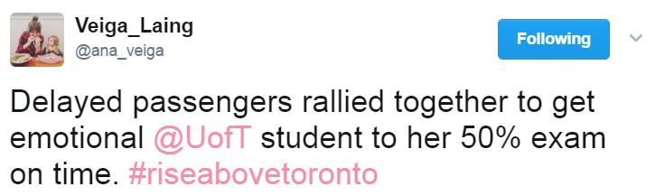
From ‘equitably late’ to well-being linked metrics
Are there operational performance thresholds below which there are significant negative costs to riders?
Can we correlate OTP and other metrics with school/work attendance, and other important activities?
Answering these questions can further the social and economic case for transit.
Photo Credit: Narcity
Photo Credit: Utoronto News

Slide 12
Conclusions
TTC’s on-time performance is horizontally equitable.
A significant number of car-less riders rely on routes with low on-time performance.
Canadian riders know the costs of a late bus, but we have yet to translate performance metrics into quantified wellbeing impacts that policymakers can understand.
Photo Credit:
The Advertiser

Slide 13
Questions?
Partners: University of Toronto XSeed Grant.
Publication: Palm, M., Shalaby, A. and Farber, S., 2020. Social equity and bus on-time performance in Canada’s Largest City. Transportation Research Record, 2674(11), pp.329-342.
Email: matthew.palm@utoronto.ca if you would like a free copy.
References
DMG. 2014. “TTS Introduction.” Data Management Group. 2014. http://dmg.utoronto.ca/
transportation-tomorrow-survey/tts-introduction.
Hulchanski, J.D., 2010. The three cities within Toronto. Toronto: Cities Centre.
Idris, A.O., Habib, K.M.N. and Shalaby, A., 2014. Dissecting the Role of Transit Service Attributes in Attracting Commuters: Lessons from a Comprehensive Revealed Preference–Stated Preference Study on Commuting Mode-Switching Behavior in Toronto, Ontario, Canada. Transportation Research Record, 2415(1), pp.107-117.
SANDAG. Title VI Triennial Program Update for Metropolitan Transit System. San Diego Association of Governments, CA, 2018, p. 441.
Van Lierop, D., Badami, M.G. and El-Geneidy, A.M., 2018. What influences satisfaction and loyalty in public transport? A review of the literature. Transport Reviews, 38(1), pp.52-72.

