Slide 1
Evaluating the Equity Implications of Ride-Hailing Through a Multi-Modal Accessibility Framework
Bilal Abdelwahab
Matthew Palm
Amer Shalaby
Steven Farber

Slide 2

Can Ride-Hailing do it all?
Ride-hailing has received popular attention as a possible first/last mile solution integrated with transit
Local governments in Ontario are being asked to consider ride-hailing and other micro-transit options in lieu of transit, tied to COVID relief funding
Research is needed to understand whether and for whom ride-hailing serves as a feasible alternative or first/last mile solution
(Source: https://superheroes.fandom.com/wiki/Uberman)

Slide 3

Accessibility and Equity
How do we compute the potential user benefits of ride-hailing and ride-hailing integration, compared to the benefits of transit?
Accessibility is the most common way to measure the benefits of transit systems in equity analyses
Any solution must consider both travel
times and costs

Slide 4
Research Questions
How does ride-hailing affect accessibility?
Does ride-hailing provide a viable first-mile solution that improves job accessibility?
How are the potential benefits of the above distributed among different population groups?

Slide 5
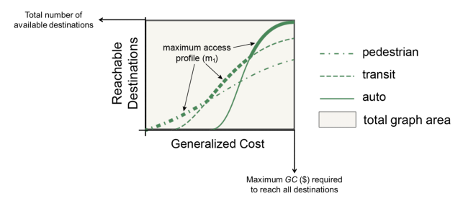
Accessibility Profile Analysis (APA)
Figure Source: Lee (2019)

Slide 6
Calculating Generalized Costs
Auto
Transit
Ride-hailing
IVTT
IVTT
IVTT
Operating cost
Wait time
Wait time
Toll cost
Walk time
Toll cost
Parking cost
Fare
Fare (UberX)

Slide 7
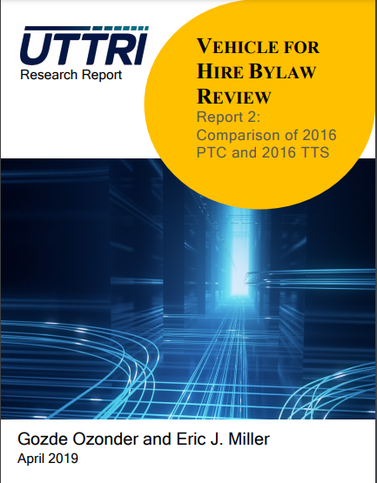
Data
Ridehailing: wait times from over 13 million records of PTC data from the City of Toronto, fares derived from Uber’s published fare schedules
Transit: IVTT, fare, walk, and wait times from GTA Model
Auto: IVTT, operating, toll, parking from GTA Model
Demographics: City of Toronto
PTC Data

Slide 8
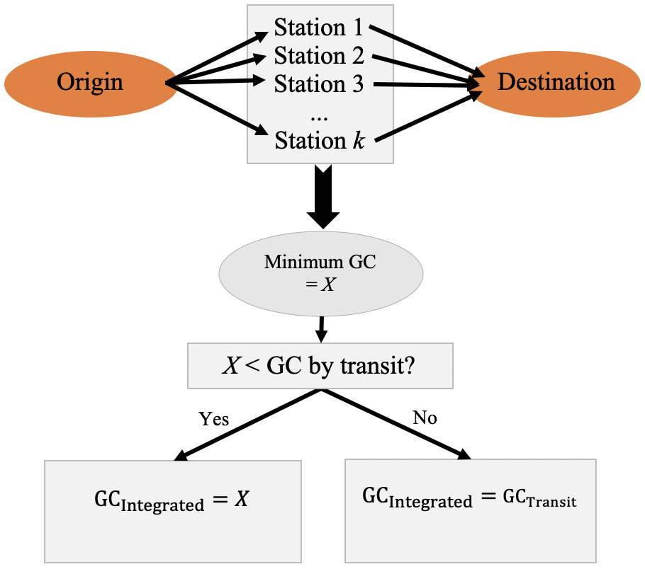
Integrating Ride-Hailing with Rapid Transit
Ridesharing
Rapid transit

Slide 9
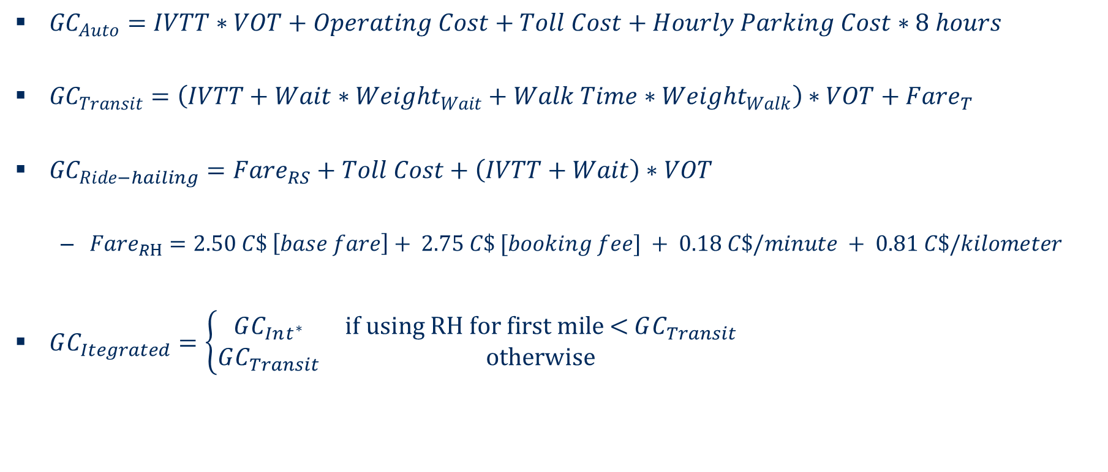
Calibrating the APA – Generalized Costs
${GC}_{Auto}=IVTT∗VOT+Operating Cost+Toll Cost+Hourly Parking Cost∗8 hours$
${GC}_{Transit}=\left(IVTT+Wait∗{Weight}_{Wait}+Walk Time∗{Weight}_{Walk}\right)∗VOT+Fare_{T}$
${GC}_{Ride−hailing}=Fare_{RS}+Toll Cost+\left(IVTT+Wait\right)∗VOT$
  $Fare_{RH}=2.50 C\$ \left[base fare\right]+ 2.75 C\$ [booking fee] + 0.18 C\$/minute + 0.81 C\$/kilometer$
$GC_{Itegrated}=\left\{\begin{matrix}GC_{Int^{∗}} & \text{if} \text{using} \text{RH} \text{for} \text{first} \text{mile}\text{ <} GC_{Transit} \\ GC_{Transit} & \text{otherwise}\end{matrix}\right.$
Notes:
Costs based on GTA Model for all modes, except Wait-times for RH which are based on ride-hailing trip data obtained from City of Toronto.
Study area is City of Toronto
Unit of Analysis is Traffic Analysis Zones

Slide 10
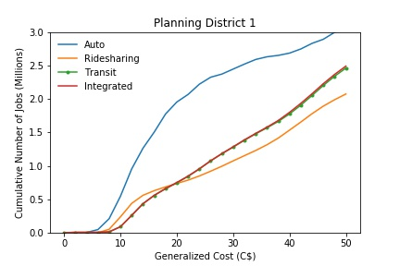
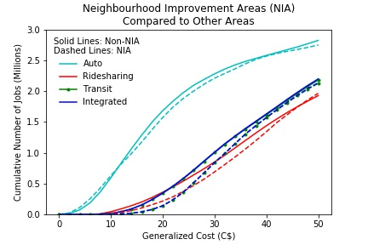
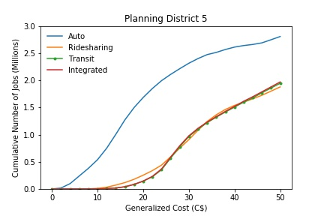
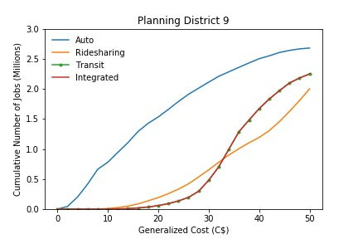
APA General Results
Neighbourhood Improvement Areas
Downtown
Integration, provides very little benefit (7% of OD pairs)
Public Transit and Ridehailing have very similar APA curves
Access in NIAs is lower than other areas for all modes
Don Mills
North-West

Slide 11
Ridesharing Added Benefit
PD 1:
  Low benefit locally and regionally
Central Areas (PDs 2-6)
  Lower local benefit than Outer suburbs
Peripheral Areas (PDs 7-16)
  PD 9 sees the highest benefit both locally and regionally

Slide 12
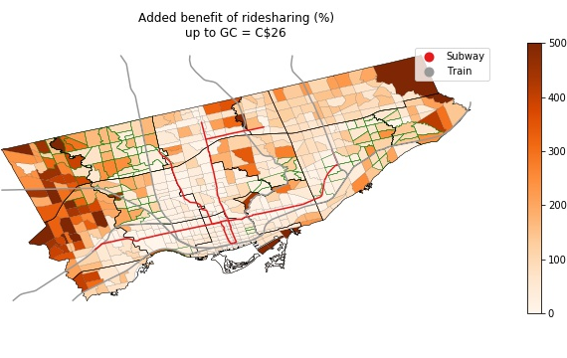
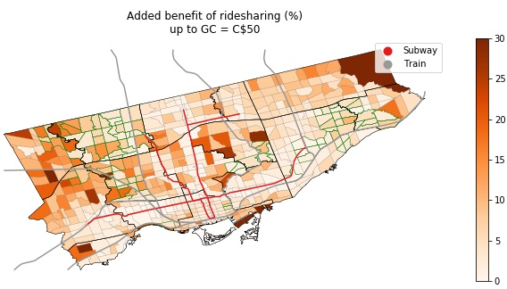
Ridesharing Added Benefit Maps
Subway lines strongly influence benefit values
High ridesharing benefit in the west
  Near airport employment area
  Low transit LOS
  Multiple fares for jobs outside the city boundaries

Slide 13
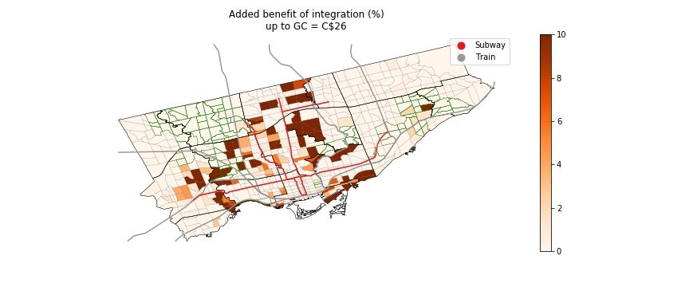
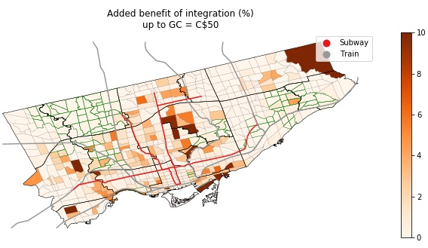
Results – Integration Added Benefit Maps
Low benefit almost everywhere
Highest benefit experienced 1-5km from subways
Low benefits in NIAs

Slide 14
Conclusions
Ride-hailing improved job accessibility in peripheral TAZs, especially those near cross-border employment districts
  Ride-hailing can be explored as a stop-gap in the absence of service and fare integration
Ride-hailing was most beneficial for local trips
  We should be exploring active travel solutions as a viable and more sustainable alternative to ride-hailing for local trips

Slide 15
Conclusions
Ride-hailing integration will require significant subsidies, especially for low-income riders
  We need to explore the subsidy size and how this compares to feeder bus services
On average, ride-sharing provides a 57% increase in accessibility within NIAs, while only a 27% increase in other communities
Affordability remains a major barrier for low-income communities

Slide 16
Acknowledgements
This research was supported by an XSeed grant from the Faculty of Engineering and Applied Sciences and UTSC

Slide 17
Questions

