Slide 1
Incorporating Service Reliability in Multi-depot Vehicle Scheduling
Margarita Castro, Ph.D.
Merve Bodur , Ph.D.
Amer Shalaby, Ph.D., P.Eng

Slide 2
Vehicle Scheduling Problem
Overview
Arises in public transit agencies
Assign buses to timetabled trips
Cover each trip exactly once
Find an optimal schedule that minimized fleet size and operational costs
Timetable
Vehicle Schedule
Trip 1
Trips: 3 → 78 → 44
Trip 2
Trip 3
Trips: 23 → 7 → 10 → 12
$$⋮$$
Trip 99
Trips: 98 → 47 → 52 → 83
Trip 100
Trips: 2 → 67
Start and end stations, departure time, route, etc…
$$⋮$$

Slide 3
(Deterministic) Multi-depot Vehicle Scheduling
Components
Depots → limited capacity
Trips → start time and duration
Operational costs
Characteristics
Assign each trip to exactly one bus
Buses start and end at the same depot
Minimize operational cost
Network flow model
Start Depots
End Depots
1 bus
$$d_{1}$$
$$t_{5}$$
$$d_{1}$$
$$t_{1}$$
$$c_{ij}$$
$$t_{3}$$
2 buses
$$d_{2}$$
$$d_{2}$$
$$t_{4}$$
$$t_{2}$$

Slide 4
Limitations and Stochastic Variants
Drawbacks of Deterministic Approaches
Optimize using average travel times
Schedule feasible on average but insensitive to delays in practice
Optimize using over-estimations
How much should we over-estimate?
May result in high-cost schedules without acceptable on-time performance (OTP)
Considering Stochasticity
Penalize expected delays [1,2]
Ignores propagation of delays
Rescheduling [3] and Real-time vehicle scheduling [4]
Make adjustments during operation
[1] Naumann, Suhl, and Kramkowski. A stochastic programming approach for robust vehicle scheduling in public bus transport. Procedia-Social and Behavioral Sciences. 2011
[2] Shen, Xu, Li. A probabilistic model for vehicle scheduling based on stochastic trip times. Transportation Research Part B: Methodological, 2016
[3] Guedes and Borenstein. Real-time multi-depot vehicle type rescheduling problem. Transportation Research Part B: Methodological, 2018
[4] He, Yang, and Li. Vehicle scheduling under stochastic trip times: an approximate dynamic programming approach. Transportation Research Part C: Emerging Technologies, 2018

Slide 5
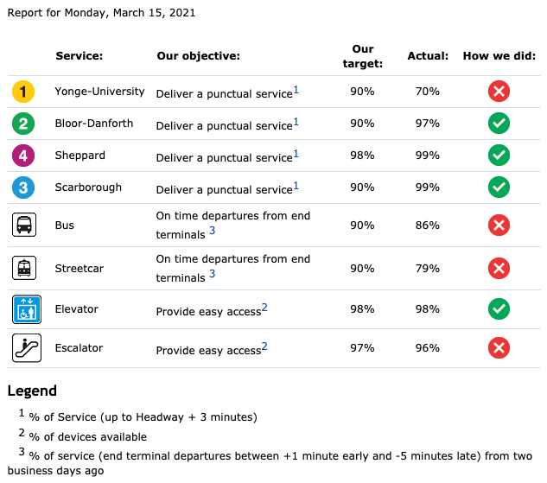
Incorporating Service Reliability
Objectives :
Build cost-efficient vehicle schedules
Guarantee on-time performance (OTP) for most days of operations
Stochastic
Optimization Model

Slide 6
Methodology – Optimization Model
Key Features:
Optimize over a set of scenarios
We aim to achieve target OTP level in at least 95% of the scenarios
OTP: 90% of the buses are no more than 5 minutes late
Modeled with probabilistic constraints
Integer variables
Assign trips to depots and buses
Number of trips without delays per scenario
Number of scenarios that meet OTP target

Slide 7
Methodology – Iterative Procedure
Proposed schedule
Create vehicle schedule
Average times
Feedback from scenarios
Evaluate schedule over scenarios
Final schedule with required OTP achieved in at least 95% of the scenarios
Feedback to improve schedule

Slide 8
Preliminary Results
Experimental Setting
# trips $∈\left\{75, 100\right\}$
# depots $∈\left\{2, 3, 4\right\}$
5 random instances per configuration
200 scenarios for solving
1000 scenarios for evaluation
Value of Stochastic Optimization

Slide 9
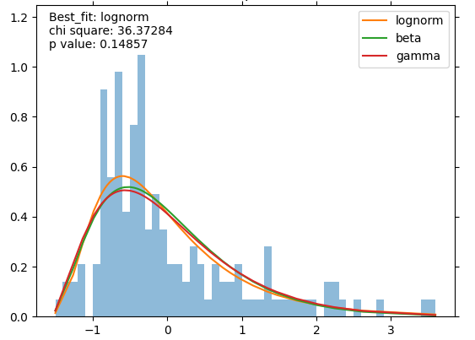
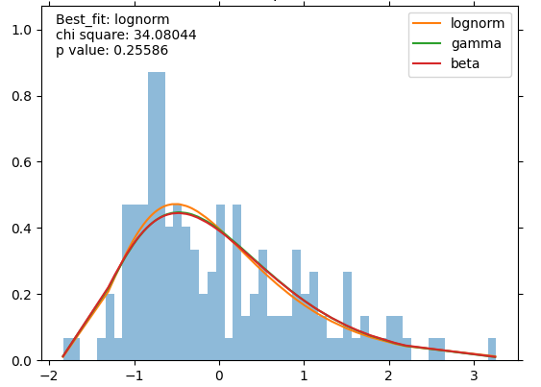
Case Study: Halifax
Characteristics
2 depots
~ 300 buses
~ 70 routes
~ 4,000 trips
Data Processing
Period: winter 2019
Trip durations
GTFS data
Fit log-normal distributions
Deadhead travel times between trips
HERE data

Slide 10
Final Remarks
Overall Approach:
Propose a novel stochastic variant of MDVSP that considers service reliability
Develop an iterative algorithm to solve the problem over a large set of scenarios
Show the value of stochastic model
Study Case:
Analyze traveling time data for the Halifax
Build scenarios and solve stochastic model
Evaluate resulting schedule

Slide 11
Questions
Partners:

