Slide 1
Leveraging Twitter Data to Support Transit Planning & Operations
Research Team: Rami Al-Sahar, Omar Kabbani, Willem Klumpenhouwer,
Amer Shalaby, Tamer El-Diraby
TAL Research Day July 6th 2021

Slide 2
Motivation
Current approach to gauging rider satisfaction is limited to customer satisfaction surveys
Expensive
Yield a static dataset
Lack temporal granularity
New approach by using Twitter
Microblog (short posts)
Abundance of data
Cheap
Real-time posts
Uncensored posts

Slide 3
Objectives
Utilize Twitter data to help transit agencies enhance transit service planning and operations.
Measuring customer satisfaction
Evaluating service changes
Detecting incidents on transit properties

Slide 4
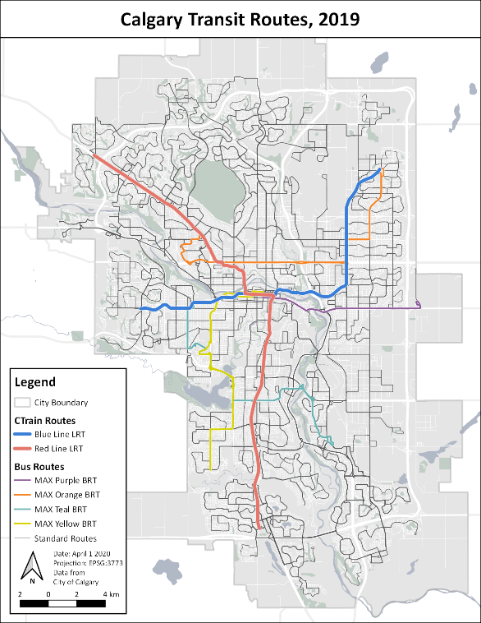
Calgary Transit Case Study
Serves 1.3 million residents of Calgary
Two light rail lines
169 bus routes
@calgarytransit actively tweets about service disruptions, responds to questions, and posts general content
Map courtesy of W. Klumpenhouwer. Data provided by the City of Calgary

Slide 5
Platform for Mining Riders’ Opinions
Semantic Analysis
Sentiment Analysis
Social Network Analysis
Temporal Analysis
Web-based tool
Team management
Customizable analyses
Reporting
Combination of different analyses
Insights on what is being said and who is saying what

Slide 6
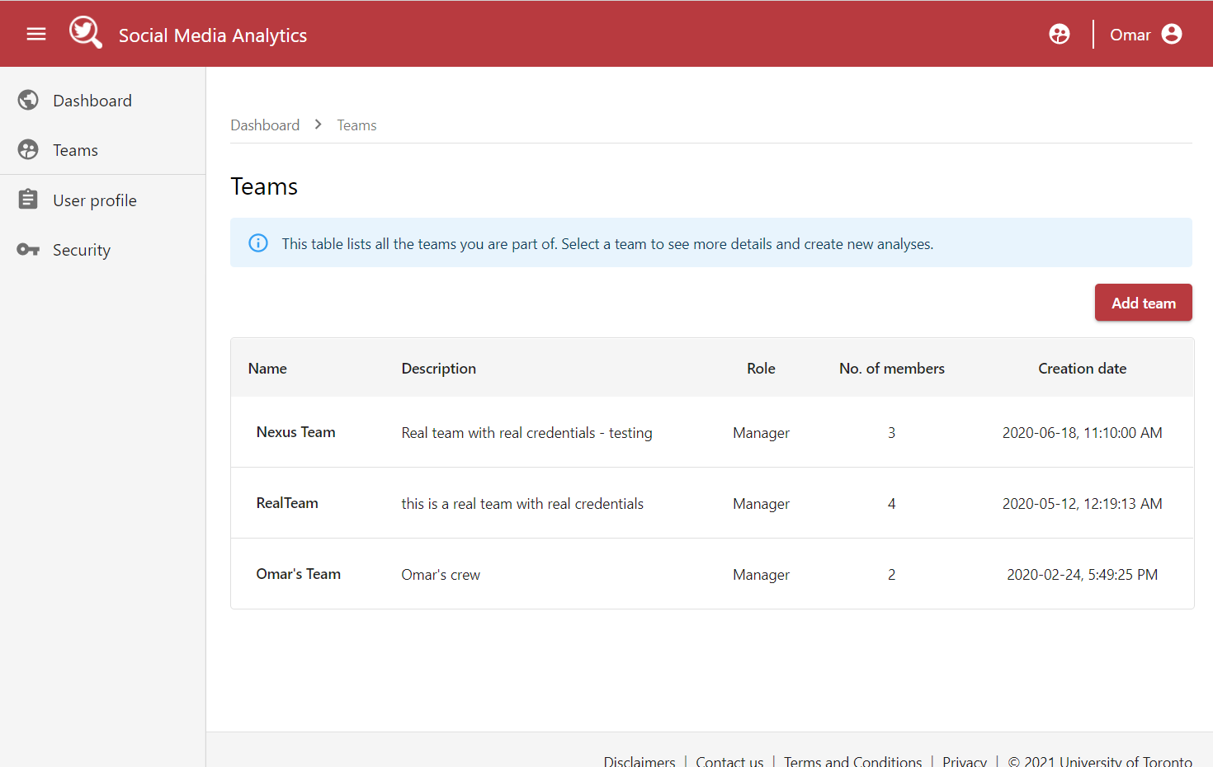
Opinion Dynamics – Workflow
Create team
Allow for different scopes
Define access levels and member roles
Create custom lexicons
Input Twitter developer keys for data extraction

Slide 7
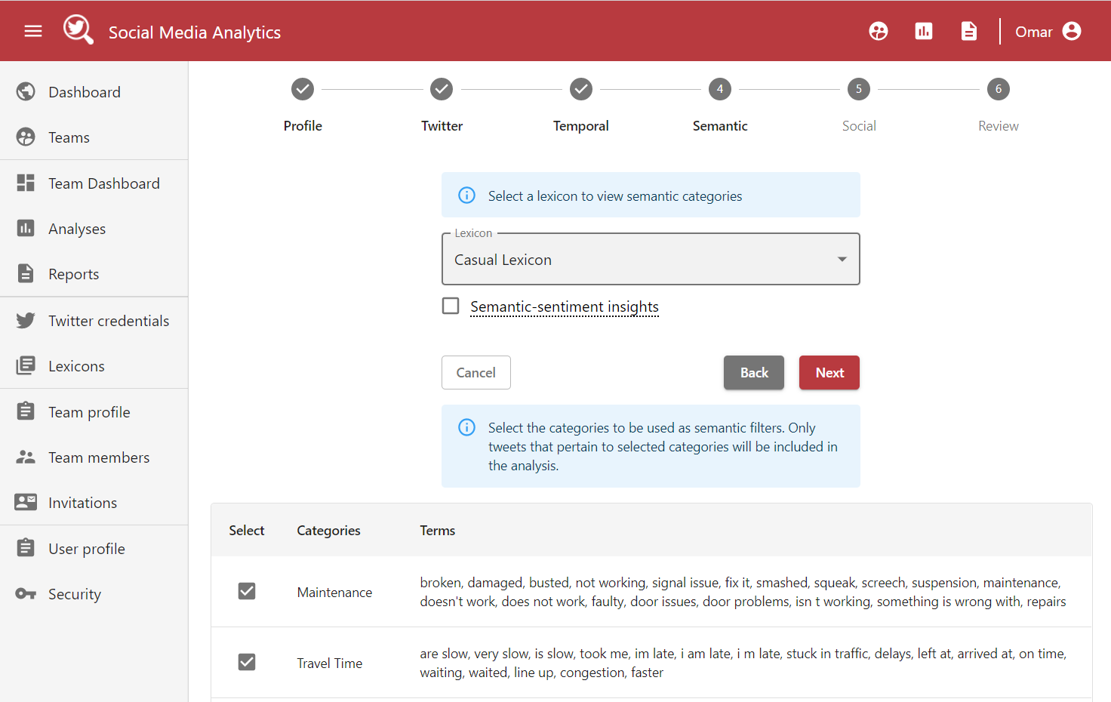
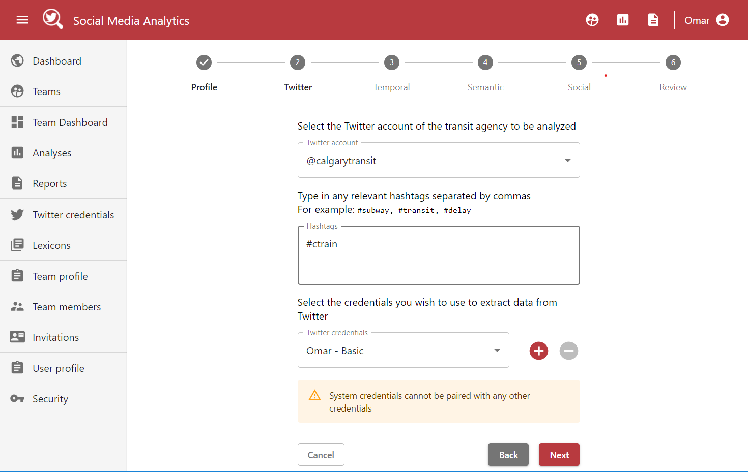
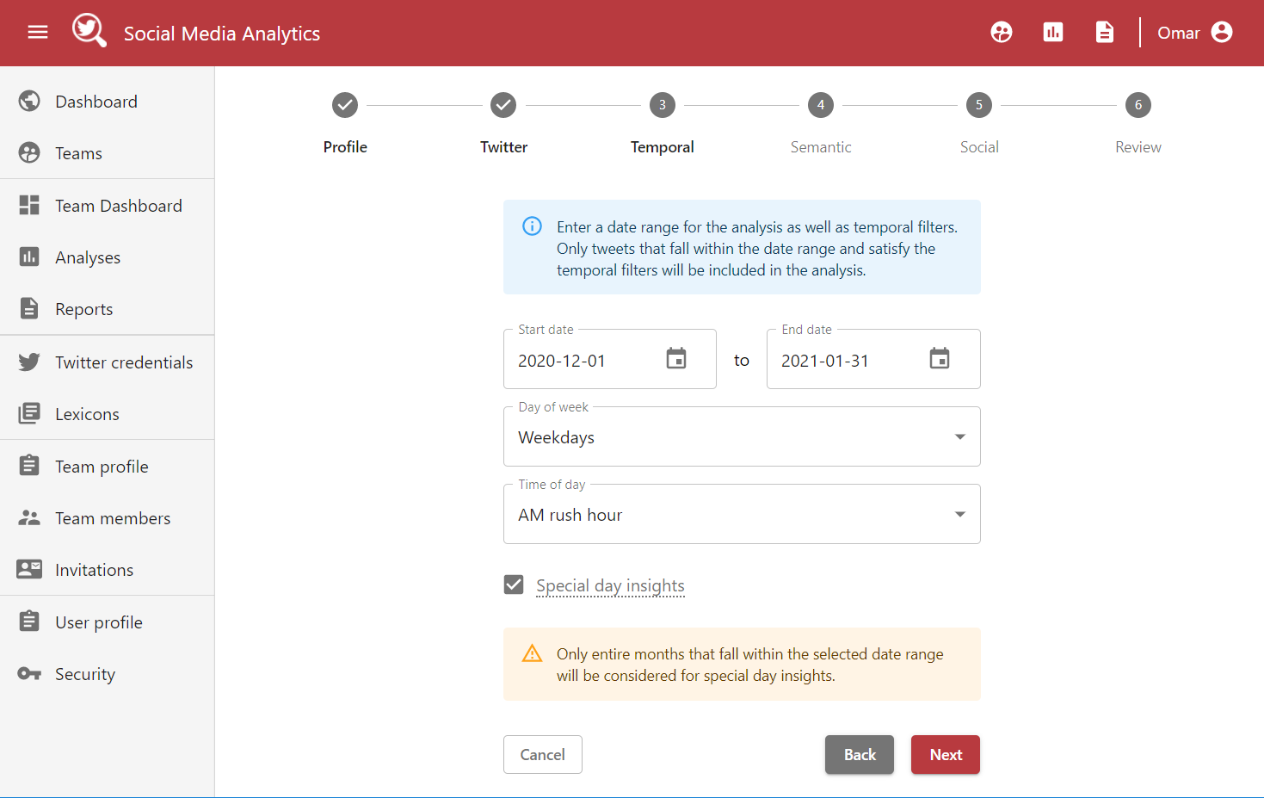
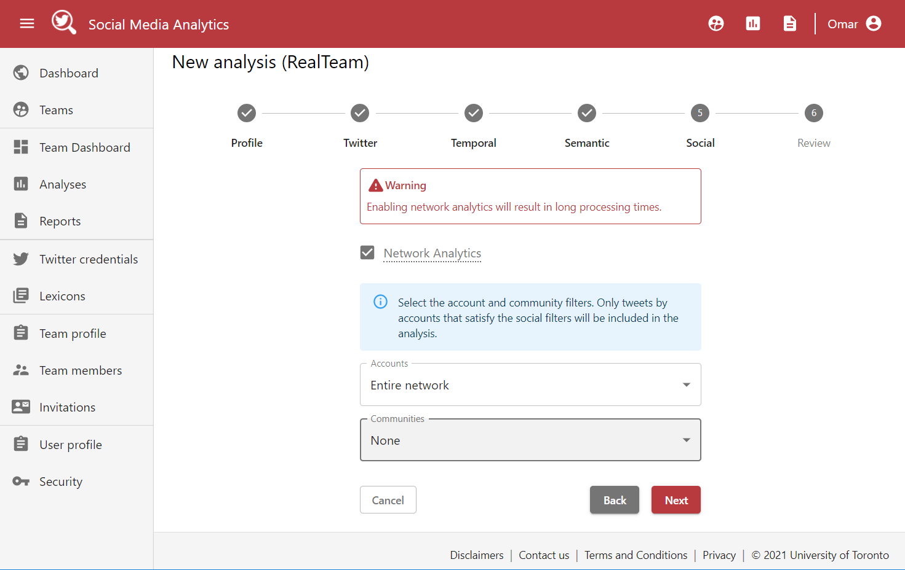
Opinion Dynamics – Workflow (Cont’d)
Start analysis
Agency
Temporal parameters
Semantic parameters
Social parameters
Start analysis
Agency
Temporal parameters
Semantic parameters
Social parameters
Start analysis
Agency
Temporal parameters
Semantic parameters
Social parameters
Start analysis
Agency
Temporal parameters
Semantic parameters
Social parameters

Slide 8
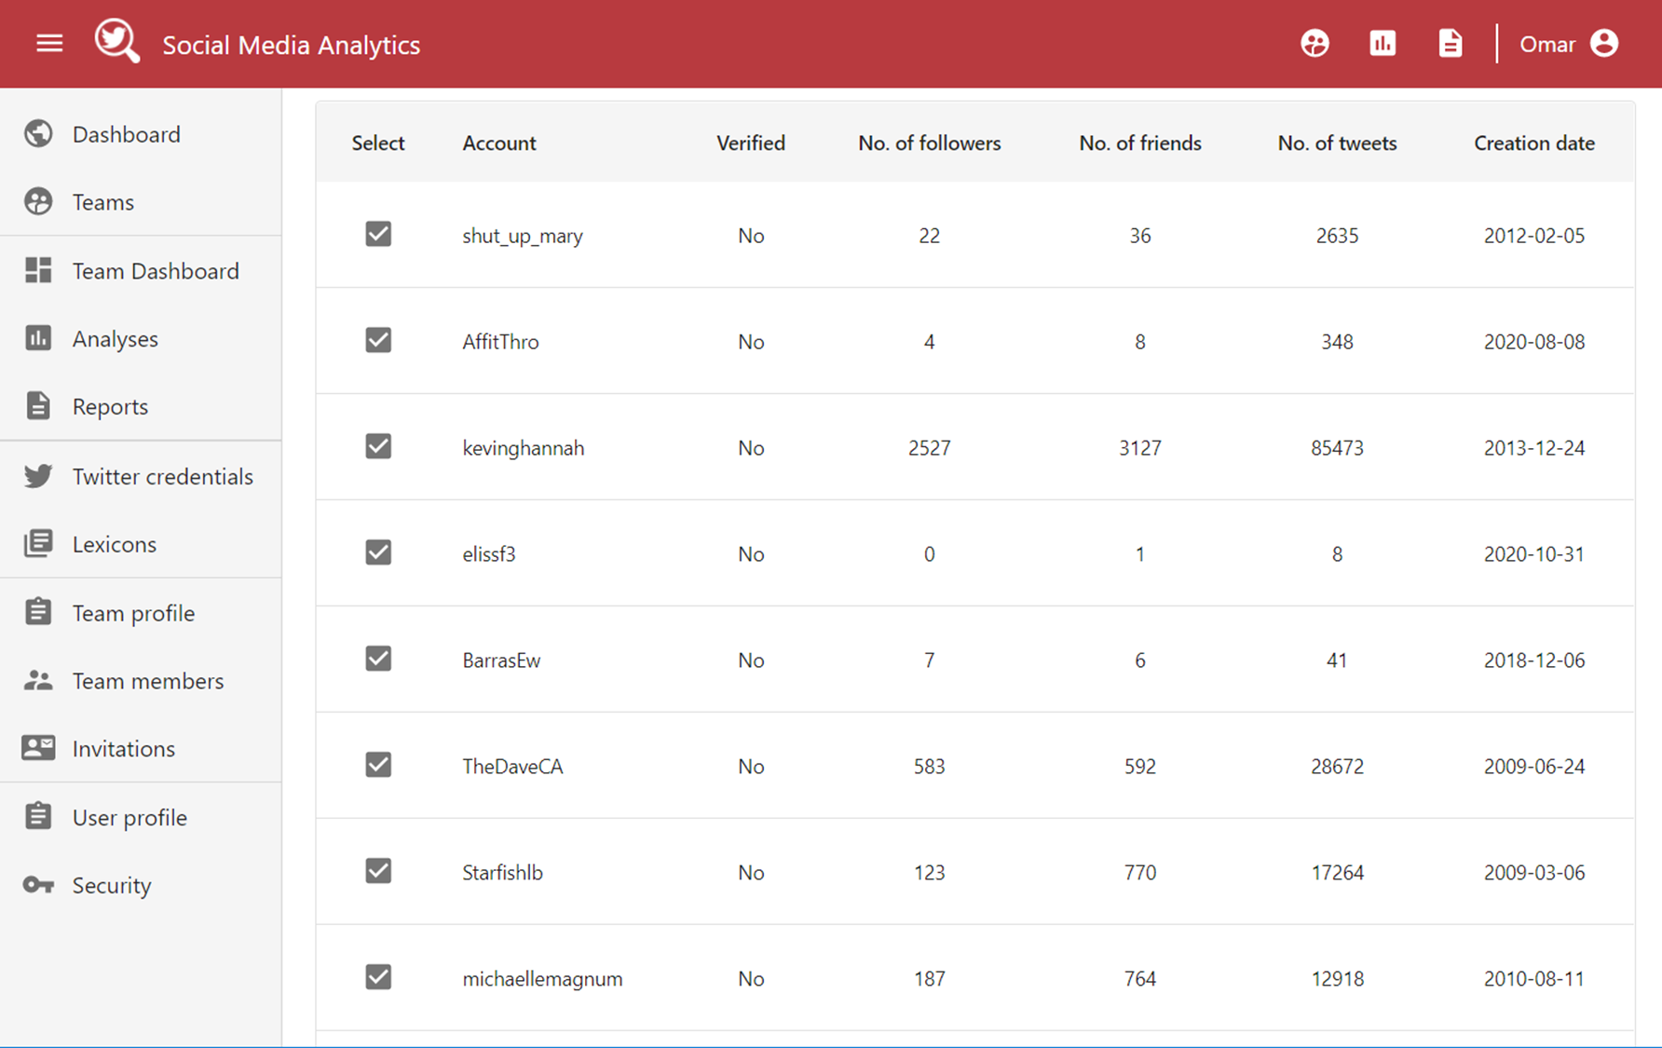
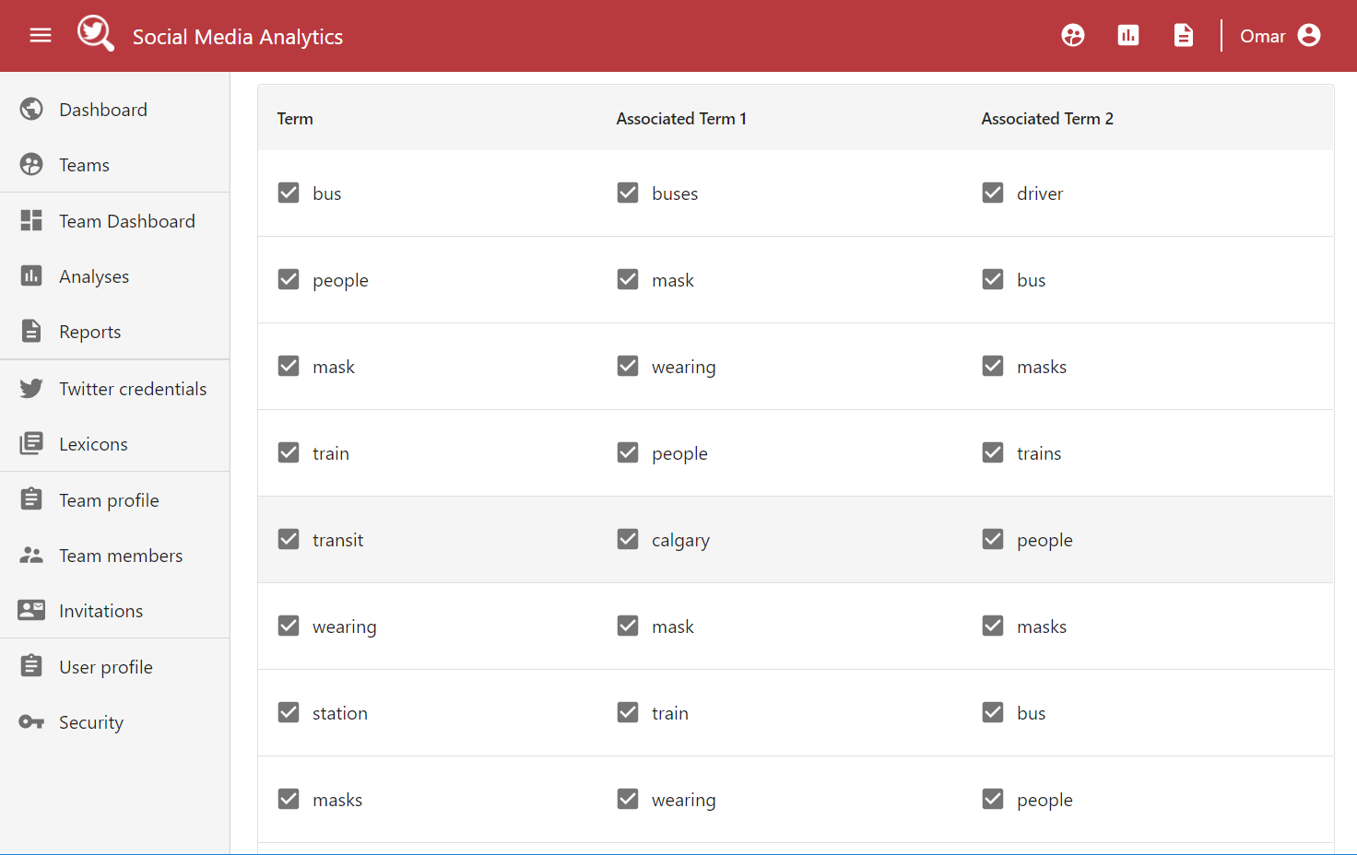
Opinion Dynamics – Workflow (Cont’d)
User-driven filtering
User involvement ensures better data quality
Top accounts
Top terms
User-driven filtering
User involvement ensures better data quality
Top accounts
Top terms

Slide 9
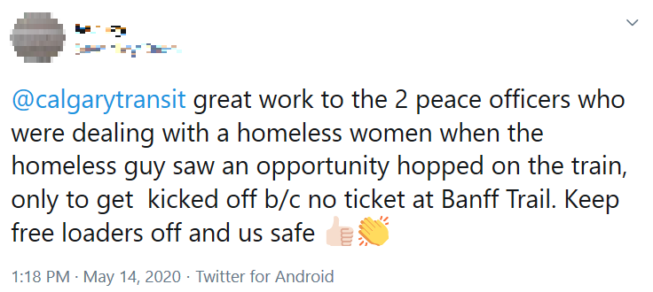
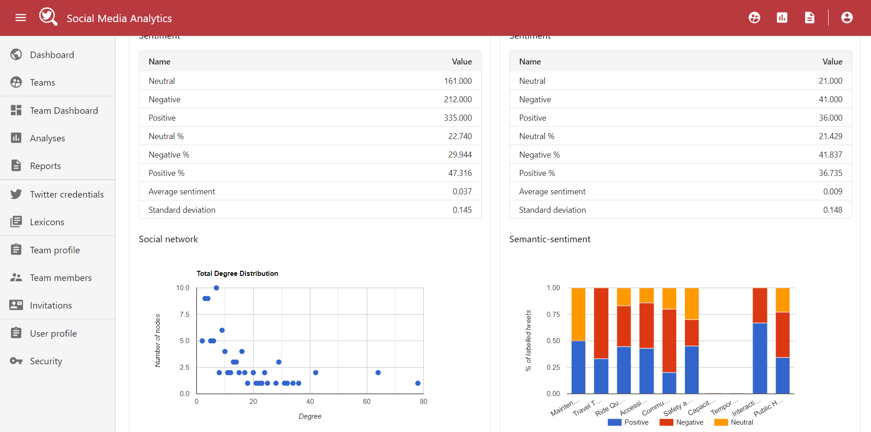
Opinion Dynamics – Workflow (Cont’d)
Network attributes
Node count
Edge count
Average in-degree
Average total degree
Density
Average path length
Diameter
Total degree distribution
Data Extraction & Filtering
Tweets that mention an agency
Data Extraction & Filtering
Data Extraction & Filtering
Data Extraction & Filtering
Sentiment analysis
+ 0.93
Sentiment analysis
Sentiment analysis
Sentiment analysis
Social network analysis
Social network analysis
Social network analysis
Social network analysis
0
Weekday, AM Rush hour
Maintenance
131 followers (influential)
Reporting
Reporting
Reporting
Reporting
- 0.83

Slide 10
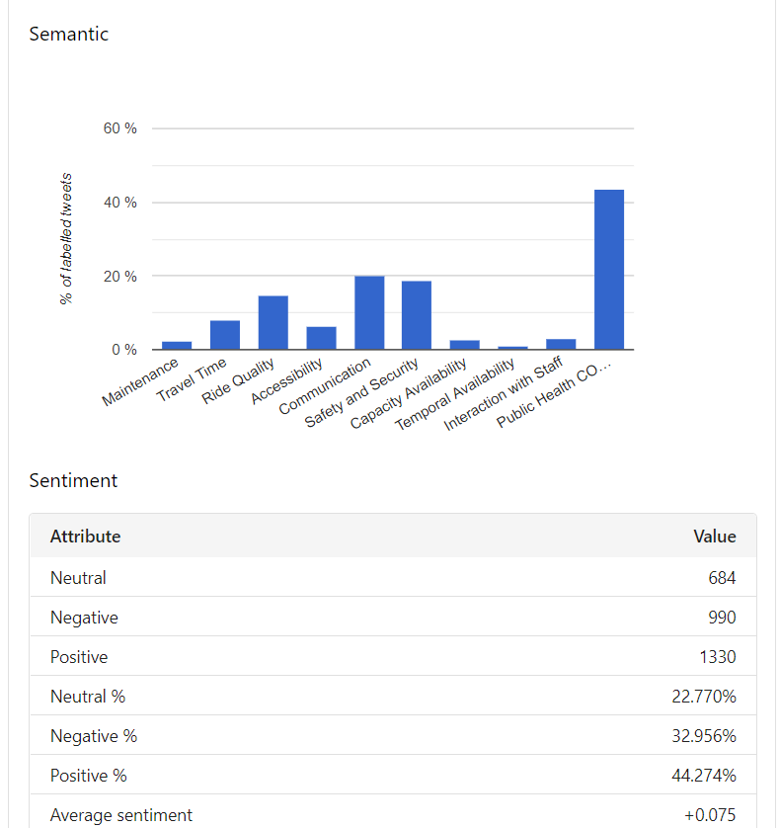
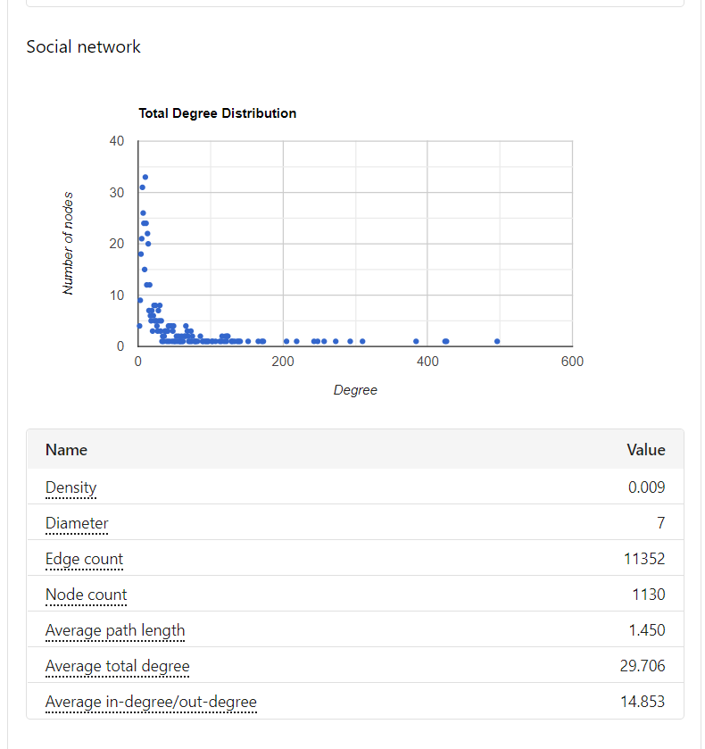
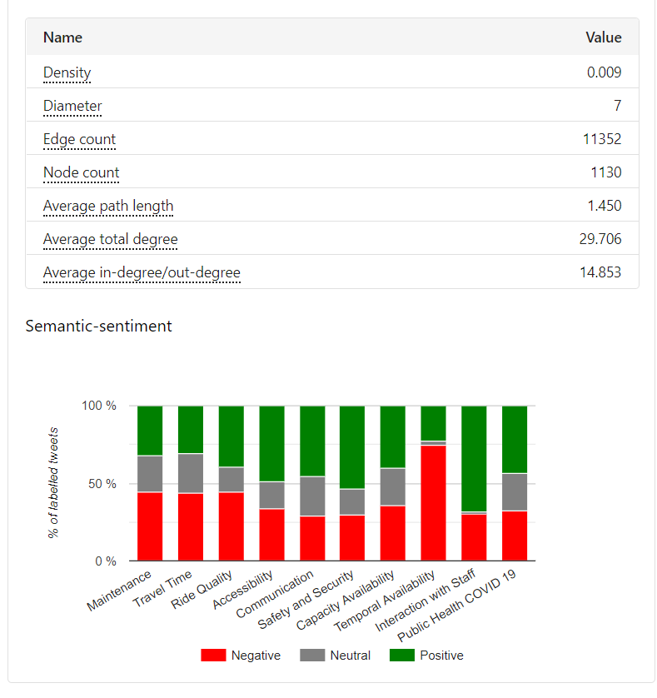
Opinion Dynamics – Workflow (Cont’d)

Slide 11
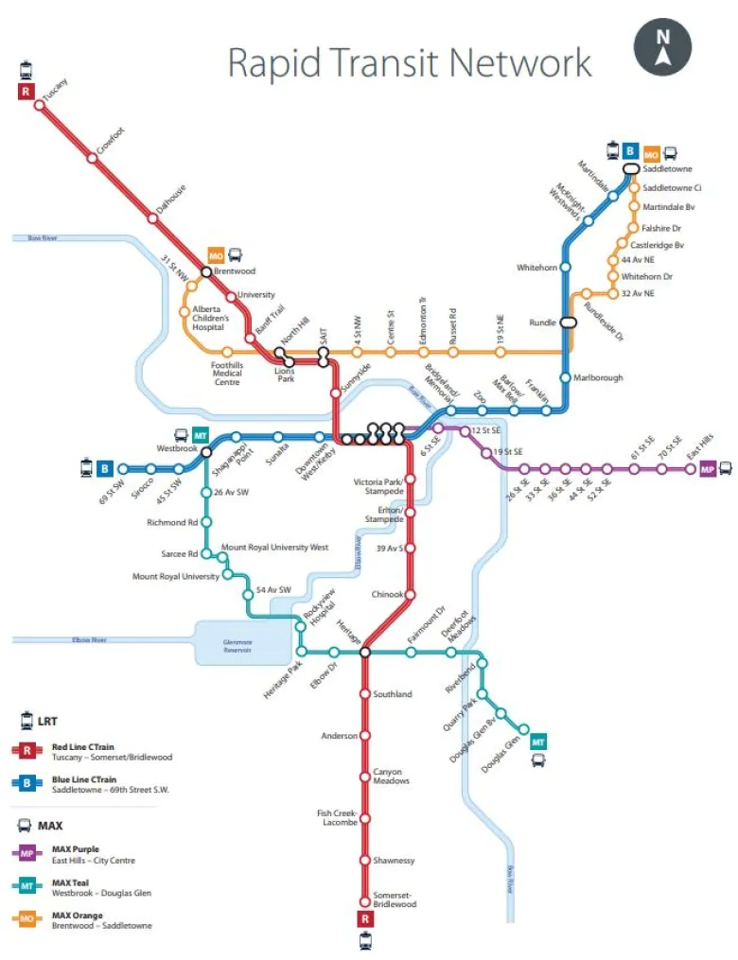
MAX BRT Service Change Evaluation
Three new BRT Lines called MAX Transit (Orange/Teal/Purple) were introduced on Nov. 19, 2018
A big overhaul of the bus network where 35 routes were changed (treatment routes) and 134 routes were unchanged (control routes)
Period of Analysis
Sep.20 - Nov.18 (before)
Nov.19 - Jan. 17 (after)
Semantic and sentiment results of tweets were manually labelled, and major disruptions days were identified and removed as a control measure
Calgary Transit. (2018). Introducing MAX Rider’s Guide. Retrieved from Calgary Transit: https://www.calgarytransit.com

Slide 12
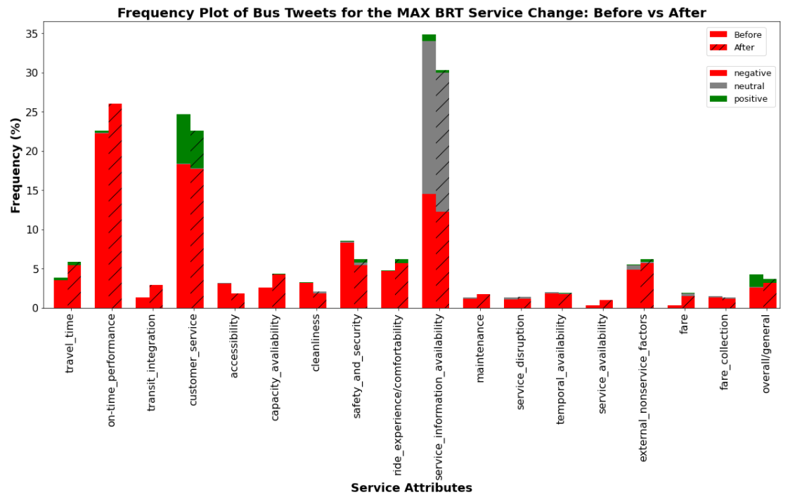
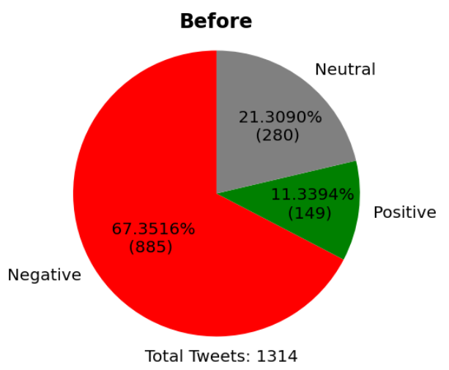
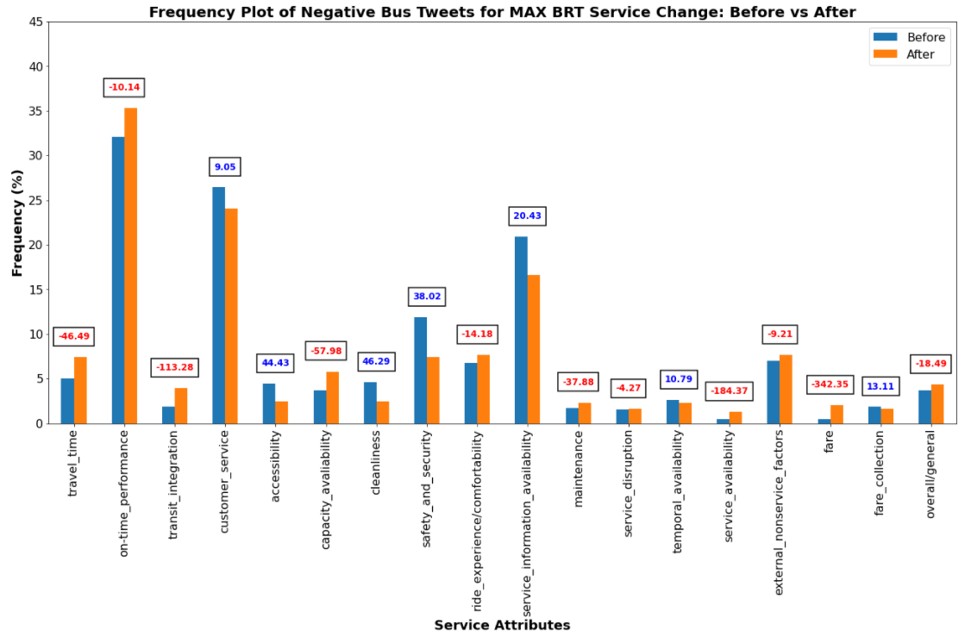
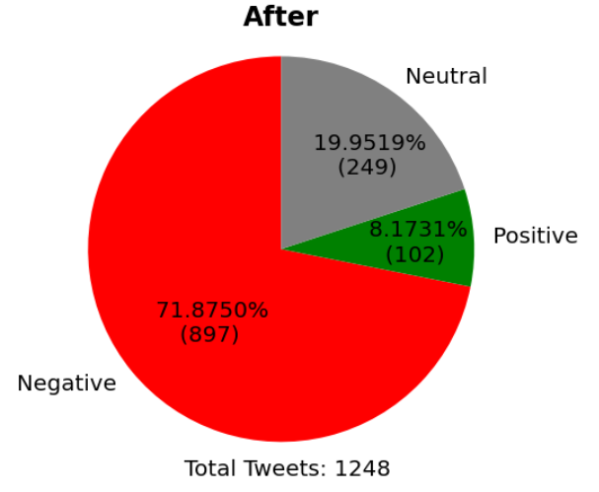
MAX BRT Service Change Evaluation (Cont’d)

Slide 13
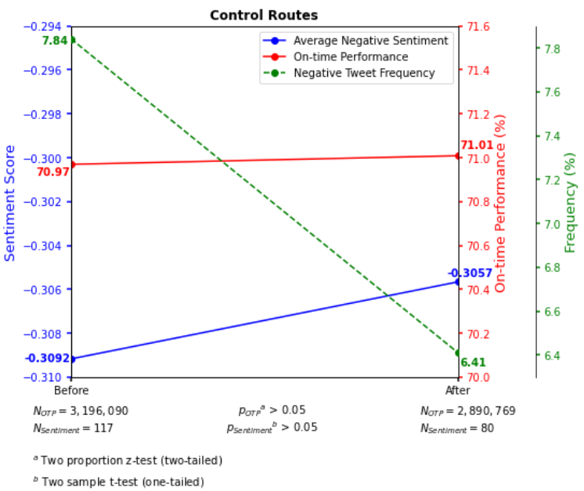
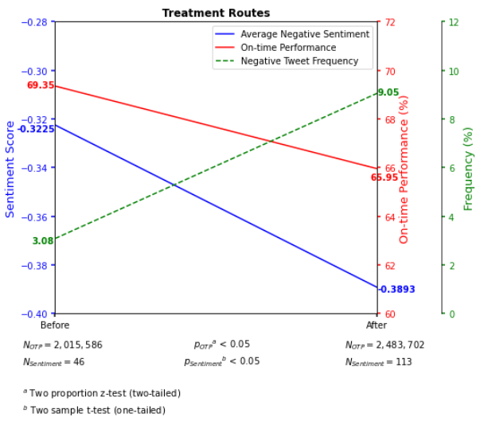
MAX BRT Service Change Evaluation (Cont’d)

Slide 14
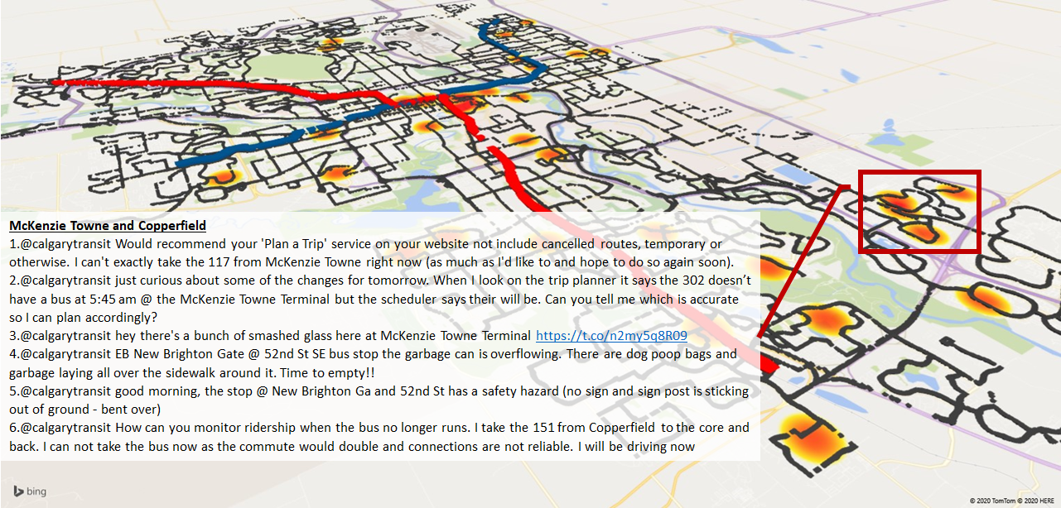
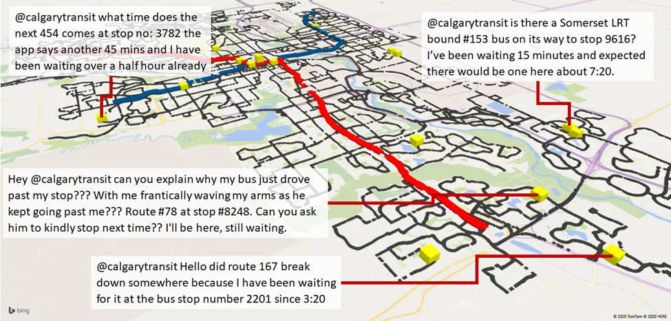
Incident Detection from Eyewitness Tweets
Kabbani, O. (2020). Leveraging Twitter Data to Support Transit Planning and Operations (Master's thesis). Retrieved from https://tspace.library.utoronto.ca
Kabbani, O. (2020). Leveraging Twitter Data to Support Transit Planning and Operations (Master's thesis). Retrieved from https://tspace.library.utoronto.ca

Slide 15
Conclusions
Twitter can be used as a complimentary source to help transit agencies with their planning and operations
Can be used for many applications such as:
Understanding the satisfaction levels of riders
Evaluating service changes
Detecting Incidents

Slide 16
Thank you!
Research Partners:

