Slide 1
Navigating the Network:
Understanding Transit Users’ Information-Seeking Behaviour using Trip Planning Data
Lisa Li, MASc.
TAL Research Day – July 6th, 2021

Slide 2
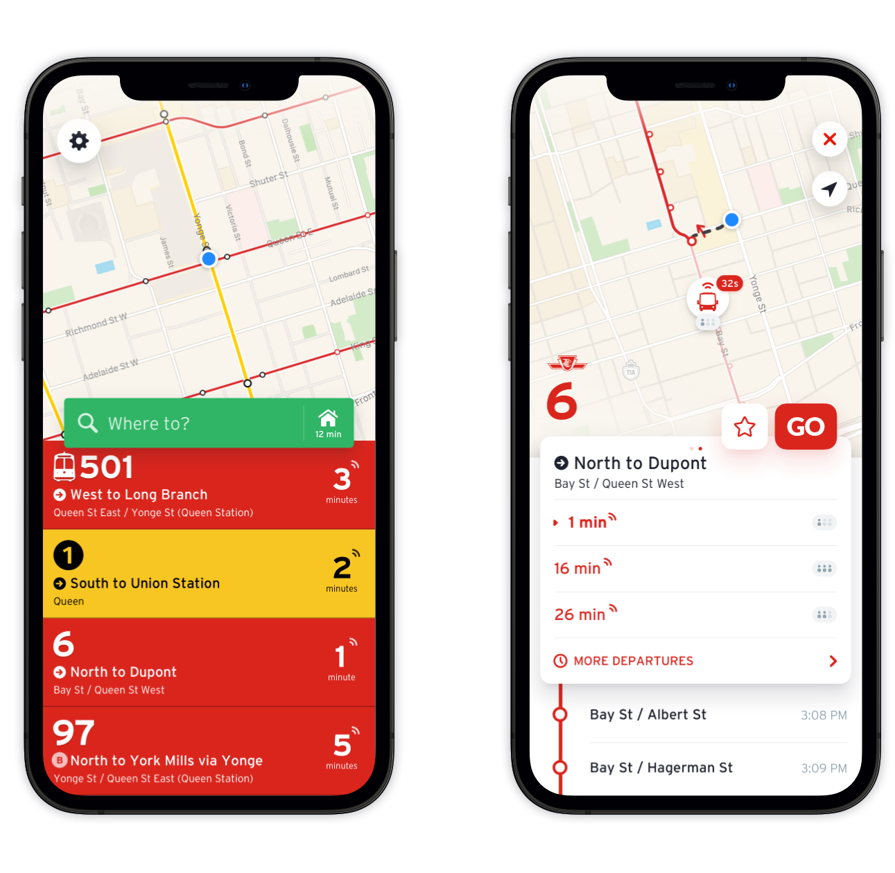
Motivation & Objective
Information provision plays an important role in retaining existing riders and attracting new ones
Previous studies have mainly used data collected from surveys
This study aims at uncovering the factors influencing the use of trip planning apps by travellers
Photo by TTC and Transit / CC BY

Slide 3
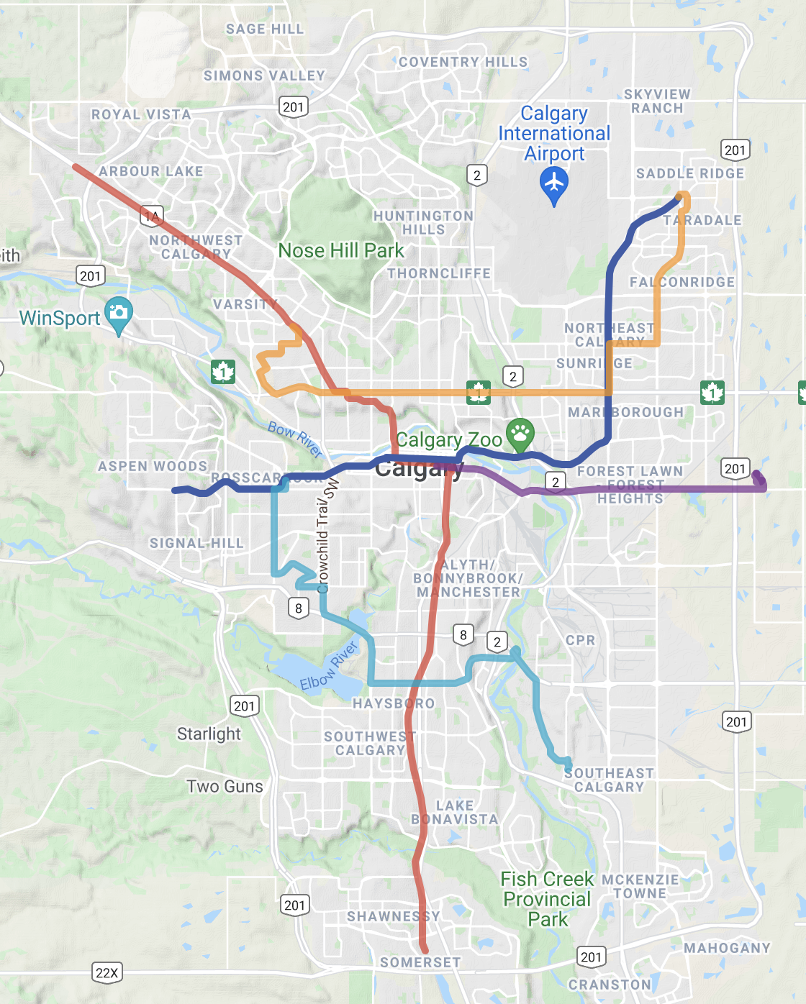
Case Study
Calgary, Alberta
  Transit network comprised of bus routes and LRT system
Time period: Sept. 3, 2018 – Mar. 2, 2019
  On Nov. 19, 2018 Calgary Transit underwent a major network overhaul

Slide 4
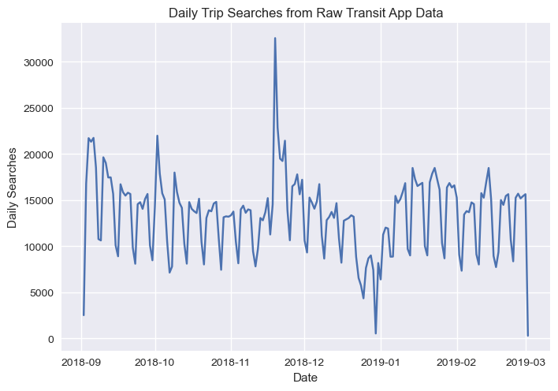
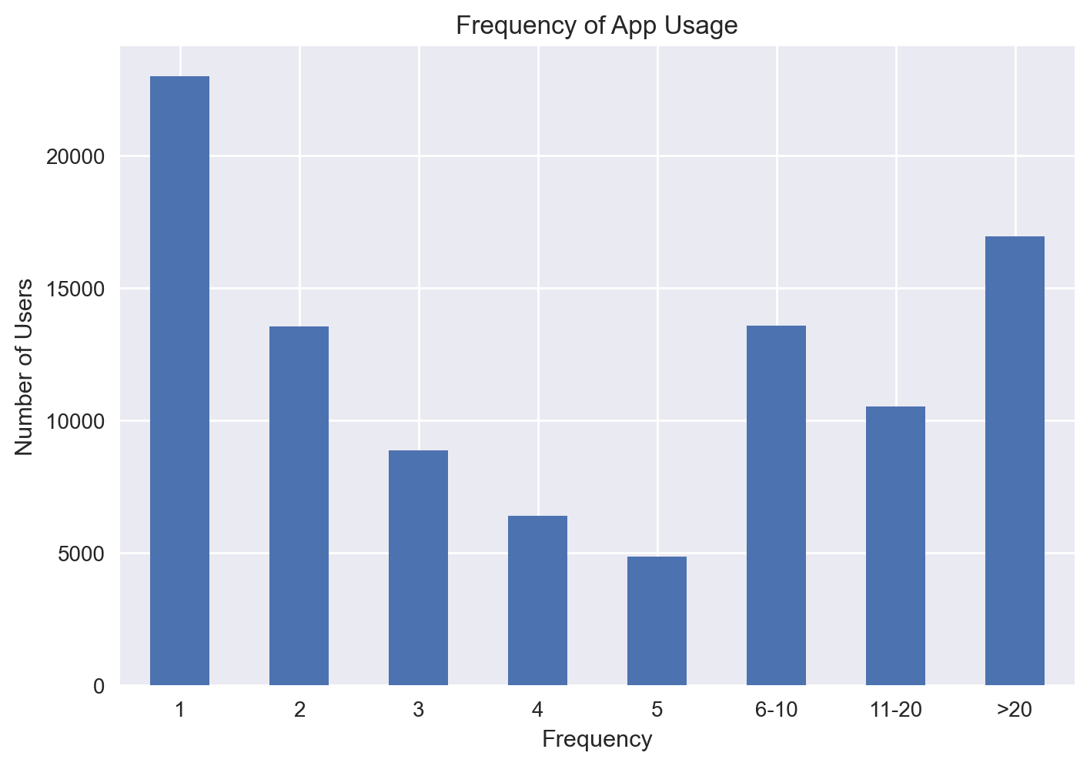
Data
Trip search data was provided by Transit app
  Unique user ID, timestamp, location of trip origin and destination
1,615,908 records and 97,717 unique users after data cleaning

Slide 5
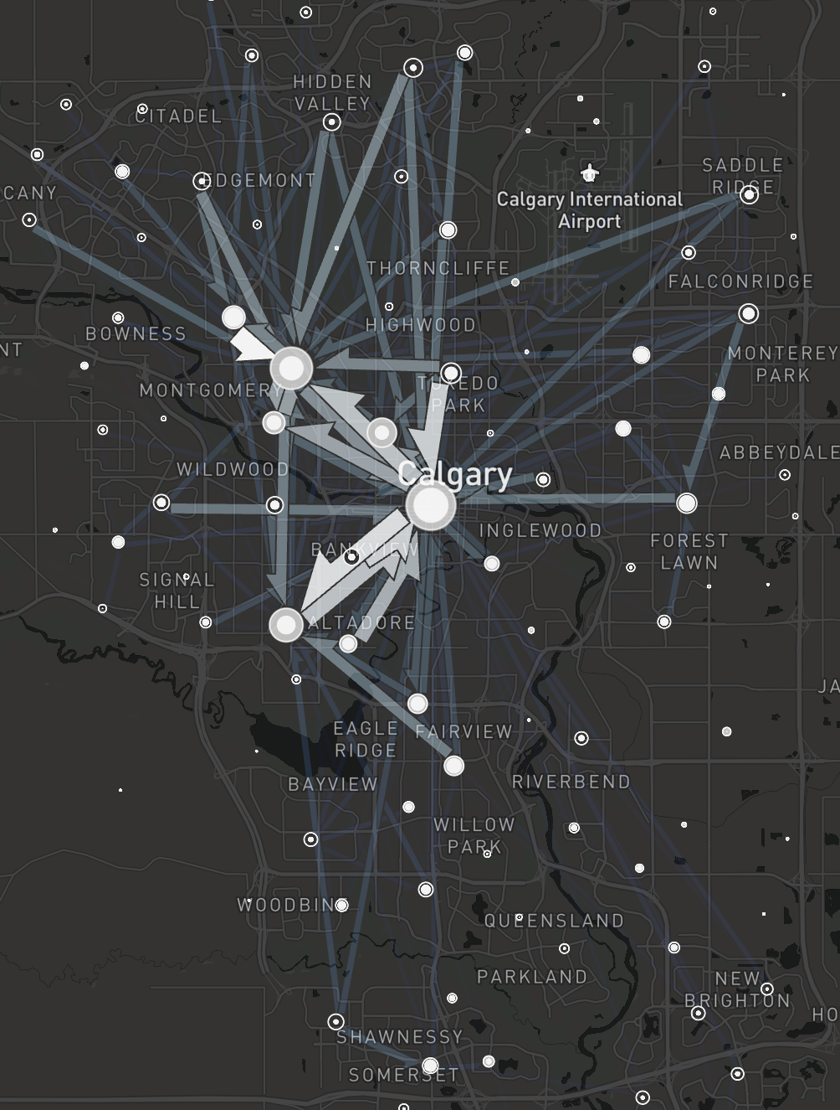
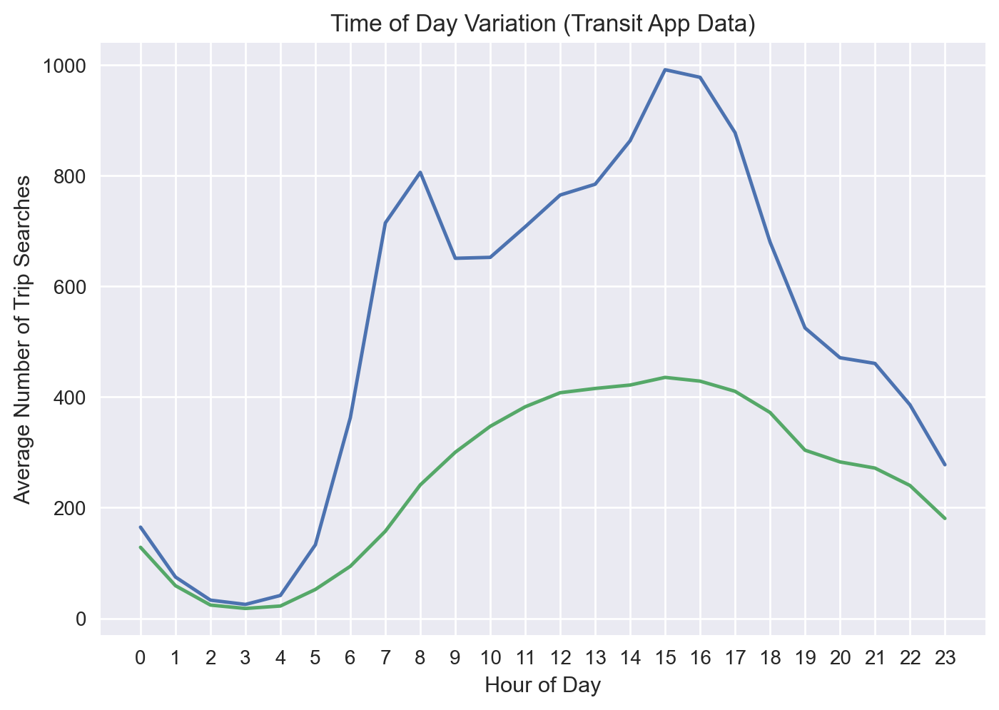
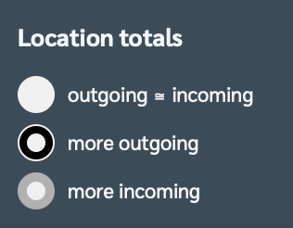
Data Exploration
Spatial Pattern - Weekday AM Peak
Temporal Pattern
Weekday
Weekend

Slide 6
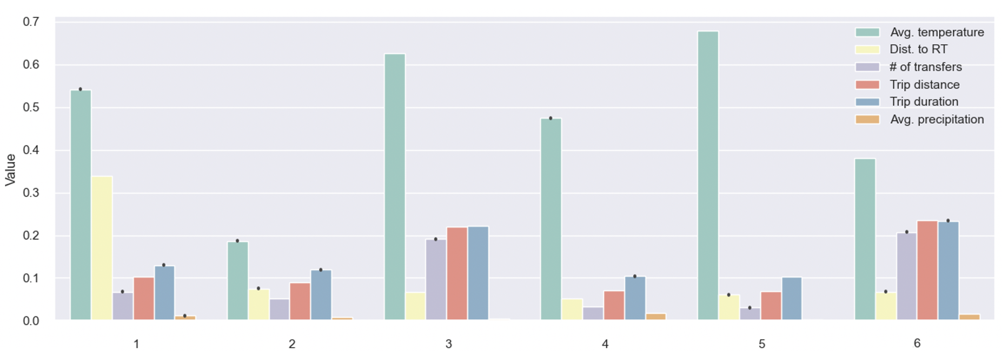
Cluster Analysis of Trip Records
Cluster 1 (10.64%): Short trips where the origin locations are further away from a RT stop
Cluster 2 (12.49%): Short trips during extremely cold temperatures
Cluster 3 (15.91%): Complex trips during mild weather
Cluster 4 (28.68%): Short trips during cooler and rainy/snowy weather
Cluster 5 (21.52%): Short trips during mild weather
Cluster 6 (10.76%): Complex trips during cooler and rainy/snowy weather

Slide 7
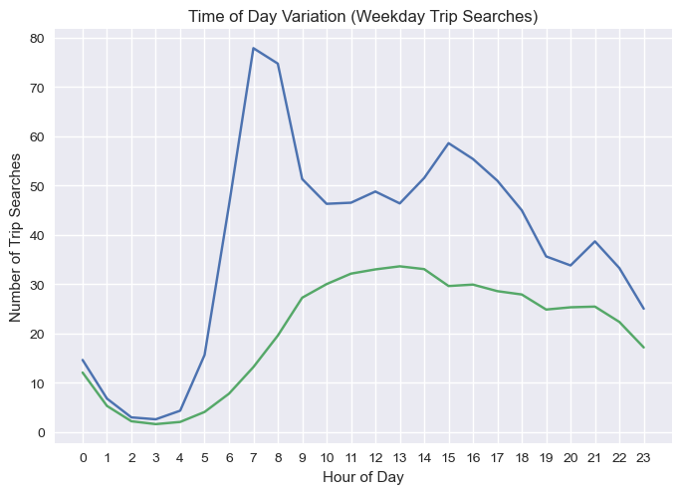
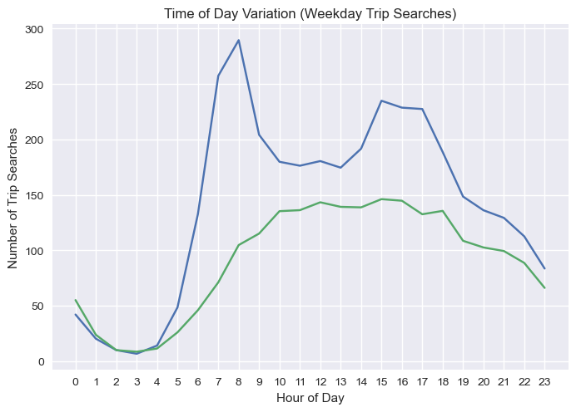
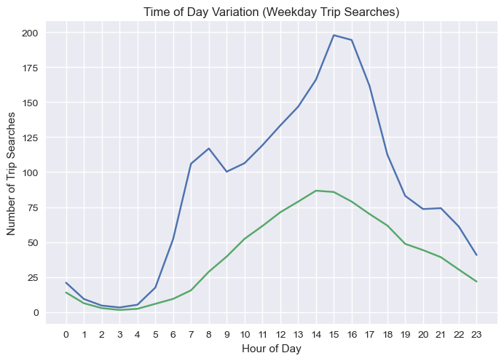
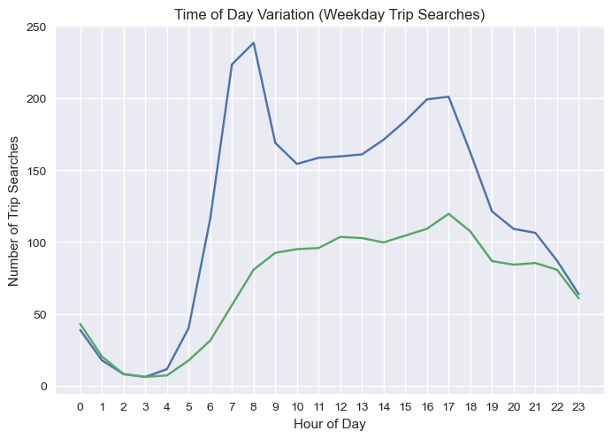
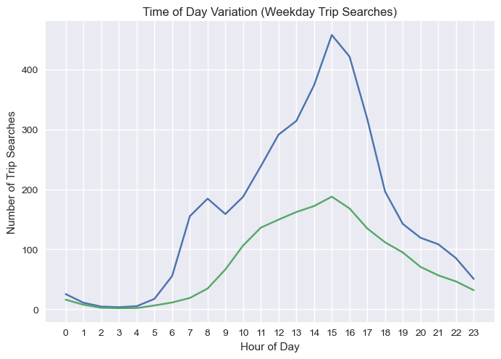
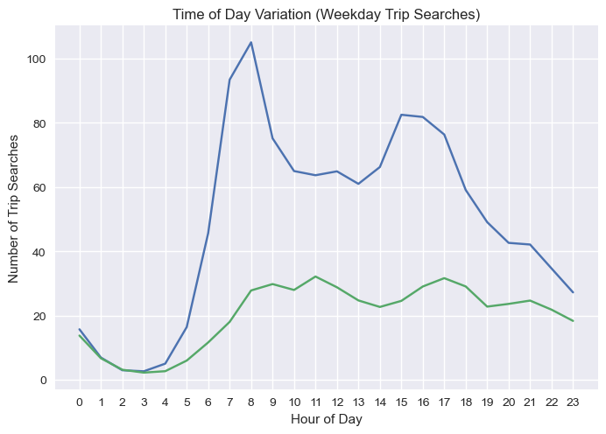
Cluster 1
Cluster 2
Cluster 3
Cluster 4
Cluster 5
Cluster 6

Slide 8
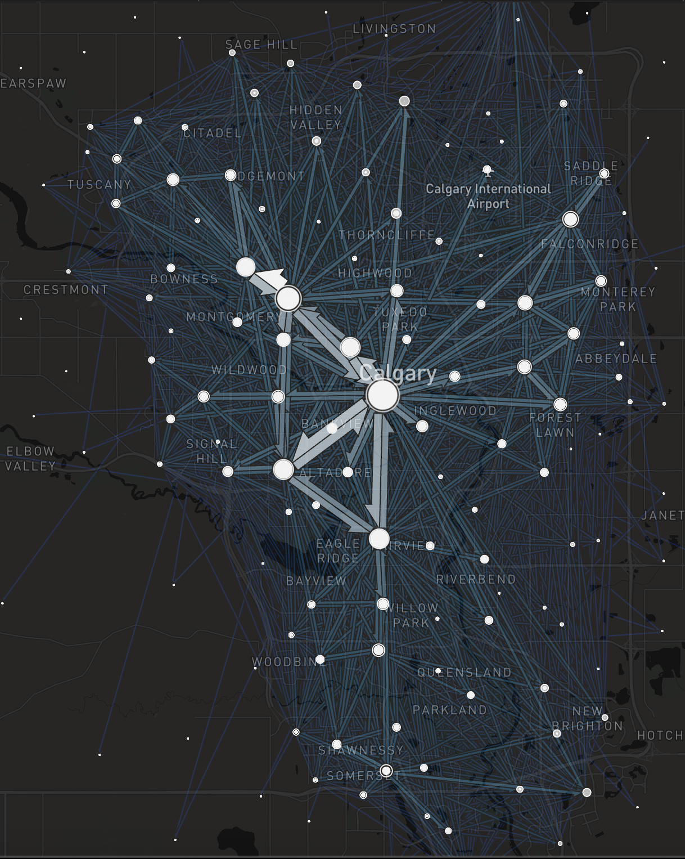
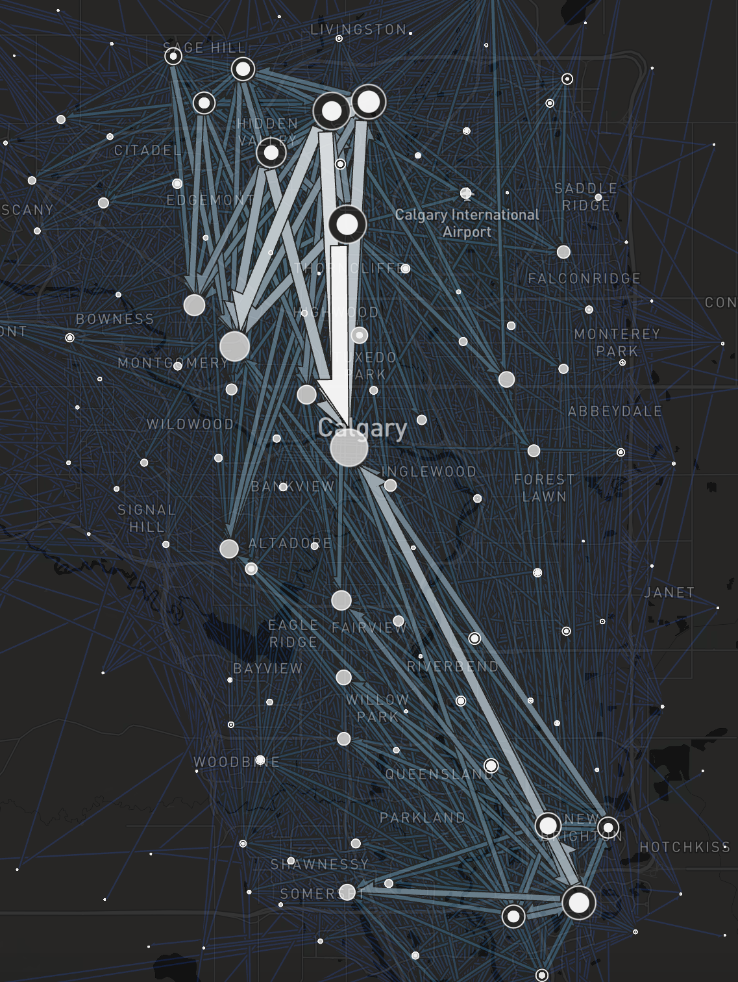
Clusters 2, 3, 4, 5, 6
Cluster 1

Slide 9
Statistical Model
Panel regression model of the hourly number of trip searches originating in a TAZ
  N = 1296 TAZs; T = 4321 hourly intervals
Combined with other data sources (APC, GTFS, historical weather data, 2016 Census) to create variables
TAZ | Timestamp | # of trip searches | APC | Reliability | Avg. temperature | …
104 | 2018-09-03 08:00:00 | 3 | 13 | 0.645 | 7.55 | …
104 | 2018-09-03 09:00:00 | 1 | 11 | 0.670 | 7.35 | …
… | … | … | … | … | … | …
105 | 2018-09-03 08:00:00 | 1 | 2 | 0.635 | 7.55 | …
105 | 2018-09-03 09:00:00 | 0 | 10 | 0.632 | 7.35 | …
… | … | … | … | … | … | …

Slide 10
Results
Fixed effects Poisson regression model
Variable | Estimated Coefficient | Effect Size
ln(APC + 1) | 1 (offset)
On-time performance | -0.702*** | -50.4%
Number of active stops | -0.016* | -1.58%
Avg. temperature (°C) | -0.0018*** | -0.18%
Avg. precipitation (mm) | 0.252*** | 28.7%
Dummy variable for introduction of MAX BRT | 0.361*** | 43.7%
Dummy variable indicating transit disruption | 0.591*** | 80.6%
* p<0.1, ** p<0.05, *** p<0.01

Slide 11
Variable | Estimated Coefficient | Effect Size
Dummy variable for holiday | 0.124*** | 13.2%
Dummy variable for weekend | 0.023 | 2.33%
Dummy variable for AM early (6 – 7 am) | -0.186*** | -17.0%
Dummy variable for AM late (8 – 9 am) | 0.038** | 3.86%
Dummy variable for midday (9 am – 3 pm) | 0.390*** | 47.7%
Dummy variable for PM early (3 – 4 pm) | 0.167*** | 18.2%
Dummy variable for PM crown (4 – 5 pm) | 0.245*** | 27.8%
Dummy variable for PM late (5 – 6 pm) | 0.327*** | 38.6%
Dummy variable for evening (6 – 10 pm) | 0.440*** | 55.2%
Dummy variable for overnight (10 pm – 6 am) | -0.07* | -6.75%
* p<0.1, ** p<0.05, *** p<0.01

Slide 12
Variable | Estimated Coefficient | Effect Size
Dummy variable for holiday | 0.124*** | 13.2%
Dummy variable for weekend | 0.023 | N/A
Dummy variable for AM early (6 – 7 am) | -0.186*** | -17.0%
Dummy variable for AM late (8 – 9 am) | 0.038** | 3.86%
Dummy variable for midday (9 am – 3 pm) | 0.390*** | 47.7%
Dummy variable for PM early (3 – 4 pm) | 0.167*** | 18.2%
Dummy variable for PM crown (4 – 5 pm) | 0.245*** | 27.8%
Dummy variable for PM late (5 – 6 pm) | 0.327*** | 38.6%
Dummy variable for evening (6 – 10 pm) | 0.440*** | 55.2%
Dummy variable for overnight (10 pm – 6 am) | -0.07* | -6.75%
* p<0.1, ** p<0.05, *** p<0.01

Slide 13
Variable | Estimated Coefficient | Effect Size
Dummy variable for holiday | 0.124*** | 13.2%
Dummy variable for weekend | 0.023 | 2.33%
Dummy variable for AM early (6 – 7 am) | -0.186*** | -17.0%
Dummy variable for AM late (8 – 9 am) | 0.038** | 3.86%
Dummy variable for midday (9 am – 3 pm) | 0.390*** | 47.7%
Dummy variable for PM early (3 – 4 pm) | 0.167*** | 18.2%
Dummy variable for PM crown (4 – 5 pm) | 0.245*** | 27.8%
Dummy variable for PM late (5 – 6 pm) | 0.327*** | 38.6%
Dummy variable for evening (6 – 10 pm) | 0.440*** | 55.2%
Dummy variable for overnight (10 pm – 6 am) | -0.07* | -6.75%
* p<0.1, ** p<0.05, *** p<0.01

Slide 14
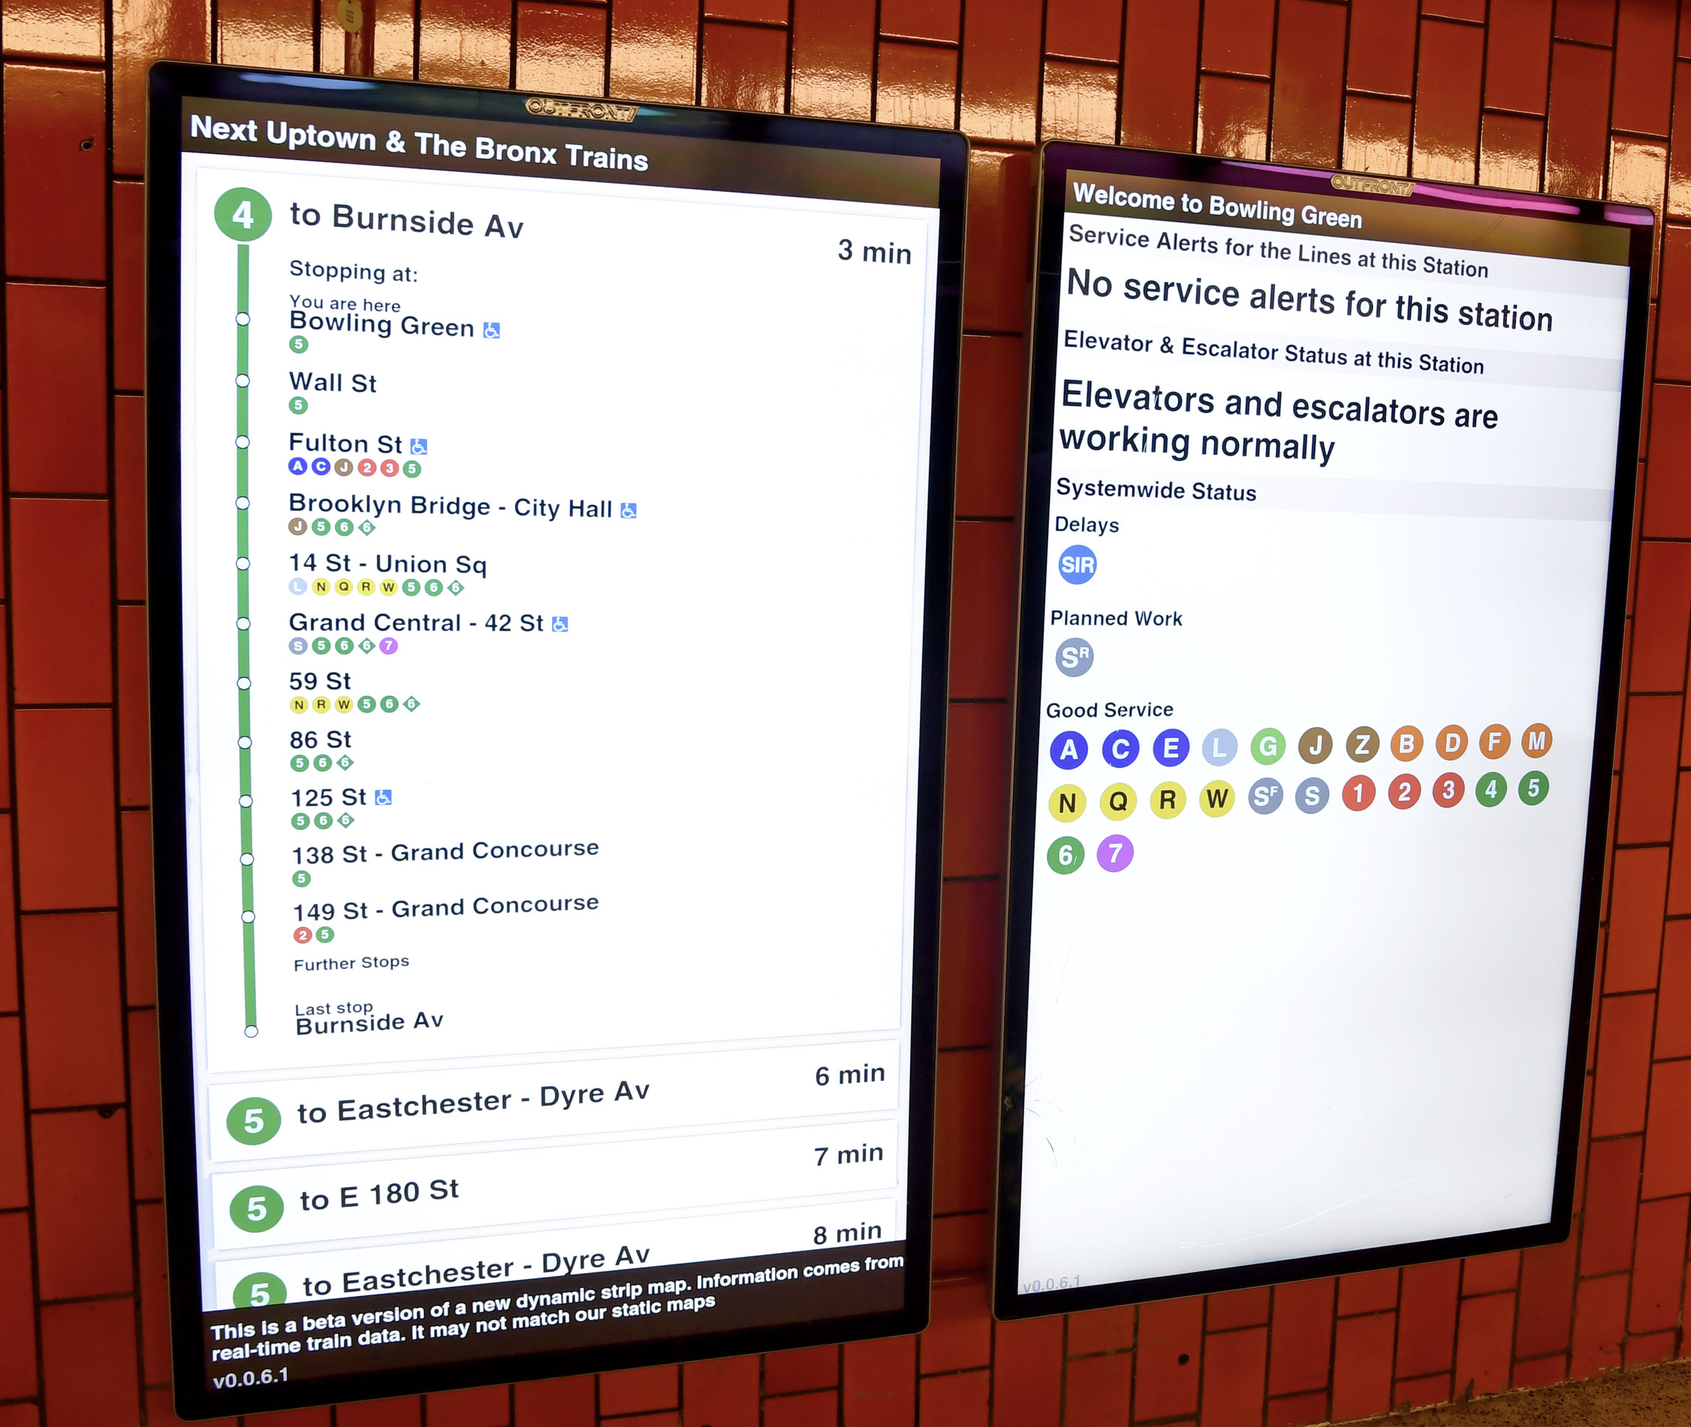
Conclusion
Findings suggest that people are more likely to use trip planning tools for non-discretionary, unfamiliar, and complex trips
People seek out information during times of uncertainty
  Important for agencies to communicate to travelers through multiple information sources during a disruption
Trip search data can be used to help agencies identify where there is a demand for transit
Photo by Marc A. Hermann / CC BY

Slide 15


Acknowledgements

Slide 16
Questions

