Slide 1
Data-driven analysis of service reliability and its determinants: machine learning approach
Diego da Silva, Ph.D.
Amer Shalaby, Ph.D.,P.Eng

Slide 2
Focus and objective
To explore São Paulo transit data through ensemble methods and explainable artificial intelligence to quantify and identify factors impacting bus service reliability measures.
How can factors affecting service reliability be quantified?
What are the most relevant factors?
How does one obtain insight through service reliability categories?
How does one understand the main difference among factors per service frequency?
Is it possible to build a framework to address multiple levels analysis (stop, route, system)?

Slide 3
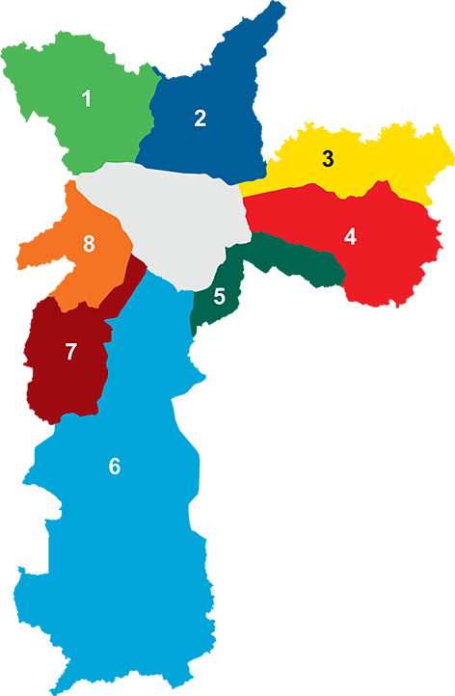
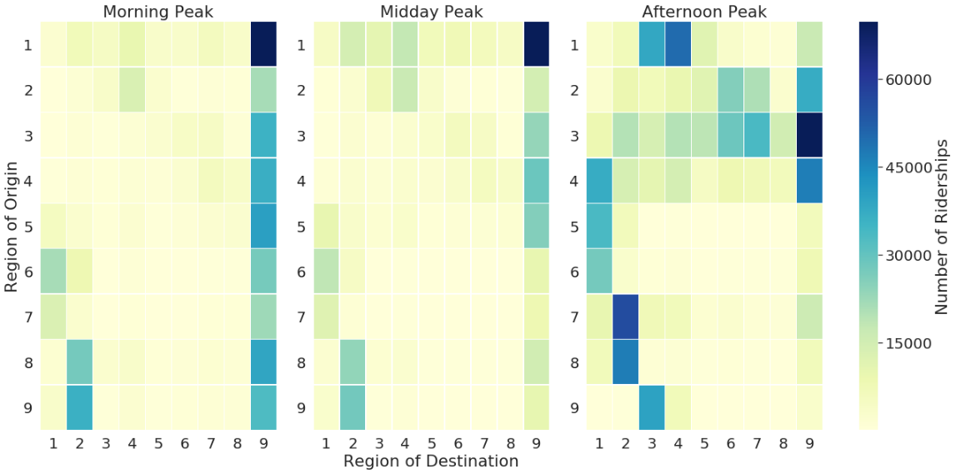
São Paulo - Brazil
Morning Peak
Midday Peak
Evening Peak
Palma ratio
9
SP
9.8
BH
7
Region of Origin
RJ
2.5
Region of Destination
11,3 million people
1,521 km2
1,317 bus routes
14,000 vehicles
6 million pax/day
4,550 km road grid
São Paulo is the most unequal city in Brazil when analyzing job access within 30 minutes of walking. [1]
Most unlinked trips per passenger are concentrated at Region 9 (Central).
Region 9 is an essential hub of services, job opportunities, transit transfer and connection to other regions.
[1] Pereira, R. H. M., Braga, C. K. V., Serra, B., and Nadalin, V. (2019). Desigualdades socioespaciais de acesso a oportunidades nas cidades brasileiras, 2019. Texto para Discussão IPEA, 2535.

Slide 4
Method
The original dataset was collected from Jan to Sep 2017 for 1,317 routes, 14,000 bus vehicles every 20 seconds, which comprised more than 50 millions trips. Although machine learning methods are concerned about prediction, we use it as a quality validation for each model design and feature selection.
GTFS
Graph
Network
Tree-based model and SHAP values
SHAP values explanation
Headway and Travel Time Distribution
Wait and travel time measures
- GTFS conversion to Graph Network [3]
- Travel time interpolation for each node
- Link distance
- Headway computation for the entire graph
- Data engineering
- Spatial and temporal aggregation (daily)
- Data enrichment
- EDA
- Compute reliability measures: Expected wait time (E[W]), Excess wait time (EWT), 95th percentile (W_{95%}), Potential wait time (W_{potential}), RBT, TT_{95%}
- Spatial and frequency segmentation
- CatBoost regression model, RMSE and MAPE scores
- TreeSHAP values per feature and per row
- TreeSHAP distribution to obtain mean for each feature
- Feature, aggregation
- Multi-level explanation: stop, route and system
[3] Morais, M. A. and R. D. Camargo. “A Framework for Scalable Data Analysis and Model Aggregation for Public Bus Systems.” (2019).

Slide 5
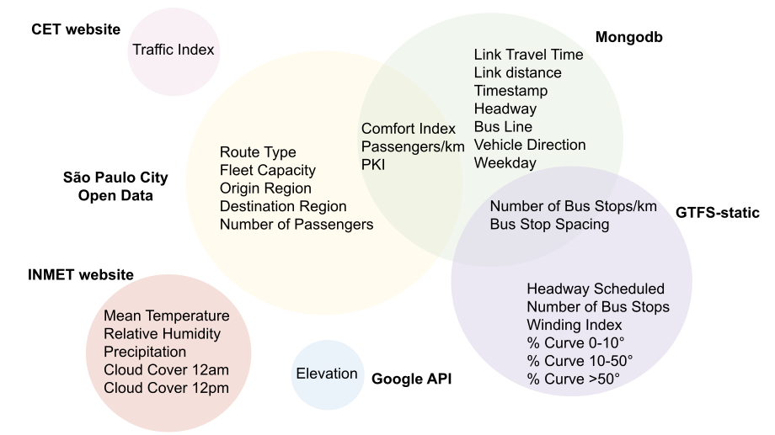
Feature engineering and data enrichment
Several data sources were used to derive the set of features describing the public transit service. The significant research effort was on data engineering/ feature selection, which provided numerous novelty techniques to work with large transit data.
Source | Data description
MongoDB | AVL data from Jan to Sep 2017 of all buses and routes every 20 seconds.
GTFS-static | Transit Agency wesite
Google Elevation API | Elevation data per route segment
National Institute of Meteorology (INMET) | Weather data from Jan to Sep 2017
São Paulo City Open Data | Transit Agency operation and demand data per route
São Paulo Traffic Enginering (CET) website | Congestion Index from Jan to Sep 2017

Slide 6
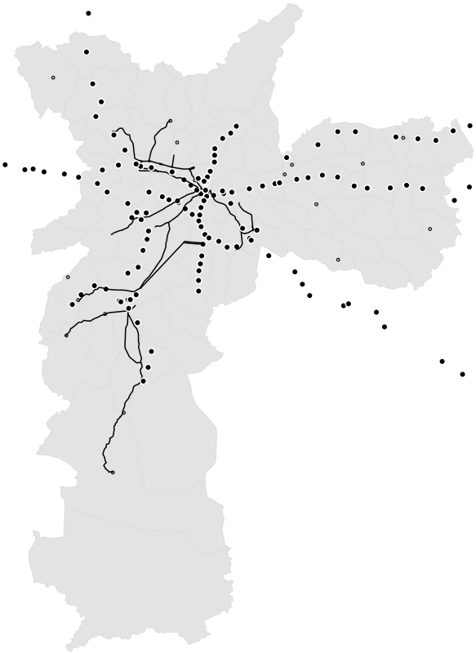
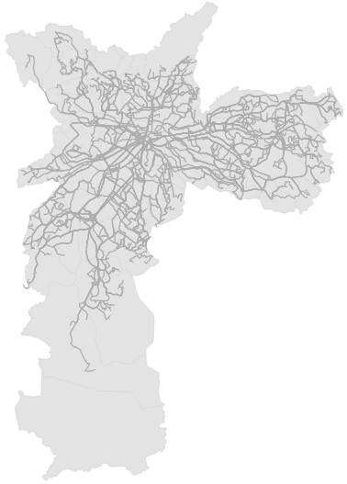
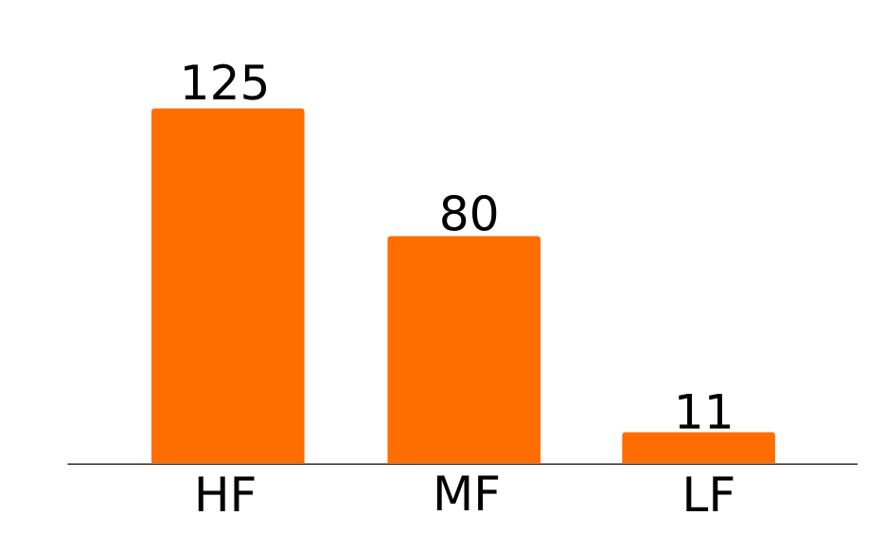
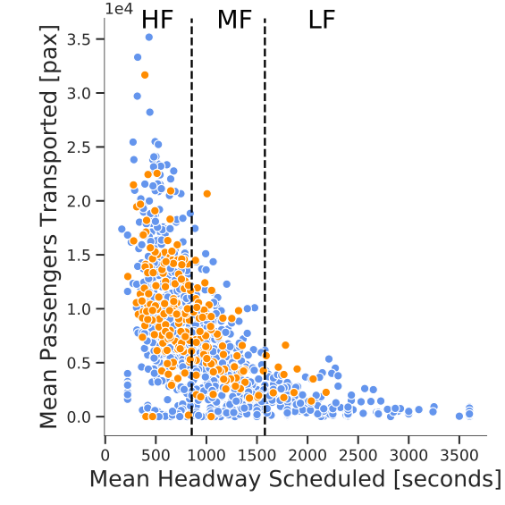
Data sampling
By 2017, São Paulo had 1,317 routes, and our route selection was carefully done by using several data engineering techniques to encompass the main transit service, route description, and demand characteristics. The sample comprised 216 bus routes and approximately 5 million trips.
Sample per service frequency
Mean Pax/day per bus route
Frequency threshold:
High-frequency (HF) ≤ 14 min
14 min < Medium-frequency (MF) ≤ 27 min
Low-frequency (LF) > 27 min
Transit System
Sample
Bus routes
Sample

Slide 7
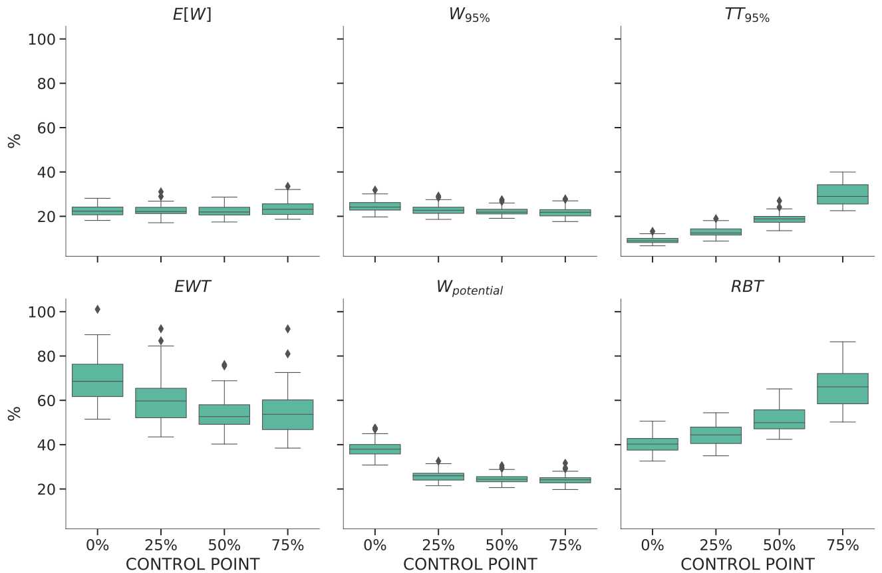
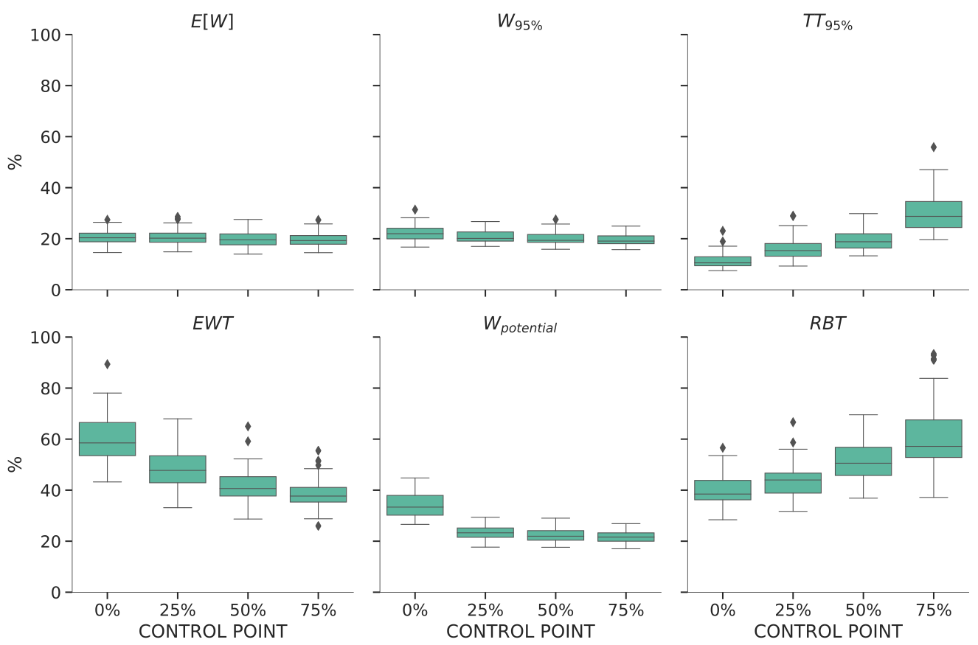
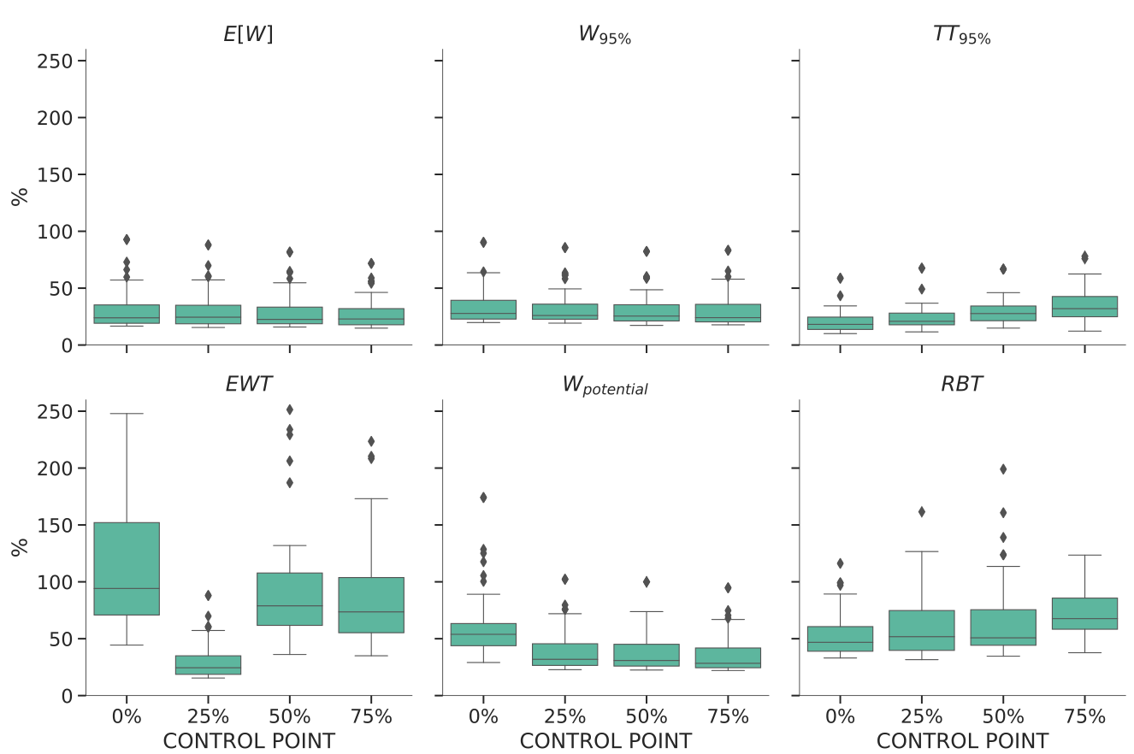
Key findings and aplicability
The reliability measures that capture wait and travel time variability had a lower performance when compared with measures that included mean, median, percentile terms on their equations (E[W], W_{95%}, TT_{95%}). Moreover, the prediction error showed that it varied across spatial aggregation and service frequency.
MAPE* Overall
MAPE High-frequency
MAPE Low-frequency
*MAPE = Mean absolute percentage error

Slide 8
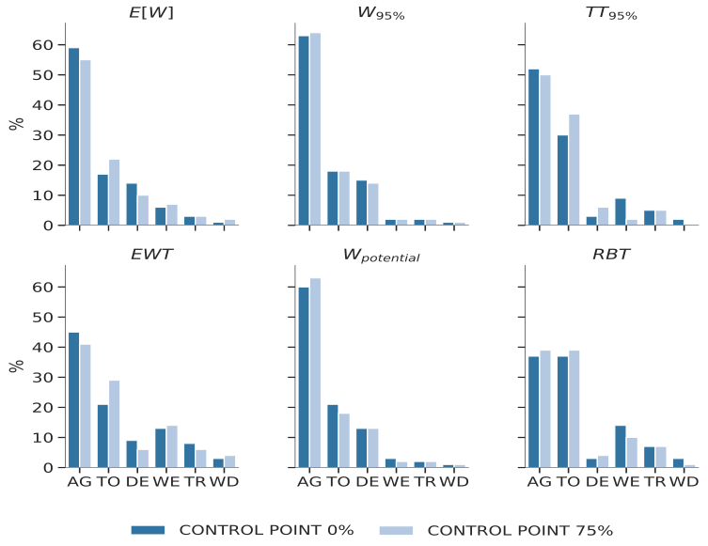
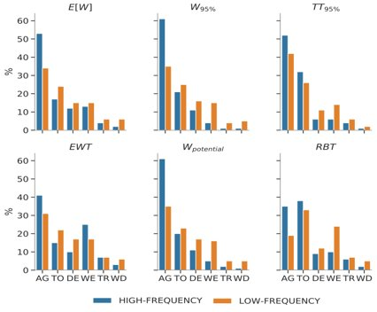
Key findings and aplicability
Once we calculated the TreeSHAP for each feature and prediction row in our cross-validation dataset, it was possible to observe the TreeSHAP distribution. For each spatial aggregation and service frequency we calculated the mean and computed the relative (%) effect on wait and travel time prediction and grouped features into six categories.
Overall result (%) by category
Service Frequency result (%) by category
Acronyms:
AG=Agency Service
TO=Topology
DE=Demand
WE=Weather
TR=Traffic
WD=Weekday
[4] Lundberg, S. M., Erion, G. G., Chen, H., DeGrave, A., Prutkin, J. M., Nair, B.,Katz, R., Himmelfarb, J., Bansal, N., and Lee, S. (2019). Explainable AI for trees:From local explanations to global understanding.CoRR, abs/1905.04610.

Slide 9
Lessons learned and future directions
Previous studies on service reliability relied on small datasets, representative samples, and models with low performance and poor generalization.
New perspective and insights to deal with service reliability and transit data at scale.
In São Paulo, the whole system is frequency-based and the framework could distinguish high-frequency and low-frequency patterns.
Although the expected impact of Agency Service category on service reliability, we could also observe that exogenous categories had at least 40% influence on the wait and travel time variability.
Transit agencies can add more features and apply the framework to evaluate different service reliability measures performance.
Agencies can also use the patterns identified on spatial aggregation and frequency segmentation for quality service decision-making.
The next feasible step is city comparison and aggregate new features to evaluate model stability.

Slide 10
Questions
Partners:
Brazilian Council for Scientific and Technological Development

