Slide 1

Using Delay Logs and Machine Learning to Support Passenger Railway Operations
Willem Klumpenhouwer, PhD | Amer Shalaby, PhD PEng
TAL Research Day | July 6, 2021
Photo Credit: Tony Yeung

Slide 2
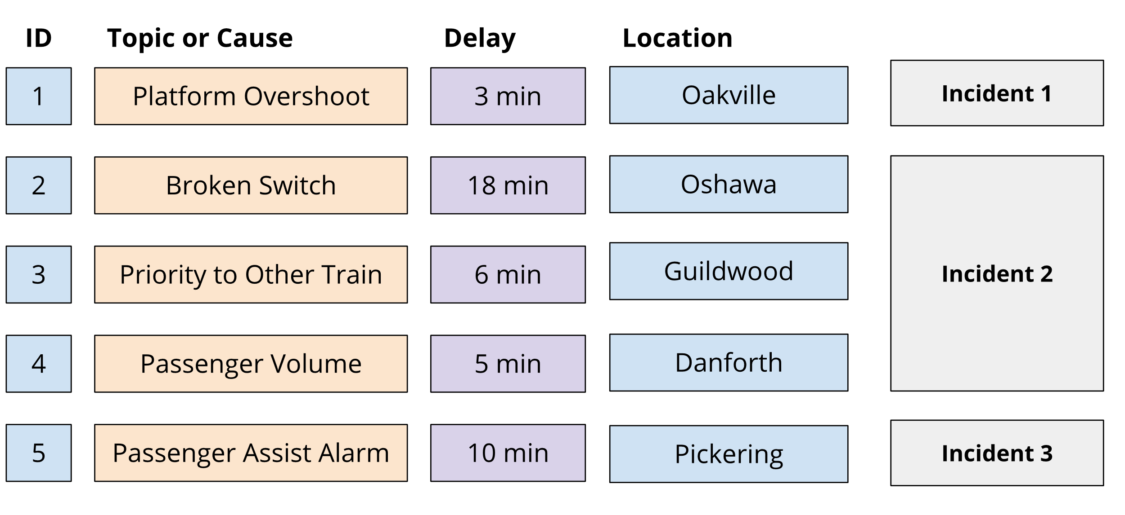

Logs, Events, and Incidents
Klumpenhouwer & Shalaby
Using Delay Logs and Machine Learning to Support Passenger Railway Operations

Slide 3
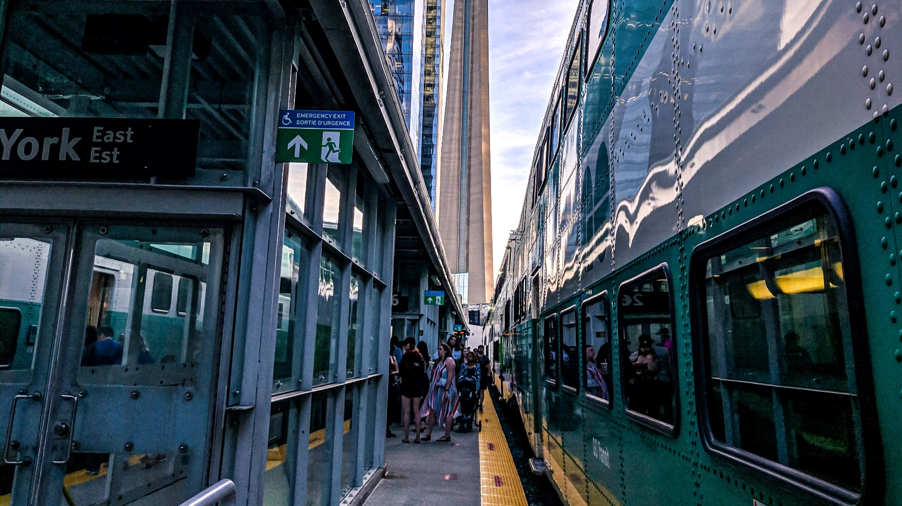
Research Questions
Where do delays occur on the railway network?
What types of delays are most common or largest?
How are delays connected on the network?
Can we provide historical context to an emerging incident?
Can we make predictions about emerging incidents?
Klumpenhouwer & Shalaby
Using Delay Logs and Machine Learning to Support Passenger Railway Operations
Photo Credit: Udayaditya Barua

Slide 4
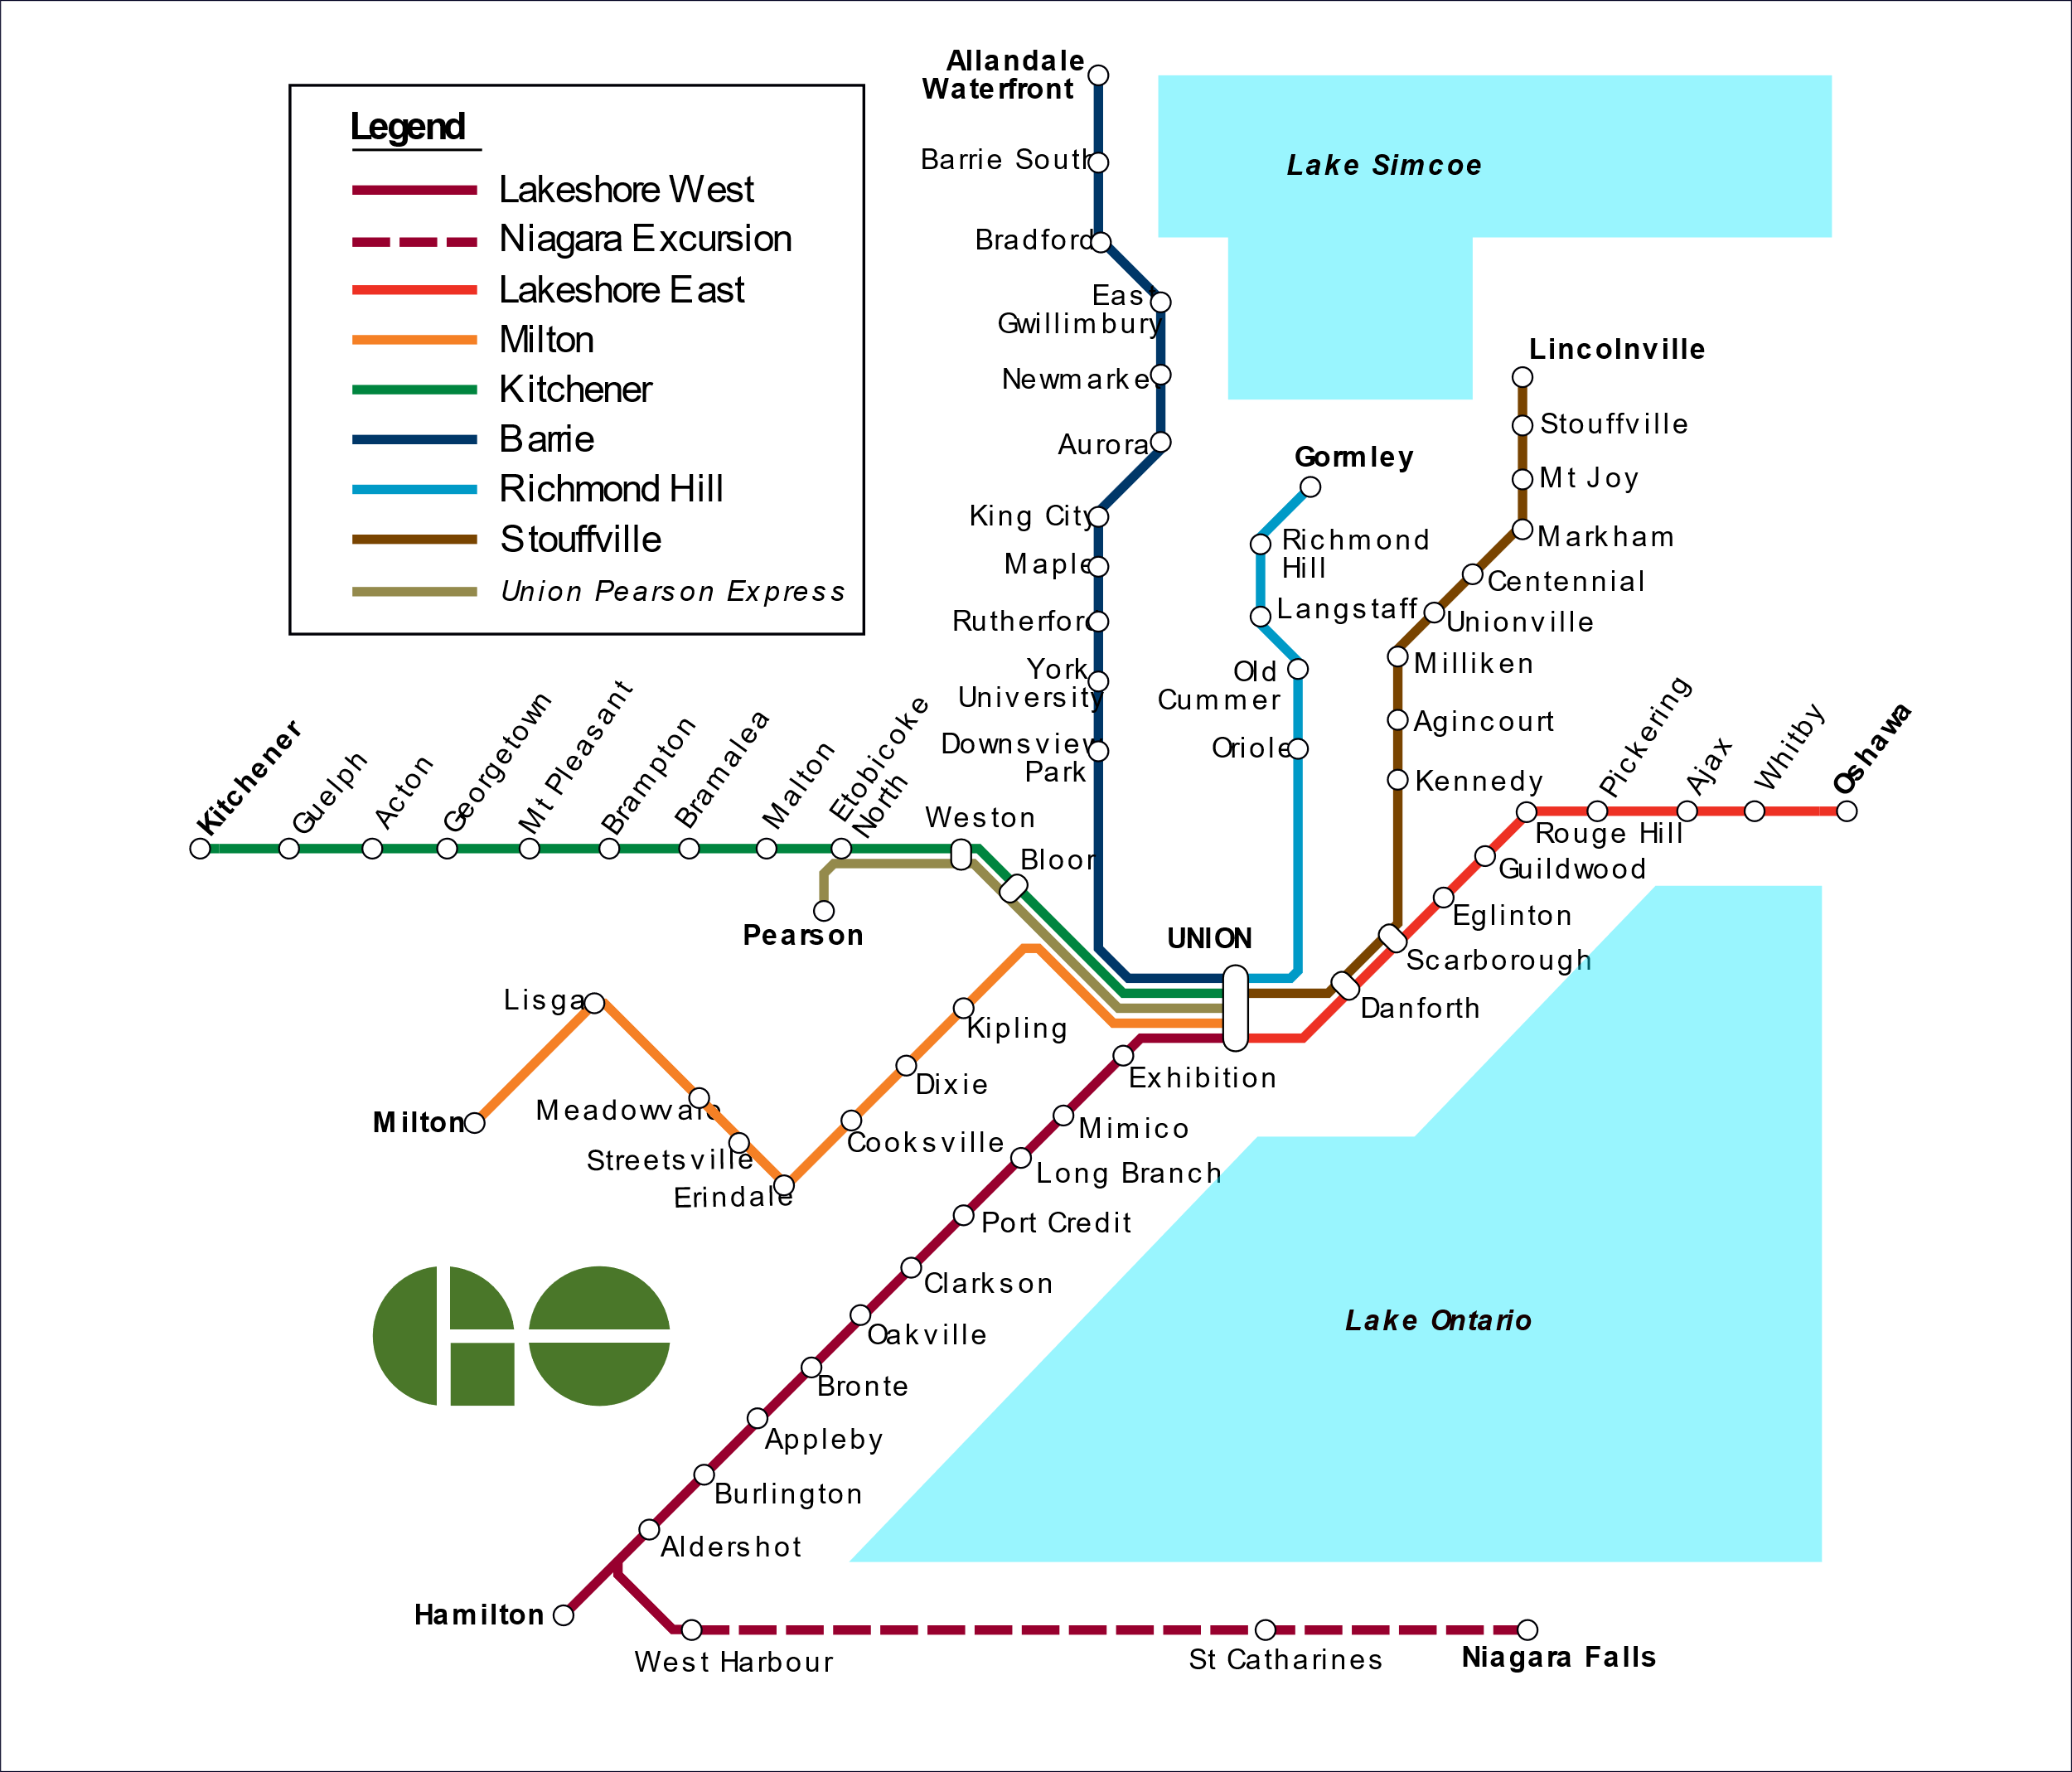
Map Credit: Natural RX (Wikimedia)

Slide 5
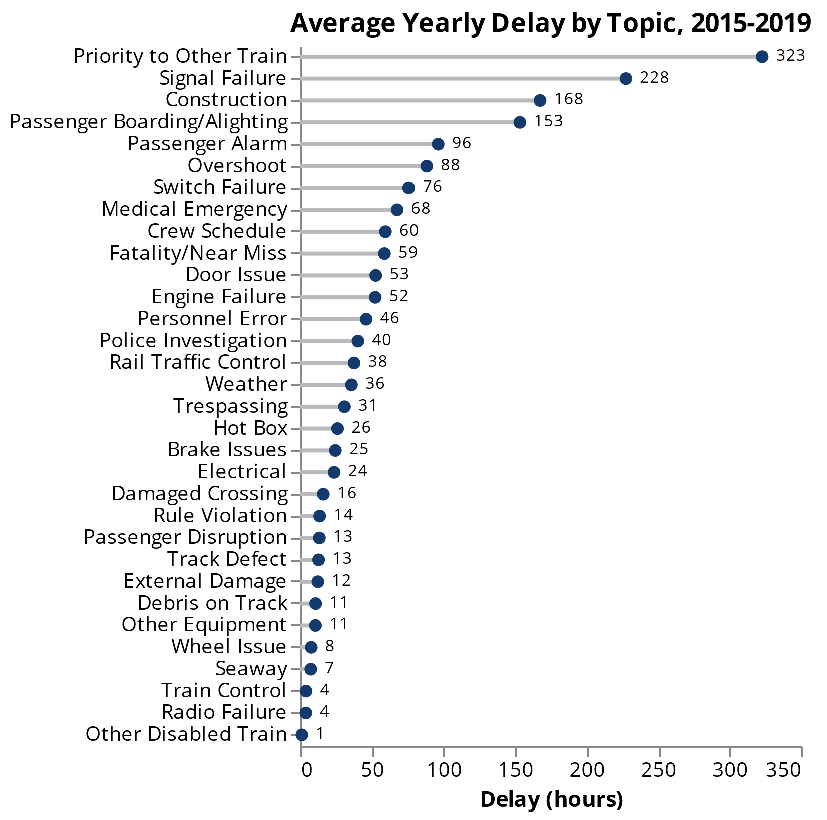
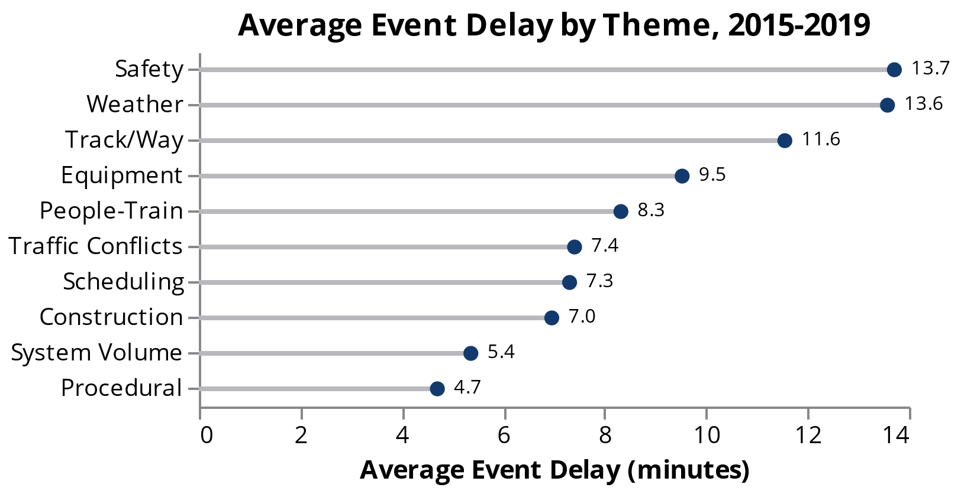
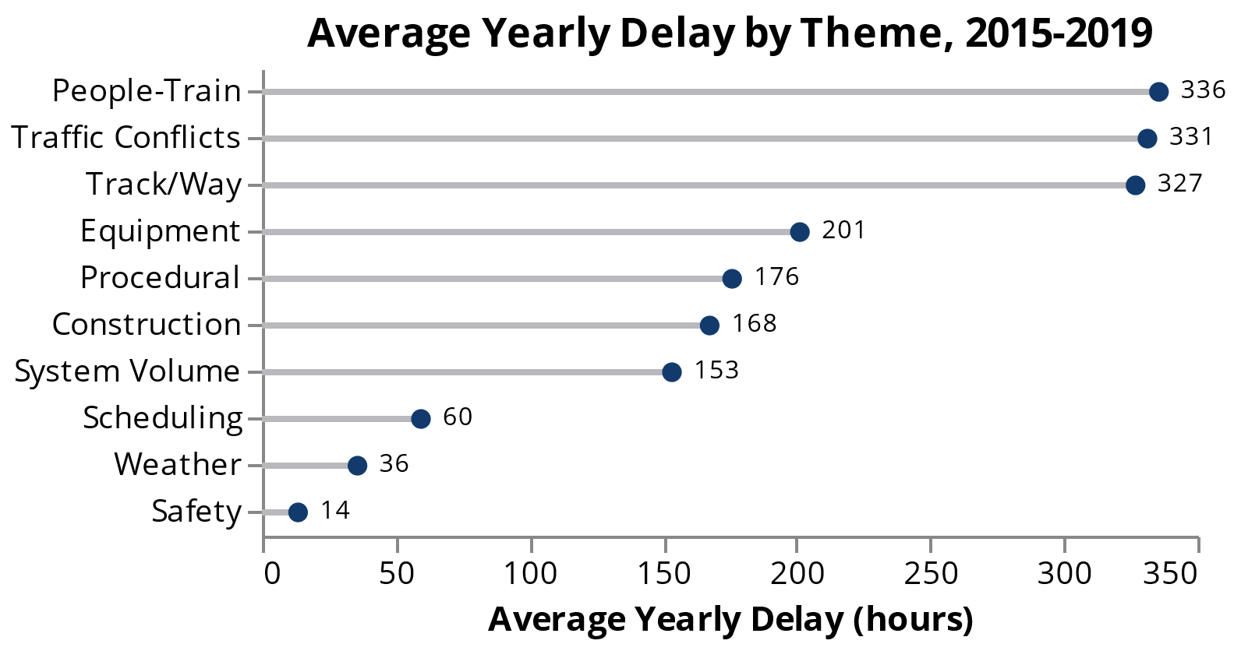
Summary Stats
70,904 categorized delays, 2015-2019

Slide 6
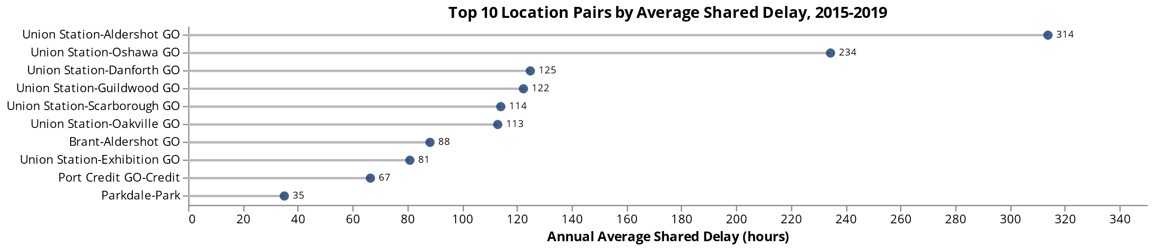
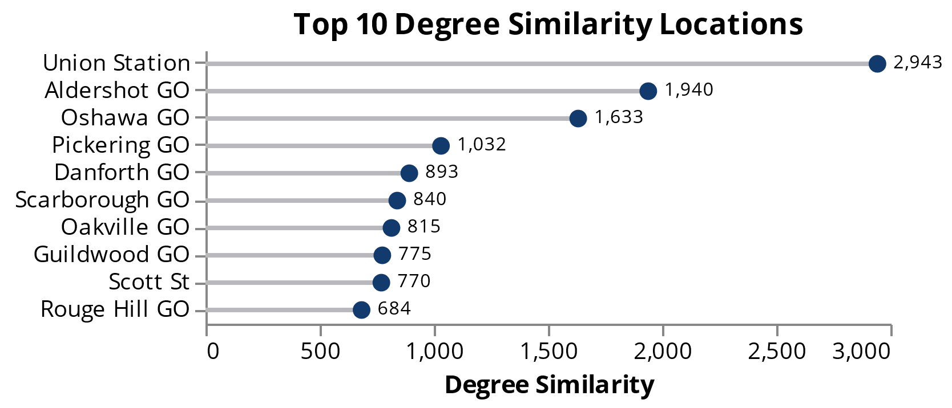
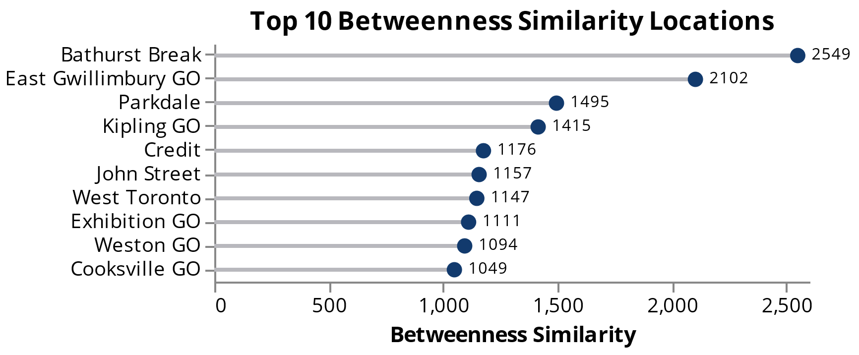
Connecting Locations Through Delay
Two locations are “connected” if they both show up in an incident
Degree
How much a node acts as an “influencer” with others
Betweenness
How much a node acts as a “bridge” between others

Slide 7
Topic Modelling
…was delayed 6 minutes at Clarkson GO due to operational issue. Heavy passenger offloading.
…5 minutes departing Danforth GO due to a platform 5ft overshoot…
…cancelled acct … running on T-2 due to congestion resulting from severe weather
overshoot | platform | reverse | required | foot | Platform overshoot
alarm | false | coach | problem | priority | Priority passenger alarm
via | late | wait | follow | train | Following a late VIA train
wait | volume | exhibition | crew | heavy | Heavy volumes at Exhibition GO
switch | pnr | signal | issue | advise | Switch/Signal maintenance issue

Slide 8
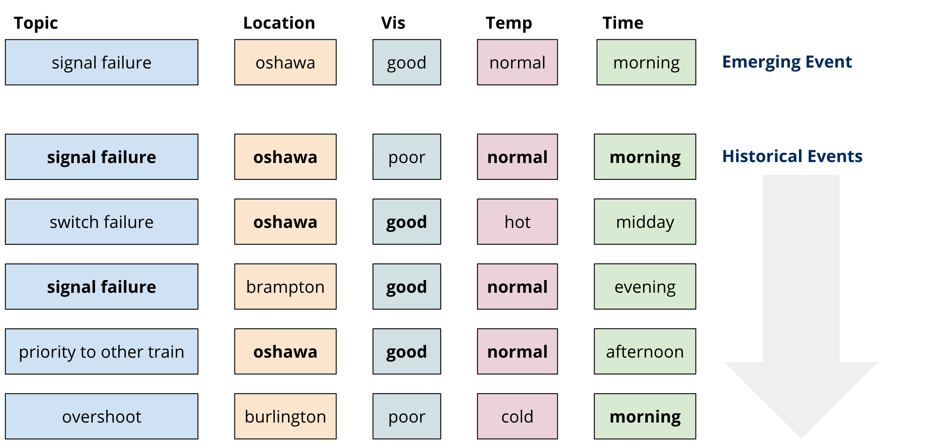
“Recommending” Historical Events
Find similar previous events that lend context to the current situation

Slide 9
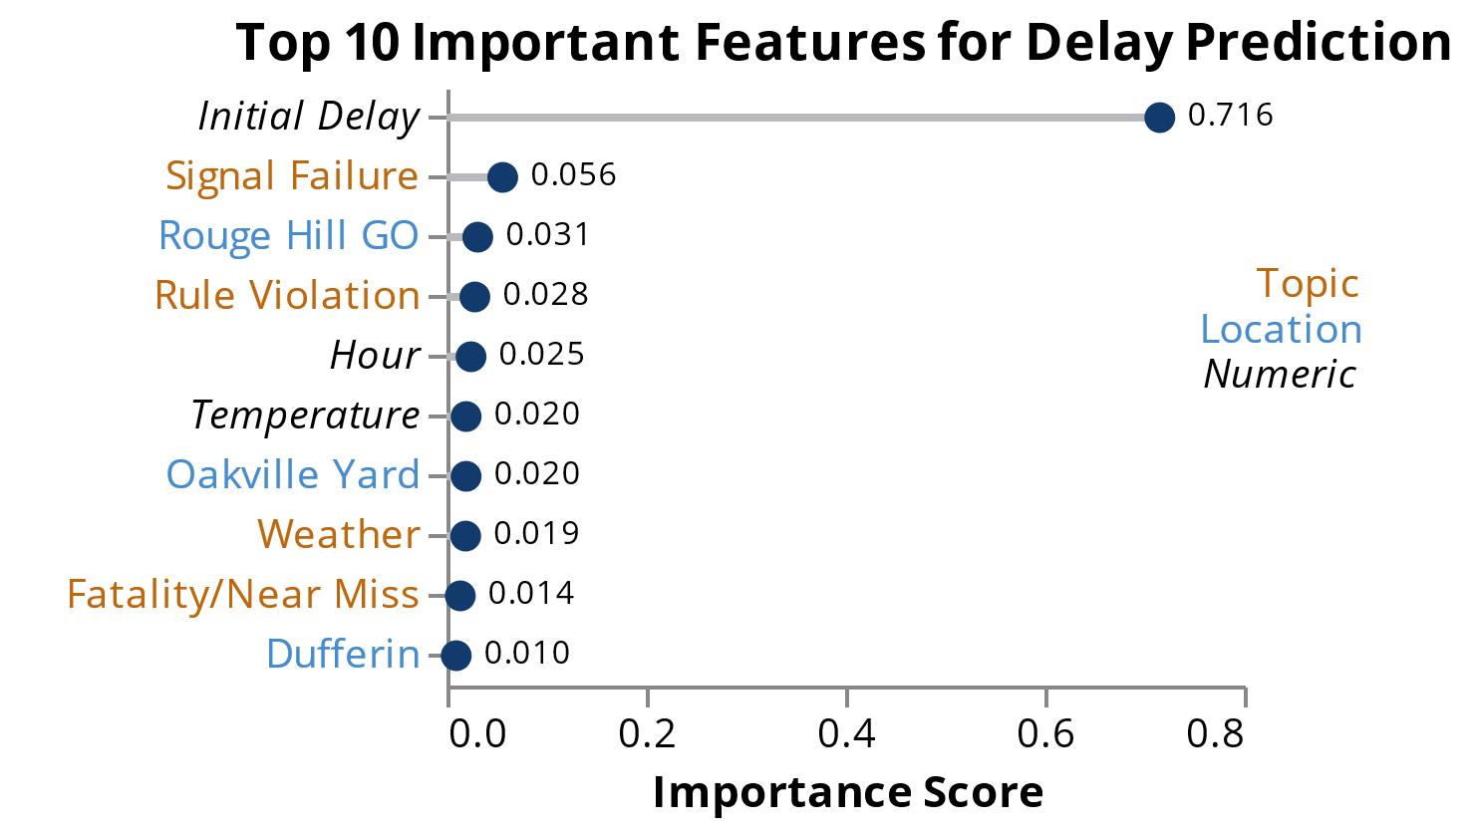
Making Predictions
Can we use information from the initial delay event to make predictions about the resulting incident?
Prediction Method | Score (Mean Squared Error)
Random Forest Regression | 565
Departure Delay | 1028
Median Delay | 953
Mean Delay | 821

Slide 10
Next Steps
Combining delay logs and location-based data (GPS)
Studying network effects and delay propagation
Using historical incidents to run response scenarios
Developing on-the-fly prescriptive methods
Klumpenhouwer & Shalaby
Using Delay Logs and Machine Learning to Support Passenger Railway Operations
Photo Credit: Udayaditya Barua

Slide 11
Questions?
Partners: Metrolinx
Photo Credit: Tony Yeung

