Slide 1
DASh-BUS: A Toolkit for Deployment and Assessment of Shuttle Buses Strategies
Alaa Itani, MASc. Aya Aboudina, PhD Siva Srikukenthiran, PhD Ehab Diab, PhD Amer Shalaby, Ph.D.,P.Eng
Transit Analytics Lab (TAL) Research Day, July 2021

Slide 2
Outline
Background and Objectives
Methodology
Use Cases
Bus Bridging Scenario Assessment
Bus Bridging Optimization

Slide 3
Background
144 unplanned subway closures in 2015
A Total of 6,500 buses were requested
70% of the requested buses were from operational bus routes
Economic cost of major subway passengers’ delay in New York City ~ $389 million annually
DASh-Bus
Notes:
In 2015, TTC dispatched shuttle buses in response to 144 incidents in the subway network
144 unplanned disruptions required the deployment of shuttle buses to bridge the disrupted service between subway stations, and this process is know as bus bridging.
A total of 6,500 buses were requested and assigned to serve as shuttle for subway and streetcar unplanned incidents
70% of the requested buses were from bus divisions (existing operational routes)
New York City comptroller Scott M. Stringer estimated the economic cost of subway passengers’ delay to be around $389 million US annually.
https://comptroller.nyc.gov/reports/the-economic-cost-of-subway-delays/

Slide 4
Background
Major unexpected rail disruptions occur frequently
Often, a simplistic approach is followed for selecting shuttle buses
Can lead to extensive delays for passengers and buildup at stations
Result in degraded service and potential loss of loyal passengers
DASh-Bus

Slide 5
Objectives
Develop a tool to help agencies dispatch shuttle buses and evaluate different scenarios
Provide measures of the impact on train and bus passengers
Provide measure of how well shuttle buses are used
DASh-Bus
Notes:
Evaluation/Assessment and post incident analysis. Testing what if scenarios. Customer perspective and operator’s perspective depicted in the shuttle bus performance

Slide 6
Methodology Overview
Route C
Route A
Route D
Route E
Route B
DASh-Bus
Notes:
DASh-Bus is a macro-simulation model based on deterministic queuing analysis that follows fluid flow approximations
Simulates passengers’ and shuttle buses movement associated with bus bridging plan.

Slide 7
Methodology Overview (Cont.)
Shuttle Buses serving rail passengers
Waiting and travel time based on shuttle service
End of incident and return of buses
Time for dissipating passengers queue
Shuttle buses tracking
DASh-Bus
Notes:
Tracking shuttle buses from their route terminal until they reach their assigned end station, while serving as shuttle, until the incident is over, and buses return to their routes. Uses deterministic queueing analysis to estimate the riders’ delay and shuttle bus movement along the disrupted segment.
The current state of the tool uses shuttle buses from existing operational routes only and it targets the morning peak period. This assumption is valid as stated by TTC, shuttle buses are dispatched from existing operational bus routes.

Slide 8
Use Cases
Bus Bridging Scenario Assessment
➔ DASh-Bus Planner
Bus Bridging Optimization
➔ DASh-Bus Optimizer
Notes:
A macroscopic queuing model was developed and used for estimation of user delays and queue dissipation times.

Slide 9
Use Case #1: Bus Bridging Scenario Assessment

Slide 10
Data Input and Output – DASh-Bus Planner
Incident location and time
Subway Passengers’ Delay
Expected duration of incident
Bus Riders’ Delay
User Specified Input
Detailed measures at disrupted stations
Dispatch time and Demand reduction
DASh-Bus Planner
Longest queue at disrupted stations
Number & assignment of shuttle buses
Detailed impact on each bus route
Transit network characteristics
Shuttle buses performance measures
Data Inputs
Train and bus ridership
Degree of utilization of shuttle buses
Train and bus travel time
Deadhead time of shuttle buses
DASh-Bus
Notes:
Dispatch time: Time needed to report an incident and inform buses to serve as shuttle
Demand reduction ratio reflects the percentage of passengers that will diverge to other modes of travel

Slide 11
Case Study: Assessing an Existing Bus Bridging Plan
Disruption occurred during the morning peak period lasting for 31 min
Closing 6 stations, between Bloor-Yonge and Eglinton
1,729
94
18
North Bound Platforms
5.7 bus-hr. wasted time
77
57
South Bound Platforms
22.5
7
20
5
734
Delays at the Disrupted Subway Stations (Passenger-hr.)
DASh-Bus
Notes:
During that specific incident, 23 shuttle buses were dispatched, as provided in the disruption data
The estimated subway delays and bus performance measures.

Slide 12
Testing Other Response Plans
1
Eliminate non-utilized buses
Unused Buses
51% reduction in bus users’ delay
Zero-min Wasted Time
DASh-Bus
Notes:
If TTC knew that 8 buses won’t serve, they would have saved 50% of bus riders delay without affecting subway presenters
Actually, they could have tested other routes that are closer: here comes another response plan

Slide 13
Testing Other Response Plans (Cont.)
2
Dispatch shuttle buses from nearby routes
Subway Riders’ Delay
DASh-Bus
Notes:
100% utilization and thus zero wasted time, major reduction in deadhead time. Drastic reduction in user’s delays and slight increase in bus riders’ delays. Routes that are closer to downtown usually have higher ridership.

Slide 14
Use Case #2: Bus Bridging Optimization

Slide 15
Data Input and Output – DASh-Bus Optimizer
Incident location and time
Expected duration of incident
User Specified Input
Dispatch time and demand reduction
DASh-Bus Optimizer
Number of shuttle buses
Number & assignment of shuttle buses
Optimal Bus routes
Number of buses from each route
Transit network characteristics
Initial end station for each bus
Data Inputs
Train and bus ridership
Train and bus travel time
DASh-Bus
Notes:
Shuttle buses deployment includes:
1) Number of shuttle buses to be dispatched ($N$).
2) Selected bus routes from which shuttle buses will be dispatched.
3) The number of buses to be dispatched from each route ($N_{i}$).
4) The end station (A or B) to which each shuttle bus will be initially dispatched.

Slide 16
Evolutionary Algorithm
Nexus Simulation Platform
Web User Interface
New Generation of Chromosomes
Mutation
Initial Solution Set
Parent Selection: Roulette wheel
Cross Over
DASh-Bus (User Delays)
No
Mapping of chromosome representation into UDMT input
Fitness Evaluation
Stop?
Yes
Most Fit Chromosome: Lowest Delay
Bus Rider Delays
Subway Rider Delay
Average Fitness of all chromosomes forming a plateau
DASh-Bus
Notes:
Genetic algorithms are optimization methods that imitate the same mechanisms as those found in nature say inheritance, mutation, selection and crossover.
Nexus: Simulate operations and demand of all transit modes: rail, bus, streetcar and pedestrian at various spatial levels: rail platform, transit hub, route, corridor, network at different resolution levels: microscopic, mesoscopic, hybrid

Slide 17
Comparison of Outcomes
15 mins, on average, is saved in deadhead time of each shuttle bus
Optimal plan shows a better utilization of shuttle buses along the disrupted segment
DASh-Bus
Notes:
The percentage of on-shuttle service time and deadhead time from the total out of service time of shuttle buses

Slide 18
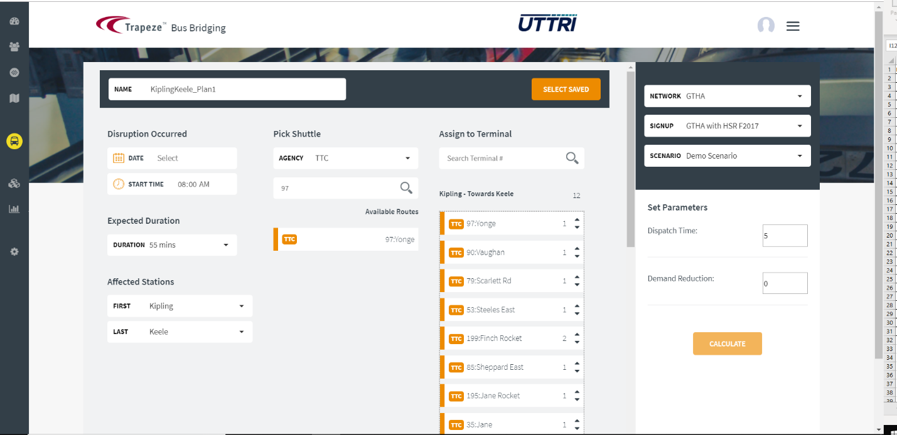
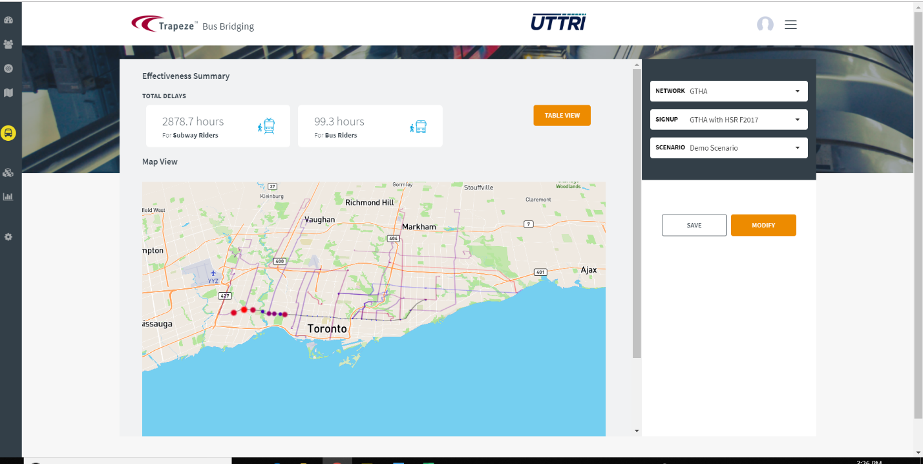
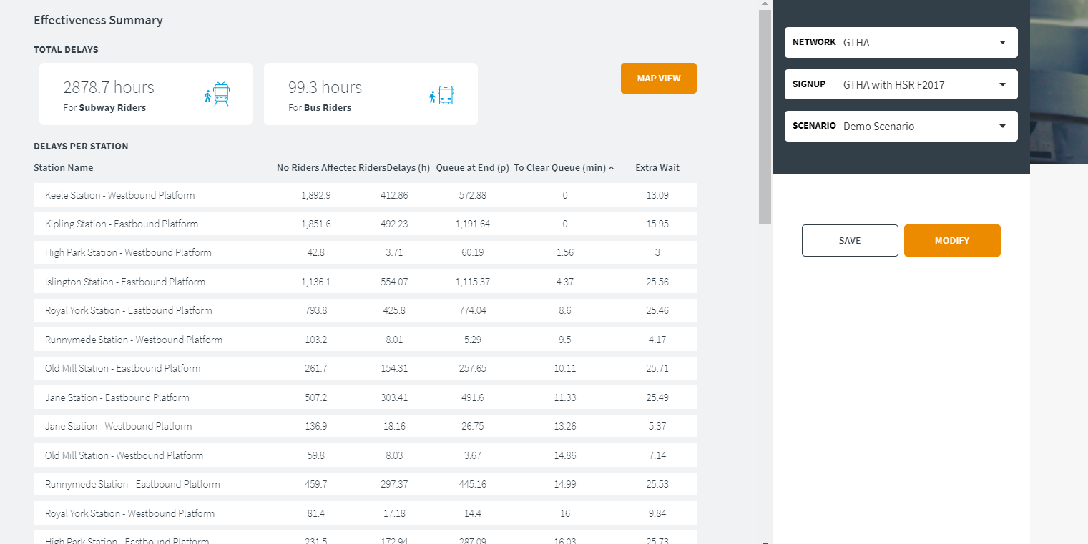
Visualization Dashboard
DASh-Bus

Slide 19
Potential Use Cases
Key challenges that face transit agencies post-COVID
“Improving the management of flows to avoid crowds/excessive concentration of travelers in a given place at a given time” ~ Sylvain Haon, Senior Director Strategy at UITP
Relief of overcrowding using shuttle buses
“Imposing physical distancing in public transport vehicles means operating them using only 20 per cent of their capacity” ~ Mohamed Mezghani - UITP
Managing rail disruptions post-COVID
“It’s equivalent of only 8 to 10 passengers in standard bus…” Mohamed Mezghani - UITP
Source: Intelligent Transport. “Looking Ahead to Public Transport Post-Pandemic.” Accessed June 5, 2020.
https://www.intelligenttransport.com/transport-articles/100389/looking-ahead-to-public-transport-post-pandemic/.
DASh-Bus

Slide 20
Publications
Aboudina, A., A. Itani, E. Diab, S. Srikukenthiran and A. Shalaby, 2020. Evaluation of bus bridging scenarios for railway service disruption management: a users delay modelling tool. Public Transport. DOI: 10.1007/s12469-020-00238-w.
Itani, A., S. Srikukenthiran and A. Shalaby, 2020. “Capacity-Constrained Bus Bridging Optimization Framework”, Transportation Research Record.
Itani, I., A. Aboudina, E. Diab, S. Srikukenthiran and A. Shalaby, 2019. “Managing Unplanned Rail Disruptions: Policy Implications and Guidelines towards an Effective Bus Bridging Strategy”, Transportation Research Record, Vol. 2673(4), pp. 473-489.
Itani A, A. Shalaby, 2021. Assessing the Bus Bridging Effectiveness on the Operational Resilience of the Subway Service in Toronto. Transportation Research Record. April 2021. doi:10.1177/03611981211007836
Diab, E., G. Feng and A. Shalaby, 2018. “Breaking into Emergency Shuttle Service: Aspects and Impacts of Retracting Buses from Existing Scheduled Bus Services”, Canadian Journal of Civil Engineering, Vol. 45(8), pp. 647-658.
DASh-Bus

Slide 21
Questions
Partners:

