Slide 1
Two-Way Transit Signal Priority Algorithm for Optimizing Transit Reliability and Speed A Deep Reinforcement Learning Approach
Wen Xun Hu, Chuhan Chen, Hirotaka Ishihara, Islam Taha, Amer Shalaby and Baher Abdulhai
TAL Research Day, July 6th, 2021

Slide 2
Motivation
The transit reliability and speed are performance indicators
Transit services are vulnerable to variability and delays
No strategies can adaptively improve headway regularity and reduce signal delays simultaneously
The conventional TSP only aims at reducing delays
Multiple TSP requests from different approaches are commonly handled by FCFS logic
Model of the dynamics of transportation environment

Slide 3
Objectives
Dual-objective TSP
Adaptively optimize reliability (i.e., headway regularity) and reduce signal delays simultaneously
Coordination of opposite directions
Develop an algorithm to coordinate TSP in opposite directions of the same intersection based on real-time bus performance

Slide 4
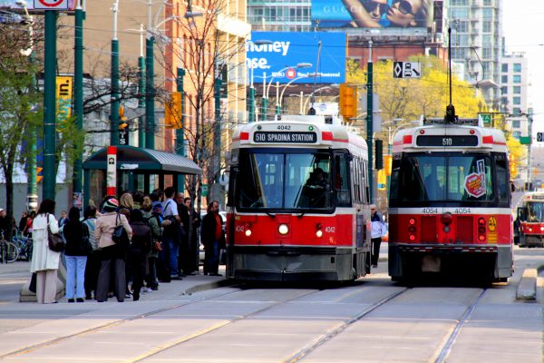
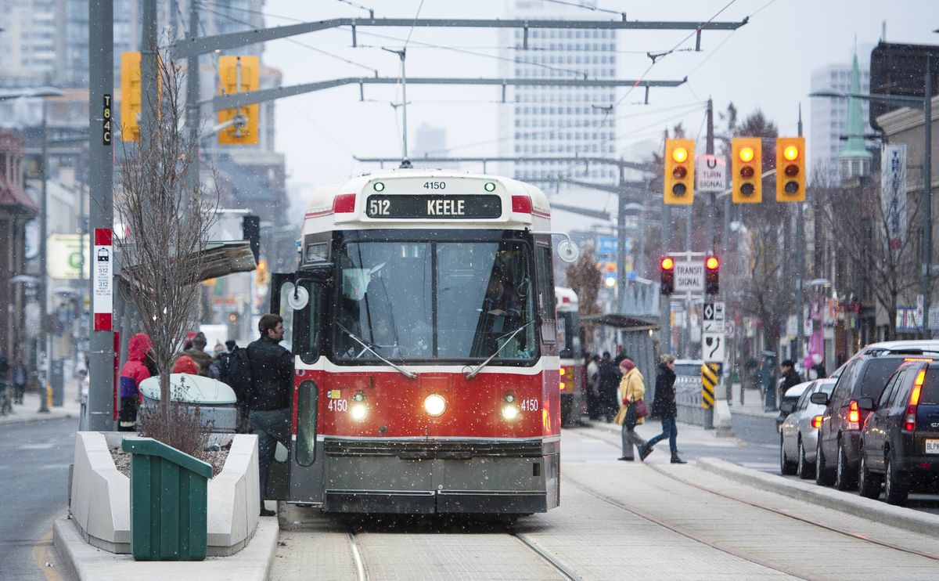
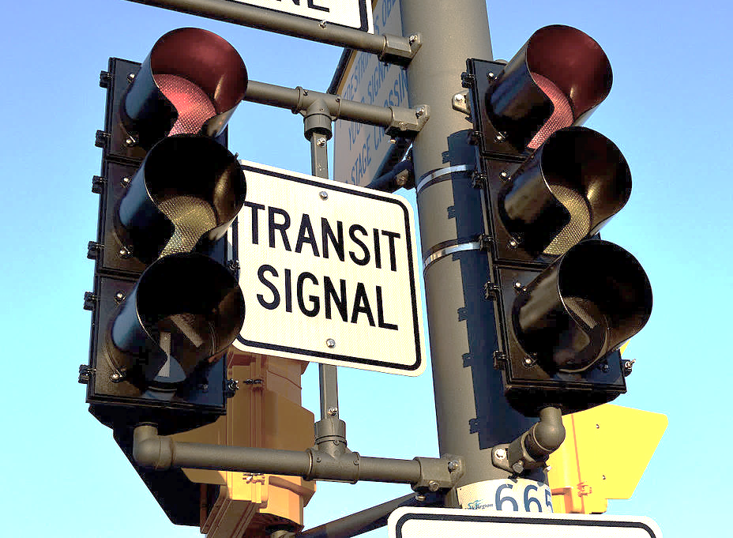
Objectives
Adaptively optimize reliability (i.e., headway regularity) and
travel time of buses coming from two opposite directions
Delays from traffic light
Source: Wylie Poon
Headway issue
Source: Kevin Van Paassen
TRANSIT SIGNAL PRIORITY
Source: Raysonho
Source: https://www.thestar.com/news/gta/2020/11/27/the-ttc-wants-to-test-platoons-of-driverless-buses.html
Notes:
Photo:
Wylie Poon, https://archive.citybuildinginstitute.ca/2019/07/03/we-need-surface-transit-innovations-while-toronto-waits-for-subways/
Kevin Van Paassen, https://www.theglobeandmail.com/news/toronto/ttc-pilot-project-reduces-use-of-streetcar-short-turns/article22000738/
Raysonho, https://www.wikiwand.com/en/Bus_priority_signal; credit: Raysonho @Open Grid Scheduler /Grid Engine; License: Creative Commons Zero, Public Domain Dedication
Focus and objective of study
Objective: Develop a TSP algorithm that adaptively and simultaneously optimize reliability and travel time of buses from two opposite directions
Why do we want to emphasize reliability/headway regularity?
Improving headway regularity and reducing transit delays are both important. Uneven headways, like long headways, result in crowdedness at bus tops; short headways lead to bunching. Passengers travel on bus lines with irregular headways experience excessive waiting time, which is out-of-vehicle travel time.
In-vehicle travel time is increased when there is transit delays, a great portion of which can be attributed to traffic light.
Does there exist a single strategy that can adaptively improve both headway regularity and travel time?
No.
Transit Signal Priority (TSP)
Effective in reducing signal delays
Does not guarantee improvement in reliability

Slide 5
Model Formulation
One-Way DRL Agent
Check-in Loop detector
Check-out Loop detector
POZ
Model-free deep reinforcement learning
Efficient for large state space

Slide 6
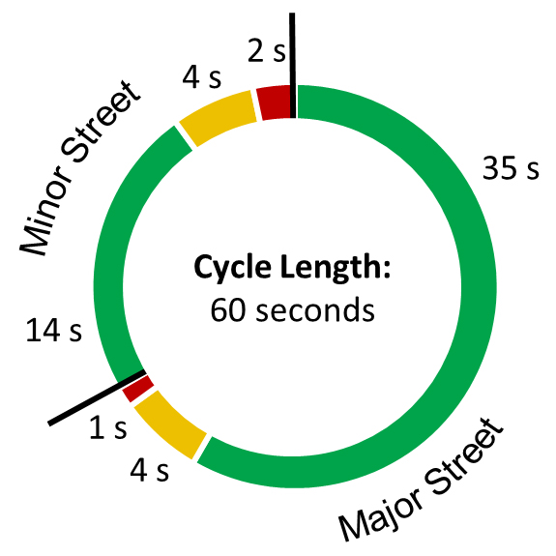
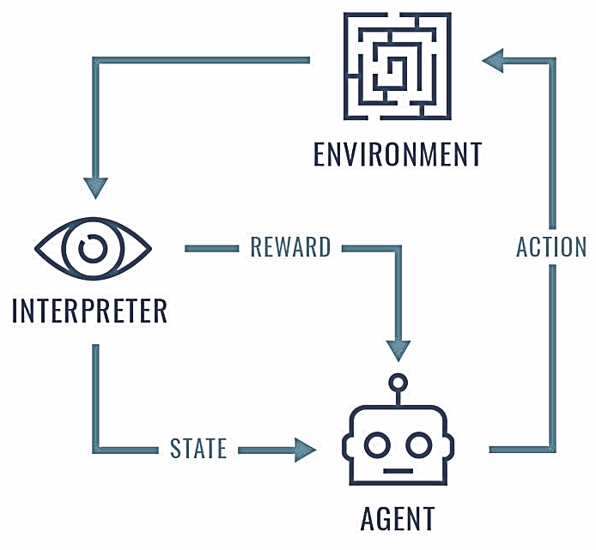
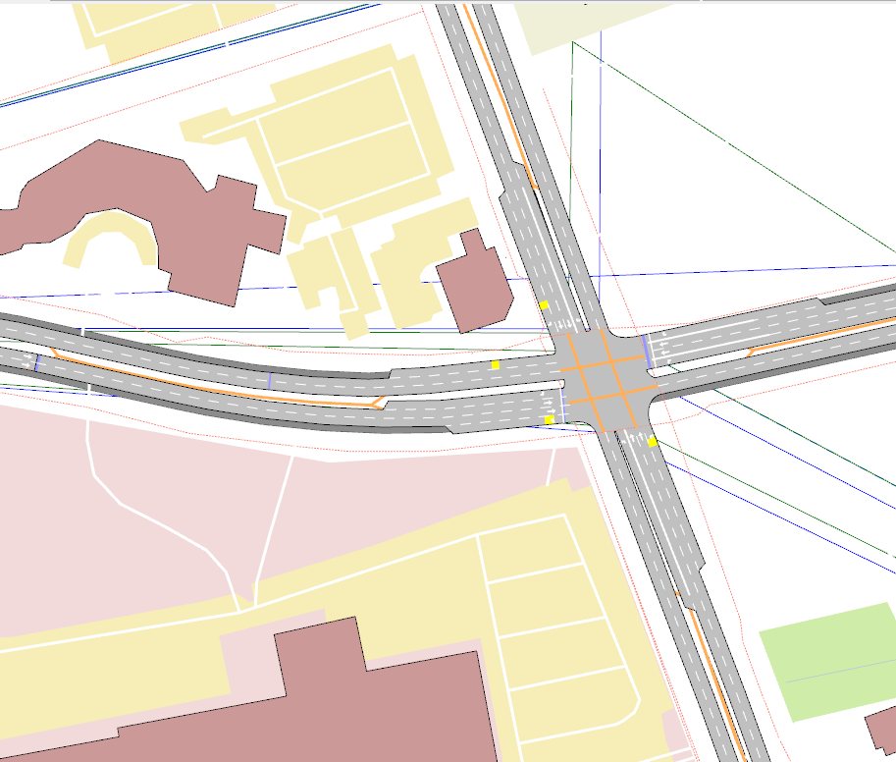
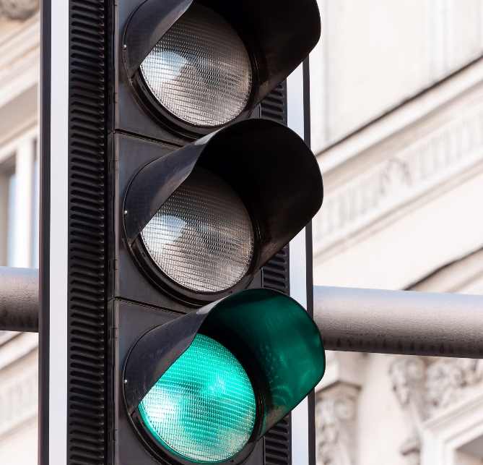
Model Formulation
One-Way DRL Agent
Transportation network simulated in Aimsun
Green phase:
-20, -15, -10, -5, 0, +5, +10, +15, +20 sec
Source: Pawel Czerwinski, unsplash.com
• Target travel time to maintain scheduled headway at check-out
• Number of vehicles in the POZ
• Time to the end of 1st available green
TSP control system
reward =
$w_{h}\left(headway improvement\right)−w_{t}(time in POZ)$

Slide 7
Model Formulation
Coordination Algorithm
RL agent X
$$Q\left(s_{t},a;θ_{t}\right)$$
Coordination algorithm
$${Action: a}_{t}^{′}=arg\max_{a}\left[w_{x}Q\left(s_{t},a;θ_{t}\right)+w_{y}Q\left(s_{u},a;θ_{u}\right)\right]$$
RL agent Y
$$Q\left(s_{u},a;θ_{u}\right)$$

Slide 8
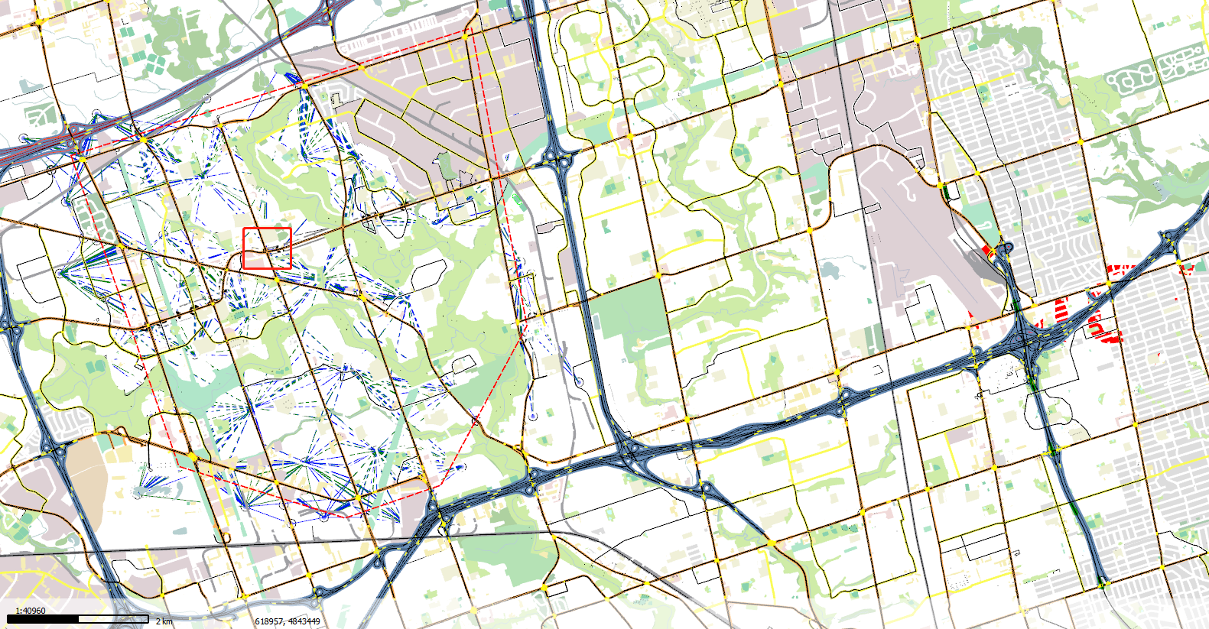
Simulation case study
Aimsun Next Microsimulation
Intersection in Toronto
Bus line: 36 Finch West
Traffic during AM peak
AVL
Signal timing cards
Subnetwork
Finch Ave West at Kipling Ave

Slide 9
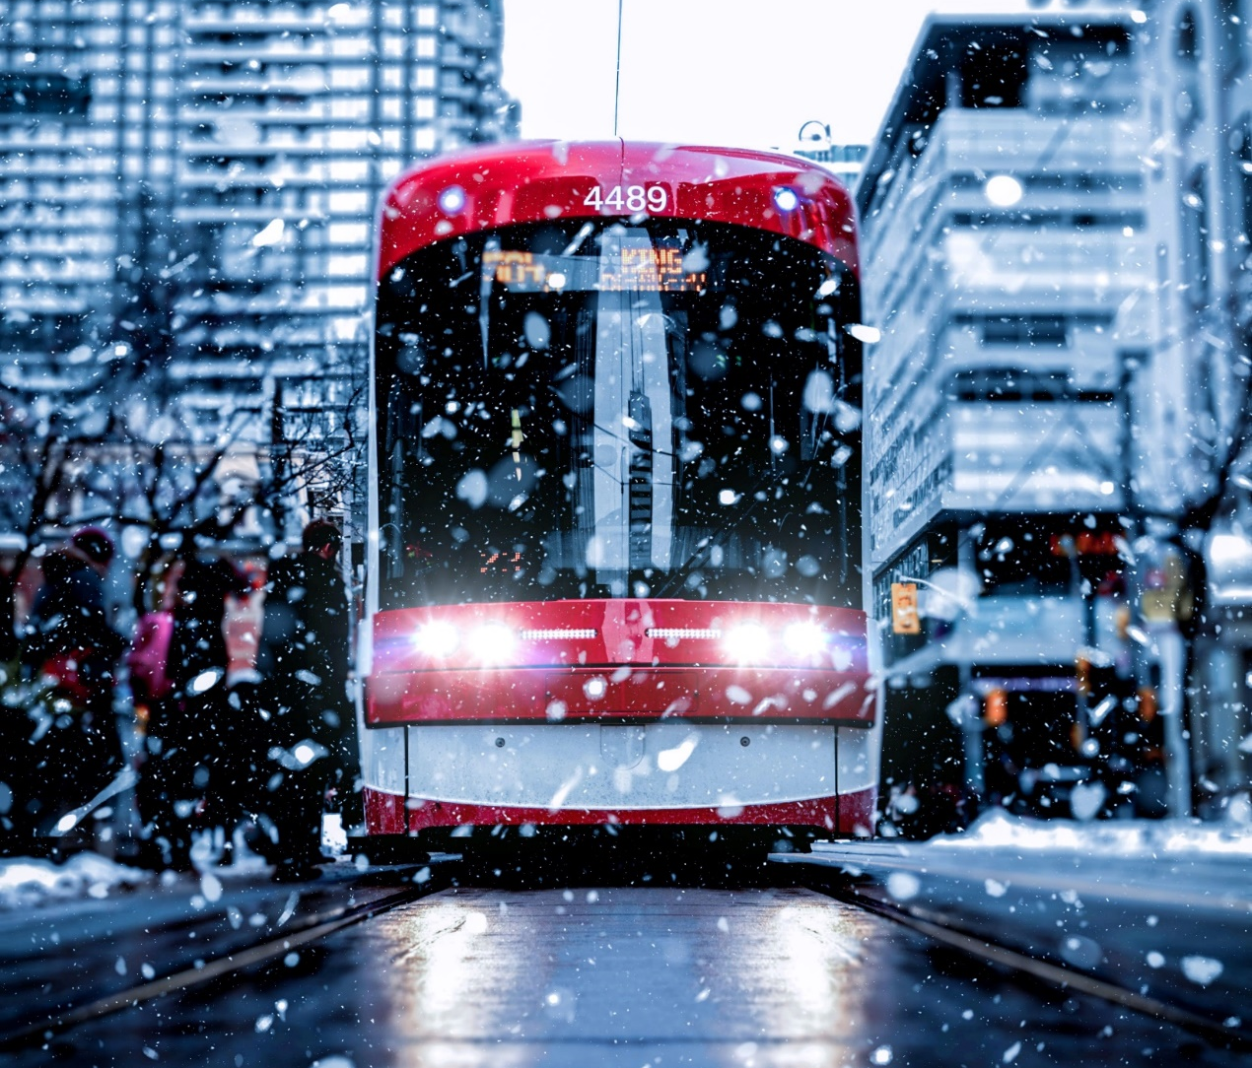
Results
Source: Andre Furtado, unsplash.com
Base scenarios
No TSP
TSP in field (Toronto TSP)
DRL agents + FCFS logic (FCFS TSP)
Proposed scenario
DRL agents + coordination algorithm (D2 TSP)
Source: Pawel Czerwinski, unsplash.com

Slide 10
Results
Coefficient of Variation of Headway

Slide 11
Results
% of Extreme Headways

Slide 12
Results
Travel Time
9 s travel time ↑,
23 s stdev of h dev↓ = 10 s waiting time↓

Slide 13
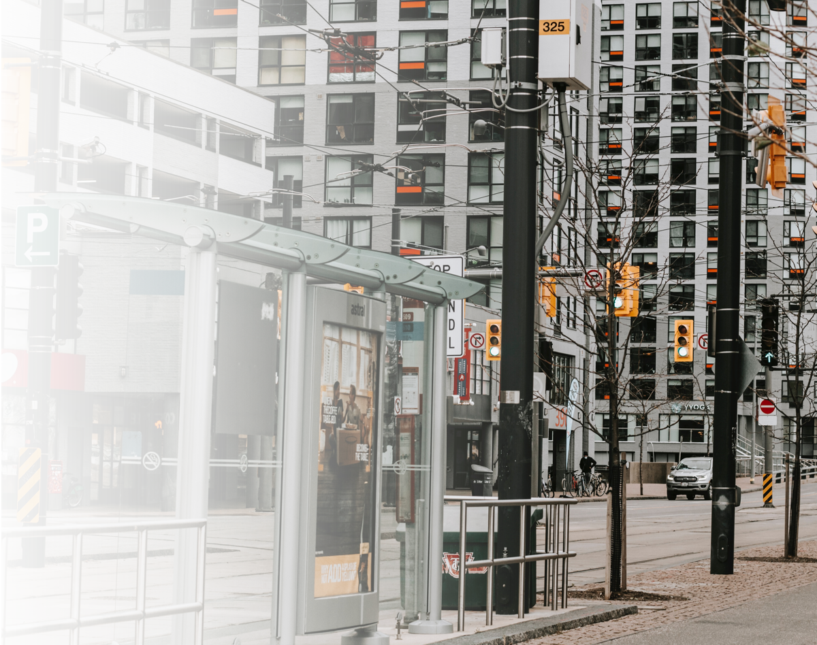
Conclusions
The proposed Two-Way TSP (D2 TSP)
Generates the best headway performance in both directions
Effective in reducing headway variability and % of extreme headways
Brings noticeable reduction in travel time compared with “No TSP”
Source: Kayla Speid, unsplash.com

Slide 14
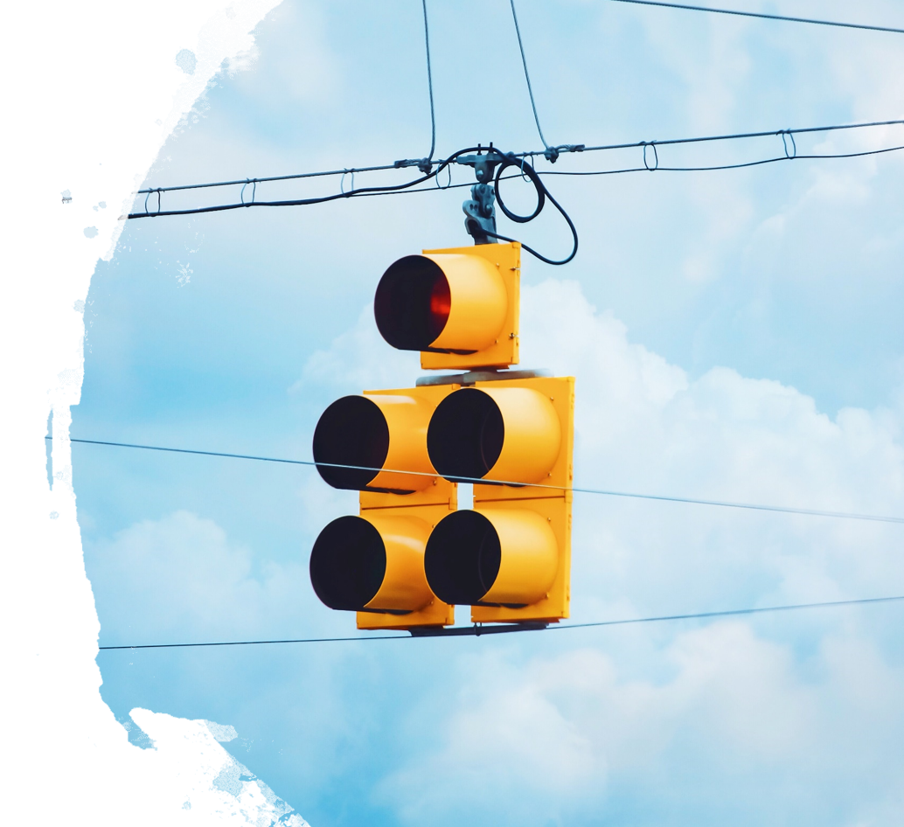
Future Work
Coordinated TSP systems to enhance the benefit on transit reliability and speed at the route level
Use connected vehicle technologies for detection and communication
Integrate TSP design with other route strategies
Source: Nong Vang, unsplash.com

Slide 15
Acknowledgement
Huawei Canada Research Centre

Slide 16
Source: chuttersnap, unsplash.com
THANK YOU!
wenxun.hu@mail.utoronto.ca

